Slide 1
Rancher Rules of Thumb
Was Grandpa Right?
Bridger Feuz
Livestock Marketing Specialist – UW Extension
Owner – Master Stockman Consulting

Slide 2
A little perspective
Take care of the land, and it will take care of you, meaning always do what is best for the land, and cash flow will be there, but if you put cash flow ahead of the land, you will likely go broke, and end up teaching in some university!

Slide 3
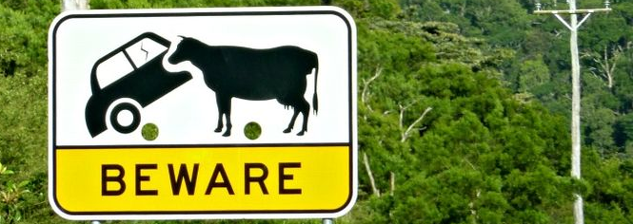
What do we think?
If you are sitting in a pickup waiting for a cow to have her calf, park sideways to the cow and try to act nonchalantly disinterested. If the pickup is facing the distraught cow, she regards the headlights as "eyes" staring at her.

Slide 4
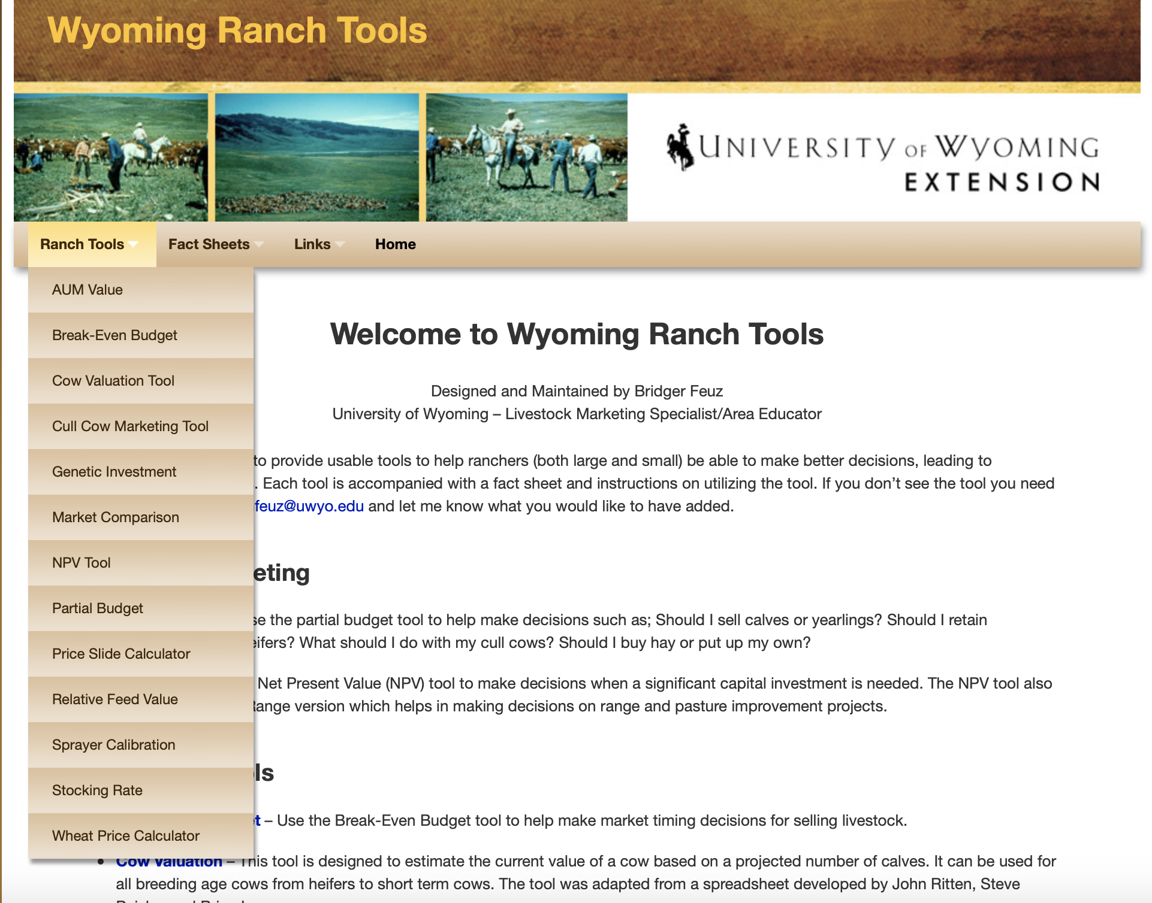

Slide 5
Cow Value
A cow is worth the price of 2 steer calves.

Slide 6
Cow Value
A cow is worth the price of 2 steer calves.
  Ok in an average year
  Over priced in high markets
  Under priced in low markets
  What about cow maintenance costs?
2014 – 2 550 lbs steers = $3245
2016 – 2 550 lbs steers = $1815

Slide 7
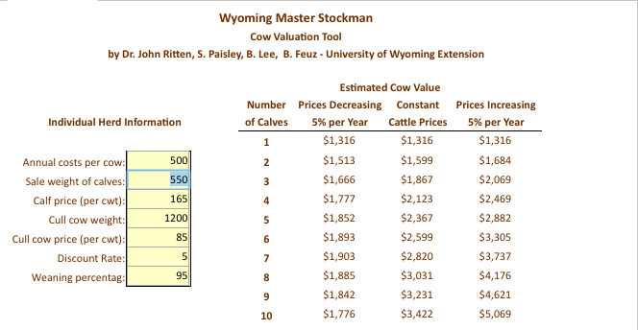
Modest Cow Cost

Slide 8
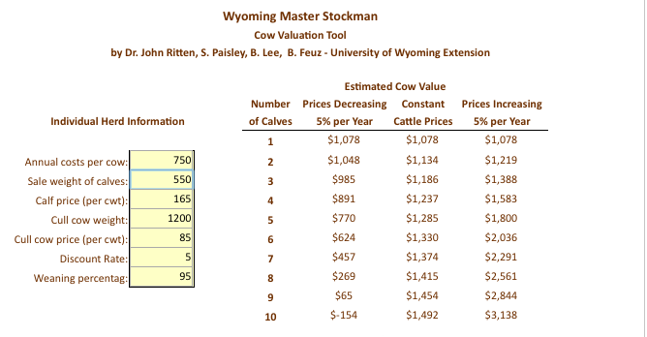
Higher Cow Cost

Slide 9
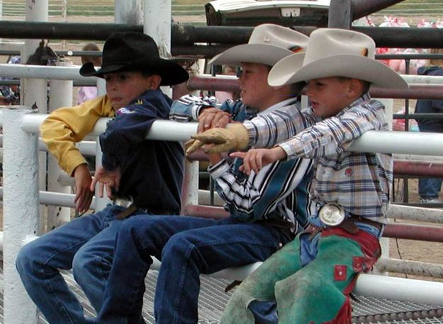
Boys
A boy is a boy; two boys are half a boy; three boys are no boys at all.

Slide 10
Horses
Don't keep kicking a dead horse. If something isn't working, kick the habit.
A good horse is never a bad color.
Gentle is a pretty color on horses and cows.
Never approach a bull from the front, a horse from the rear, or an idiot from any direction.

Slide 11
Pasture Value
A theory I heard just lately is that five months worth of rented summer pasture should cost a third of what a steer calf is worth at weaning time. If the calf is worth $900, a third of that would be $300. $300 divided by five months would be $60 per month.

Slide 12
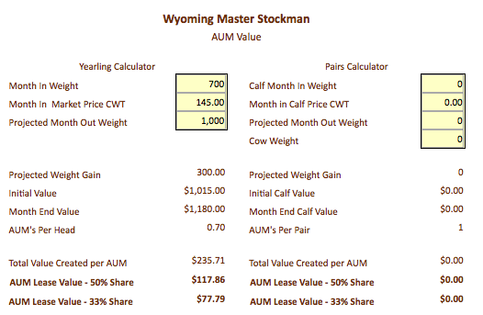
Yearling approach

Slide 13
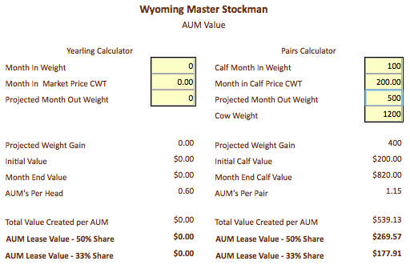
Cow/calf approach

Slide 14
Dogs
Oddly enuf, most here have the same name "Getinthepickup,yousonof...”
A good cowdog can replace a couple good hands, sometimes. I saw one once---about 1957 or so....
Grandpa used to say, "Kids, horses and dogs...ya get out of them exactly what ya put in.”
If you think you're in charge try bossing someone else's dog around.

Slide 15
Quantity versus weight
The number of calves you sell is more valuable than weight.
  Smaller cows – smaller calves – higher stocking rate
  Larger cows – larger calves – lower stocking rate
How do you make this decision?

Slide 16
Partial Budgeting
Systematically organizes the answers to four questions
  What new or additional costs will be incurred?
  What current income will be lost or reduced?
  What new or additional income will be received?
  What current costs will be reduced or eliminated?

Slide 17
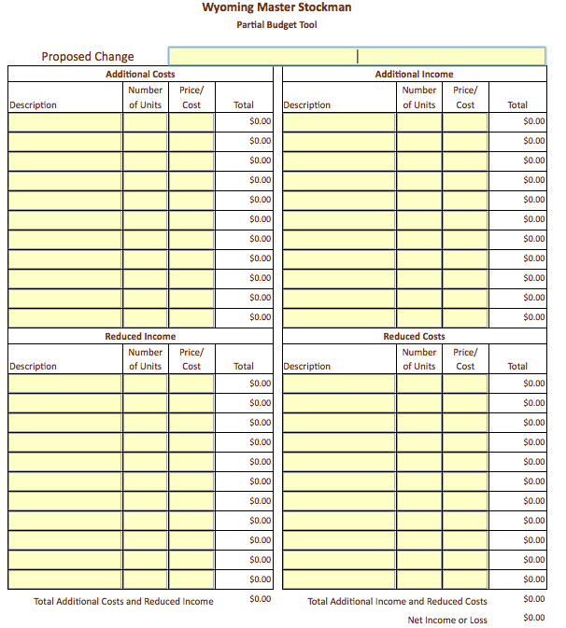

Slide 18
What do we think?
If a bunch of cow/calf pairs won’t cross a barrier such as a bridge or slippery ice, rope a calf around its neck. When it bellers, its mother will come and bring many of her bovine friends with her. Pull the calf across the barrier, and the rest will follow.

Slide 19
Ideal Calf Marketing Weight
Conflicting Rules of Thumb
  I get paid almost as much for my small calves as big calves.
  Last I checked you still get paid for pounds.

Slide 20
350
450
550
650
$171
$158.88
$144.40
$133.85
$12.12
$14.48
$10.55
$598.50
$714.96
$794.20
$870.03

Slide 21
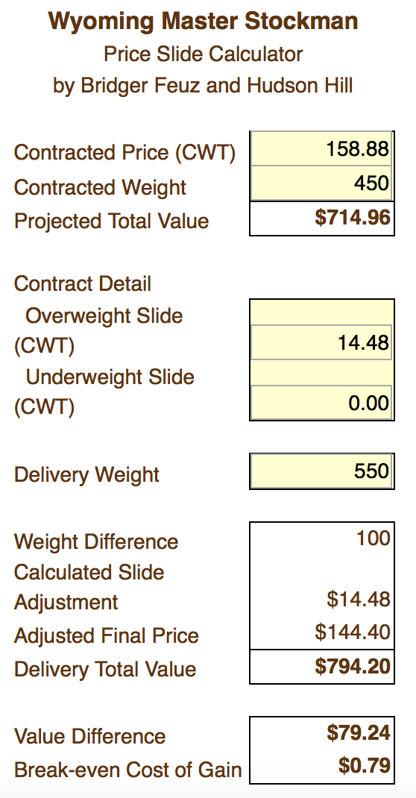

Slide 22
Economics 101
You can owe for Cows, Land and Equipment. If you owe for 1 out of 3 that is ok, 2 out of 3 is tough and 3 out of 3 is a recipe for disaster.
The time to prepare for the lean years is pretty much always.
Sign the backs of checks not the front!

Slide 23
Risk Management Rules of Thumb
Never sell Hay!
The best insurance is a fat cow going into the winter.
Manage for the 8 normal years and you will do fine. Cut a fat hog in the two abnormal years.
Don’t squat with your spurs on.

Slide 24
Bridger’s Risk Management Rules
Use crop insurance products to mitigate risk, not as a speculative money making strategy.
Buying crop or livestock insurance every year may not be wise, but analyzing your options every year is critical.

Slide 25
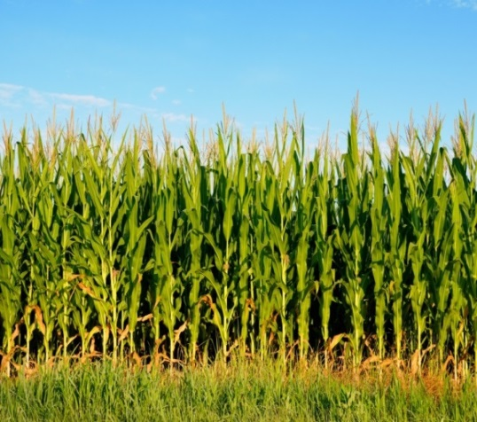

USDA / RMA
Federal Crop Insurance Programs
Like Agriculture Itself, USDA/RMA
Crop Insurance Programs are Dynamic…
The information in this presentation does not replace or supersede any procedures or modify any provisions contained in the complete insurance policies.
Notes:
Explain wide range of programs; offer availability of program ‘fact sheets’ and other RMA materials.
Promote importance of discussing crop insurance with a local agent.
Promote RMA website.

Slide 26
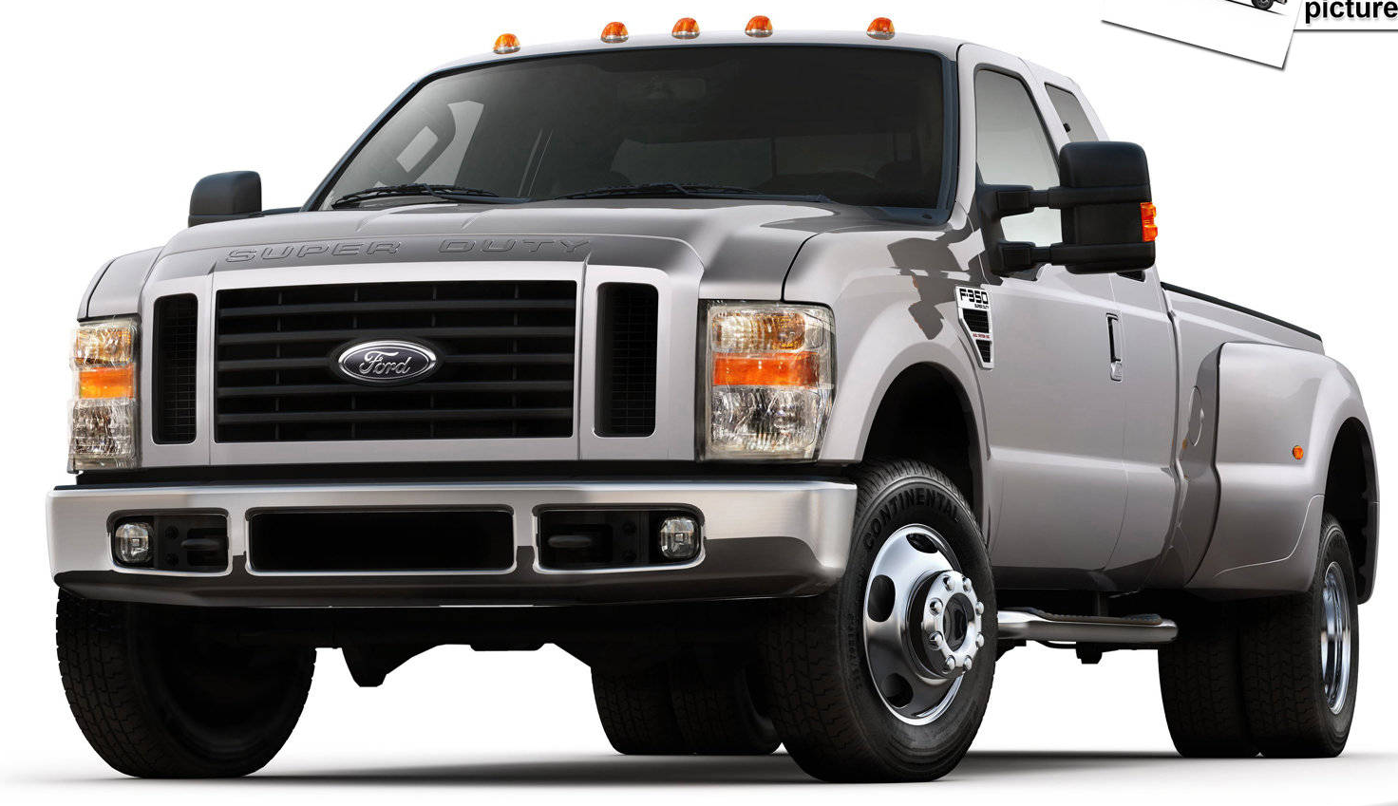
When you buy insurance for this…

Slide 27
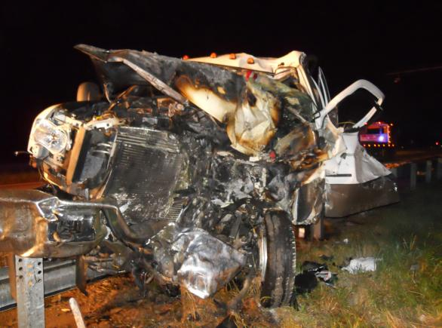
Is this what you are hoping for?

Slide 28
Key Programs for Livestock Producers
Pasture, Rangeland, Forage (PRF)
Livestock Risk Protection (LRP)
Whole Farm Revenue Protection (WFRP)
Notes:
Why did RMA decide to insure Pasture, Rangeland and Forage

Slide 29
Pasture, Rangeland and Forage Pilot- Overview
Area plans only – Losses cover an area / grid
No individual coverage –
Does NOT measure actual individual production
Index – based on deviation from normal/historical
No loss adjustments, records, etc.
Timely payments
Does not reward poor management practices – Producer cannot influence outcomes/losses

Slide 30
Rainfall Index
National Oceanic and Atmospheric Administration Climate Prediction Center
  NOAA CPC Data
Grid is approximately 17X17 miles
Must select at least two 2-month periods

Slide 31
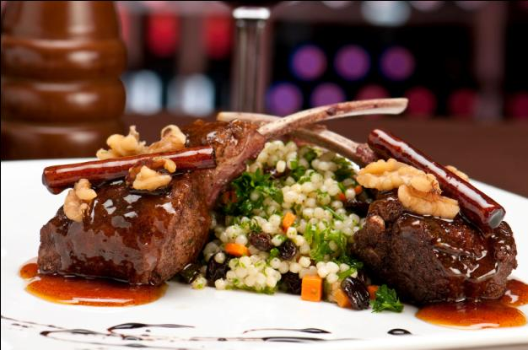
Livestock Risk Protection (LRP)
  Lamb
  Feeder Cattle
  Fed Cattle
  Swine
  Insures against declining market prices

Slide 32
Using Livestock Risk Protection (LRP) to Reduce Price Risk
Livestock Risk Protection Insurance
  Establishes a floor selling price
  Pays producer if National cash price index falls below insured level
    Does not insure your cash price
  Very similar to purchasing a put option
    Options are fixed in size (50,000 lbs)
    LRP is flexible (1-1,000 hd)
    LRP purchased through Crop Insurance Rep.

Slide 33
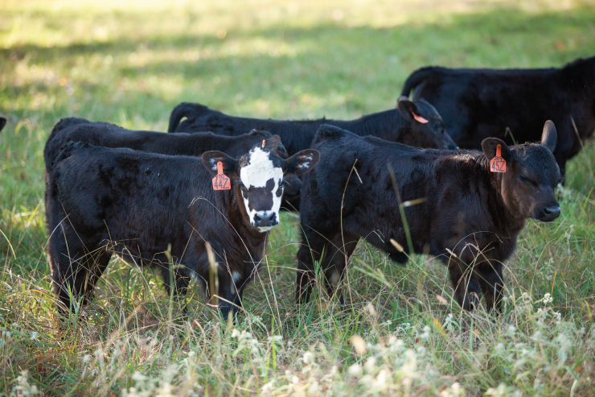
Use LRP to increase Market Power

Slide 34
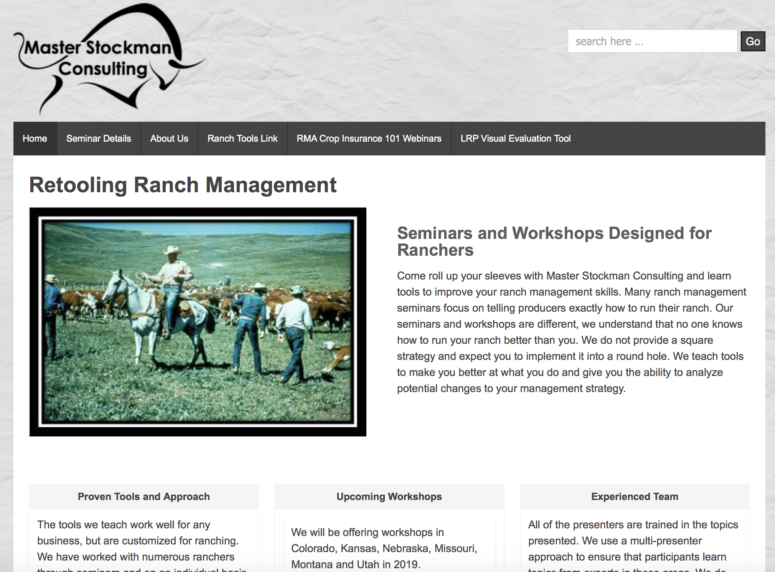

Slide 35
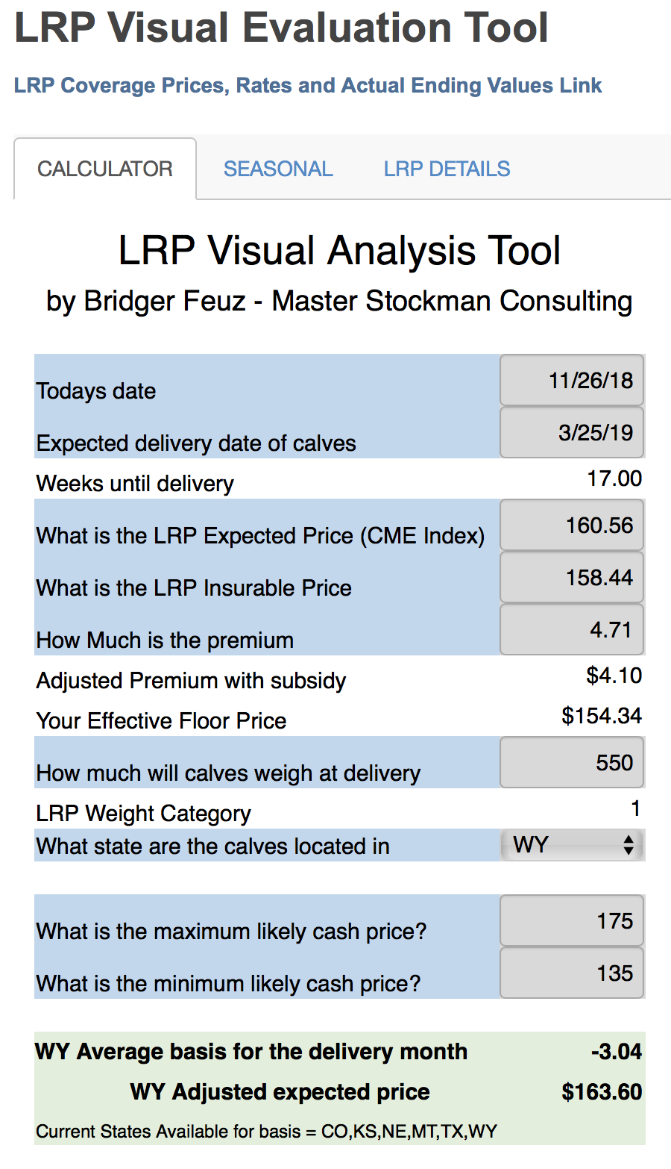
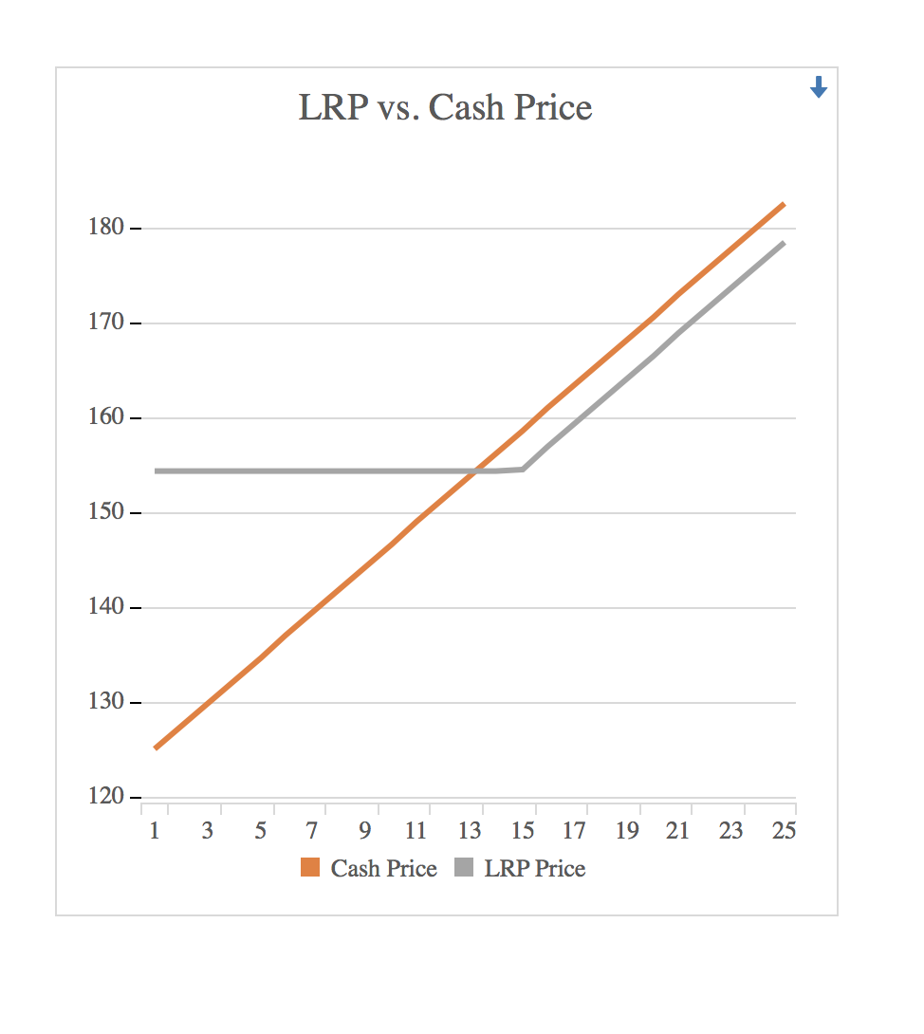

Slide 36
Visual Tool Updates
We are updating the tool
  Adding additional States to the Basis file
  Working on Probability Visual
  Working on Price Slide Adjustment
Follow us
  Facebook – Master Stockman Consulting

Slide 37
Whole Farm Revenue Protection
Whole-Farm Revenue Protection (WFRP) provides a risk management safety net for all commodities on the farm under one insurance policy.
  This insurance plan is tailored for any farm with up to $8.5 million in insured revenue, including farms with specialty or organic commodities (both crops and livestock).

Slide 38
WFRP loss of revenue protection
Commodities you produce during the insurance period, whether they are sold or not;
Commodities you buy for resale during the insurance period; and
All commodities on the farm except timber, forest, and forest products; and animals for sport, show, or pets.

Slide 39
WFRP – replant coverage
For annual crops, except those covered by another Federal crop insurance policy;
Equal to the cost of replanting up to a maximum of 20 percent of the expected revenue; and
When 20 percent or 20 acres of the crop needs to be replanted.

Slide 40
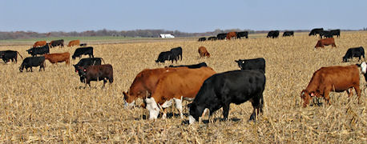
WFRP – Diversified Livestock Producers

Slide 41

How to get started.

Slide 42
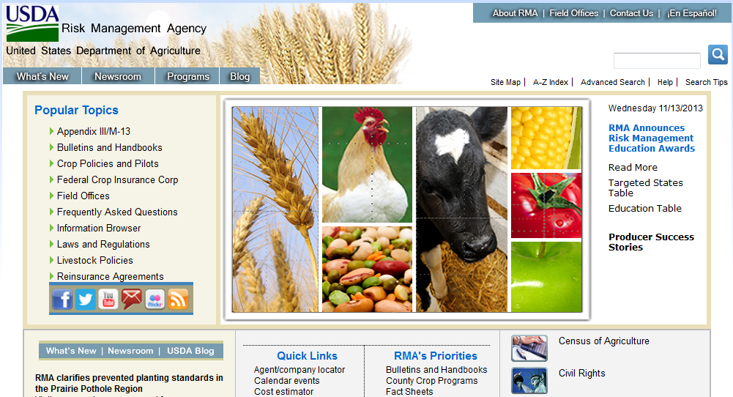
www.RMA.USDA.gov
The RMA websites offer information and tools to help producers make better decisions about managing risk and using Federal crop insurance programs.
Notes:
The RMA website provides a wealth of information about RMA and its programs.

Slide 43
Find a Good Agent
Crop Insurance Agent
  On PRF Page
Livestock Price Insurance Companies by State
  On LRP Page
Find a Crop Insurance Agent
  On WFRP Page

Slide 44
Oh, and one last thumb rule.....
KEEP YOUR THUMB OUTA YOUR DALLYS, SAID STUMPY AT THE BRANDING.

Slide 45
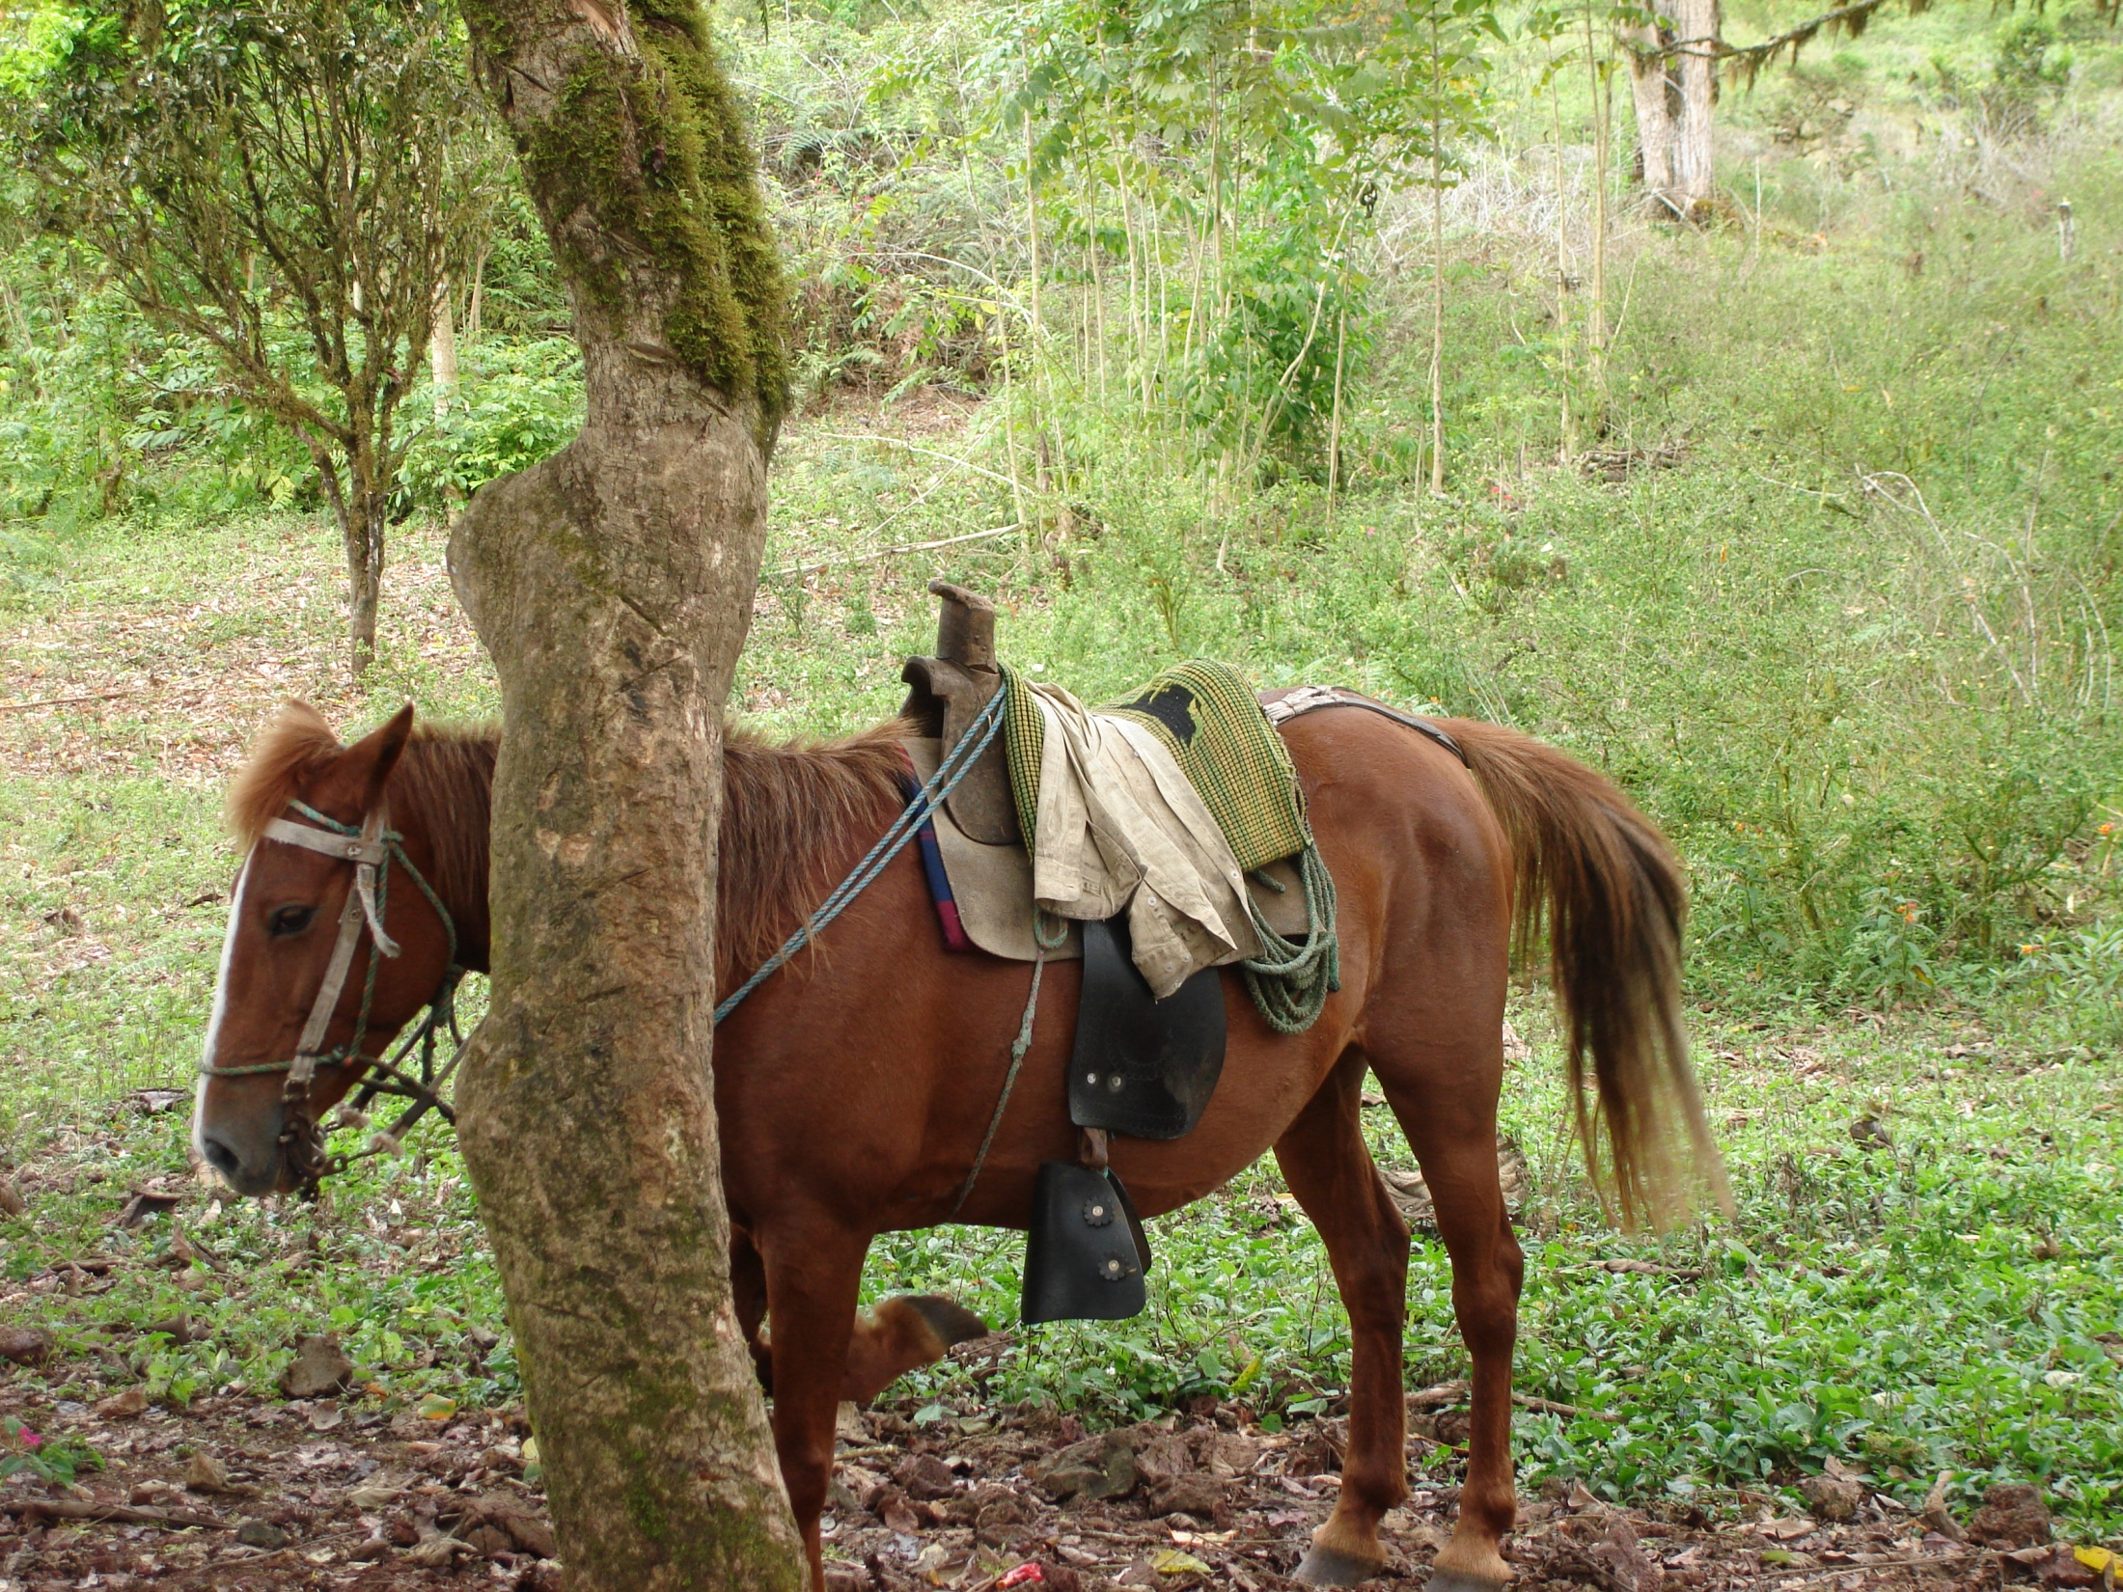

Bridger Feuz
masterstockman@outlook.com
uwyoextesnion.org/ranchtools
Text Rules of Thumb
307-799-8740

