Slide 1

Nutrition and Management Strategies that Impact the Bottomline
Justin Waggoner
2019 Rancher Rules of Thumb Series

Slide 2
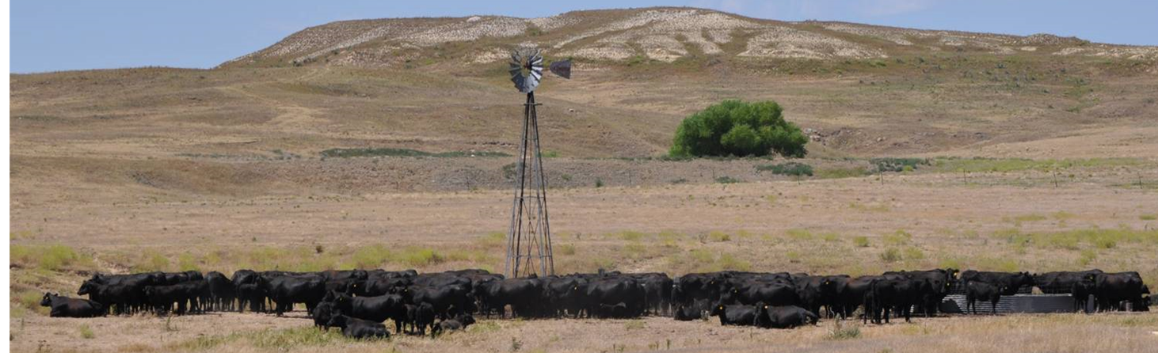

Slide 3
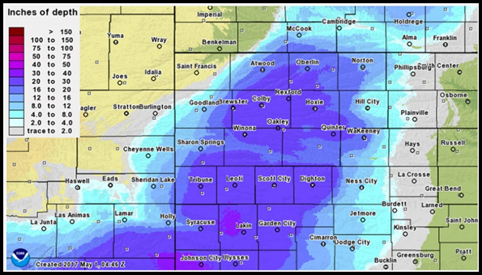
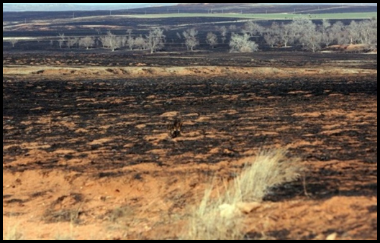

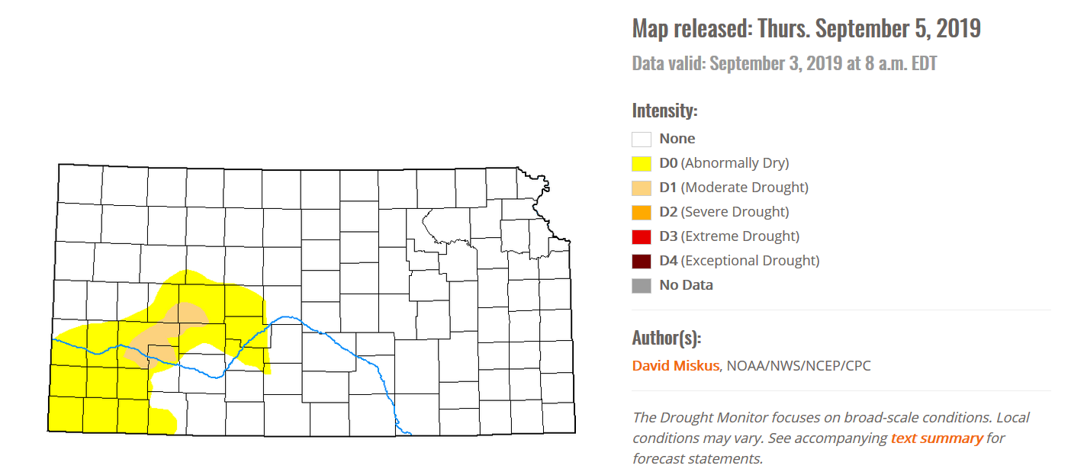
Challenges

Slide 4
Know Your Costs
Margins are thin
Evaluate new opportunities
  What can I afford to pay?
  Opportunity/Alternative cost approach?
    Grazing cover crops/ Drylotting cows

Slide 5
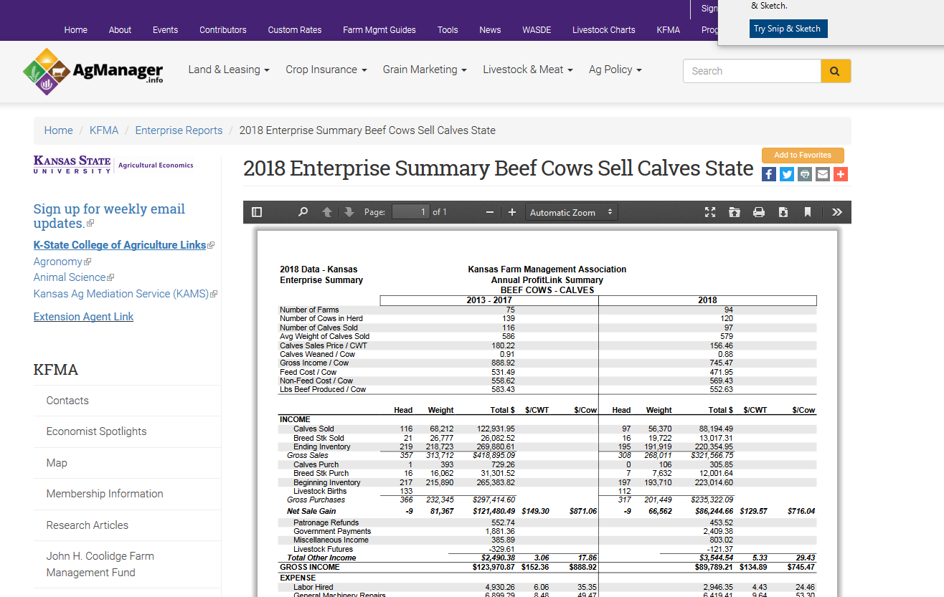
Kansas Farm Management Assoc.
Enterprise summaries
https://www.agmanager.info/2018-enterprise-summary-beef-cows-sell-calves-state

Slide 6
2018 Expenses, $1041/cow
Kansas Farm Management Assoc.
Interest
Operator Labor
Feed
Pasture
Repairs
Vet

Slide 7
Annual Pasture Cost, $/cow
Kansas Farm Management Assoc.
180 days
$178 = $0.99/day
$214 = $1.18/day

Slide 8
Annual Purchased Feed Cost, $/Cow
Kansas Farm Management Assoc.
180 days
$281 = $1.56/day
$371 = $2.06/day
https://www.agmanager.info/2018-enterprise-summary-beef-cows-sell-calves-state

Slide 9
Annual Total Feed Cost, $/Cow
(Pasture and Purchased)
365 days
$471 = $1.29/day
$574 = $1.57/day
https://www.agmanager.info/2018-enterprise-summary-beef-cows-sell-calves-state

Slide 10
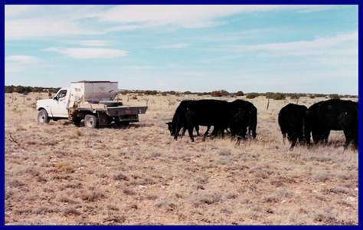
Why do we Feed/Supplement cows?
Notes:
Supplementation or fe

Slide 11
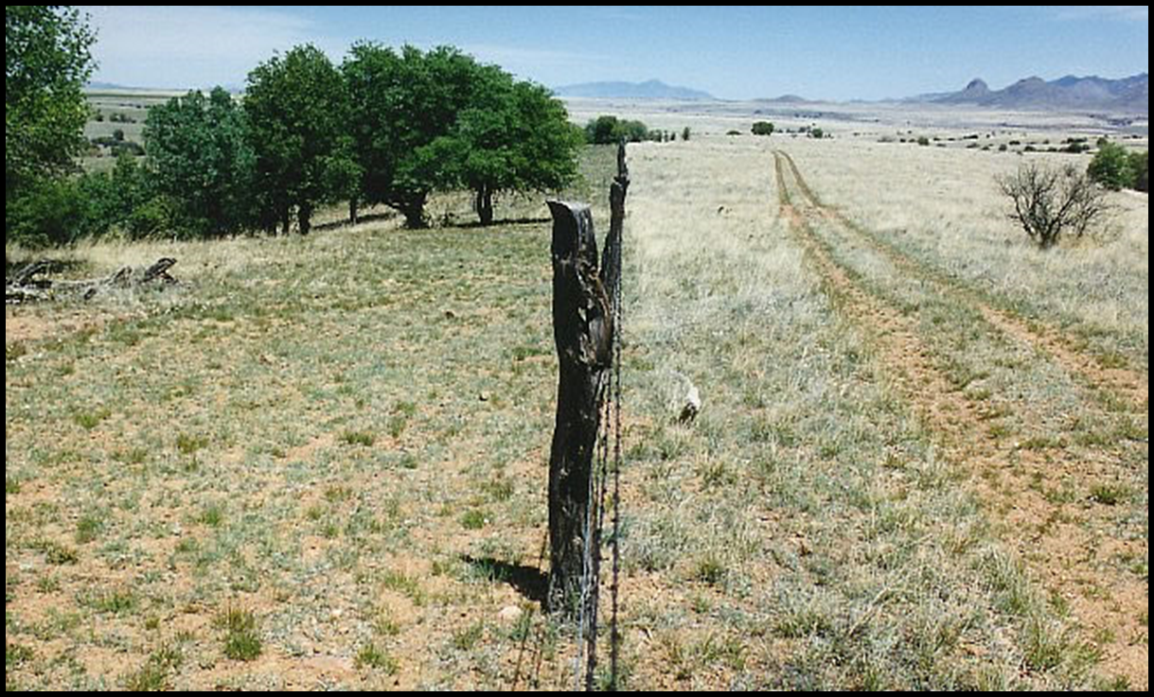
Managing Feed/Supplementation Costs
Cow nutrient requirements
  ENERGY, PROTEIN, minerals, vitamins
Forage resources
  Quality
  Availability
Weather
Stocking rate

Slide 12
Protein Requirement and Supply
11% CP Forage @ 2.2% BW (3.4 lbs)
4 lbs of 20% CP Supplement
(0.72 lbs)
Calving
7% CP Forage @ 2.2% BW (2.2 lbs)
Weaning
5% CP Forage @ 2.2% BW (1.5 lbs)
Beef NRC, 2000

Slide 13
Energy Requirement and Supply
0.65 Mcal/lb Forage @ 2.2% BW
(20.8 Mcals)
Calving
Weaning
0.35 Mcal/lb forage @ 2.2% BW (10.8 Mcals)
Beef NRC, 2000

Slide 14
Energy Requirement and Supply
(Earlier Calving)
0.65 Mcal/lb Forage @
2.2% BW
(20.8 Mcals)
Calving
Weaning
0.35 Mcal/lb forage @ 2.2% BW (10.8 Mcals)
Beef NRC, 2000

Slide 15
Energy Requirement and Supply
(20% Reduction in Available Forage)
0.65 Mcal/lb Forage @
1.76% BW
(16.01 Mcals)
Calving
Weaning
0.35 Mcal/lb forage @ 2.2% BW (10.8 Mcals)
Beef NRC, 2000
Notes:
BCS score = about 200 Mcal
14/30 cow = 5 mcal deficit (150 mcal in 30 days)= 0.75 BCS
14/20 cow = 2 mcal deficit (60 mcal in 30 days) = 0.25 BCS

Slide 16
Can we manage cow requirements?
(1400 lb cow, 20 lb milk)
Annual ME requirements, Mcals
Month | Months Since calving | Total ME | Class | calf age
April | 1 | 858.45 | Lactation | 30
May | 2 | 905.85 | Lactation | 60
June | 3 | 892.05 | Lactation | 90
July | 4 | 845.37 | Lactation | 120
August | 5 | 793.8 | Lactation | 150
September | 6 | 763.62 | Lactation | 180
October | 7 | 612 | Dry
November | 8 | 623.7 | Dry
December | 9 | 637.53 | Dry
January | 10 | 667.32 | Third Tri
February | 11 | 712.8 | Third Tri
March | 12 | 786.6 | Third Tri
 | Total | 9099.09

Slide 17
Annual Maintenance Energy
(1400 lb cow, 20 lb milk, Early Weaned)
Annual ME requirements, Mcals
Month | Months Since calving | Total ME | Class | calf age
April | 1 | 858.45 | Lactation | 30
May | 2 | 905.85 | Lactation | 60
June | 3 | 892.05 | Lactation | 90
July | 4 | 845.37 | Lactation | 120
August | 5 | 612 | Dry | 150
September | 6 | 612 | Dry | 180
October | 7 | 612 | Dry
November | 8 | 623.7 | Dry
December | 9 | 637.53 | Dry
January | 10 | 667.32 | Third Tri
February | 11 | 712.8 | Third Tri
March | 12 | 786.6 | Third Tri
 | Total | 8765.67
Maintenance Energy Savings = (9099.09)- (8765.67)
= 333.42 Mcals

Slide 18
Body condition score of cows weaned when calves were 100-160 days of age
Item | Calf Age, d |  |  |  |  | SEM | P-value Unweaned vs. weaned
 | 100 | 115 | 130 | 145 | 160
BCSª
Initial^{b} | 5.46 | 5.50 | 5.48 | 5.41 | 5.46 | 0.091 | 0.87
Final^{c} | 5.90 | 5.99 | 5.85 | 5.67 | 5.48 | 0.091 | 0.01
BCS change | 0.43 | 0.50 | 0.37 | 0.25 | 0.02 | 0.118 | 0.01
ªBody condition score (scale = 1 to 9; 1 = emaciated, 9 = obese) ^{b}Initial BCS measured at 100 days of calf age ^{c}Final BCS measured at 220 days of calf age
Bolte et al., 2007
Notes:
Initial when calves were 100 DOA
Final taken when calves recived at feedlot 220 days of calf age
0 column calves were weaned for 60 days

Slide 19
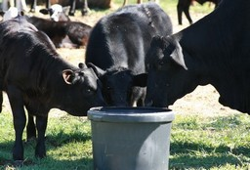
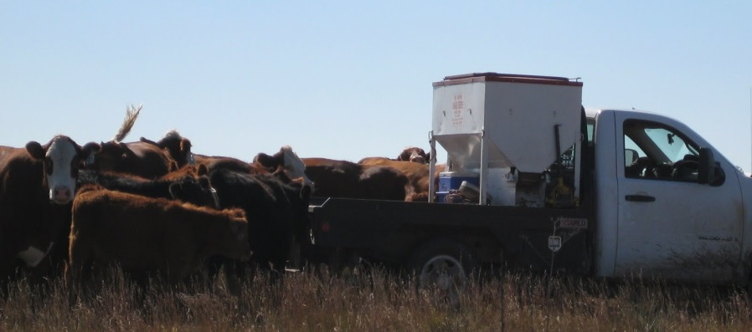
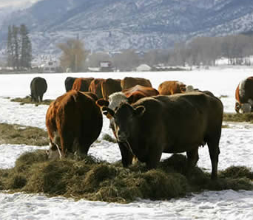
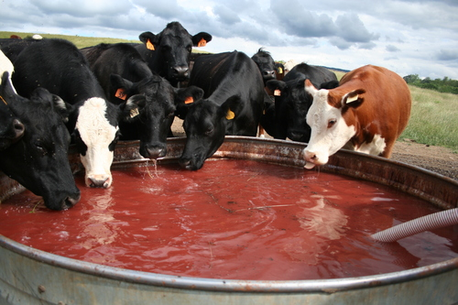
Choosing the best supplement for the situation

Slide 20
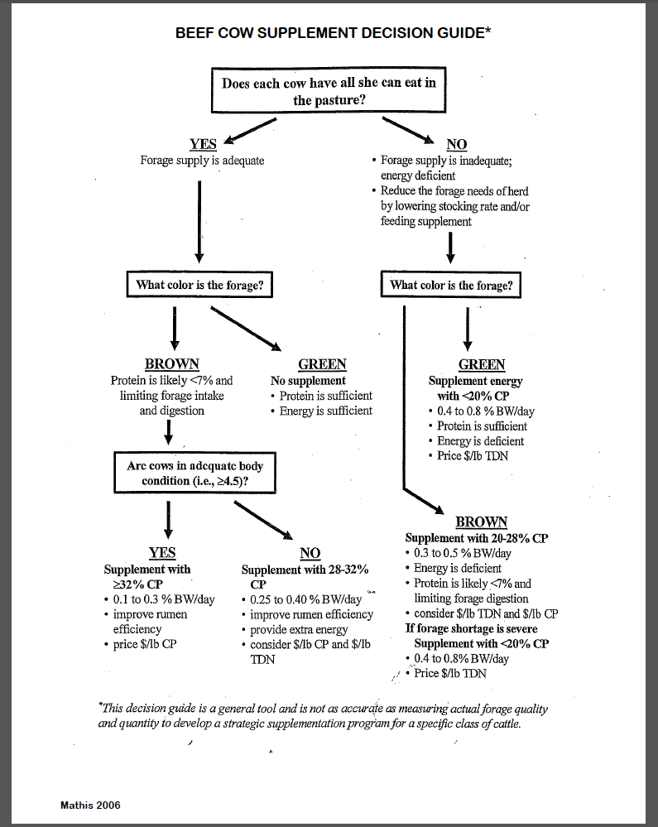

Slide 21
Feed and Operational Costs
Kansas Farm Management Assoc.

Slide 22
2018 Income, $/cow
Kansas Farm Management Assoc.
Cull Animals
Calves

Slide 23
Income from Calves and Culls
Kansas Farm Management Assoc.

Slide 24
Cull Cows: Failure or Opportunity…..
Market cows account for:
  16% of total returns. National Market Cow and Bull Beef Quality Audit 2007
  17-24% Gross Income KS Farm Mgmt. Assoc. 2013-2017
2018 KS Farm Management Assoc.
  Sales of Breeding Stock (Culls?) = $13,017.31
  Gross Sales = $101,211.80
  Sale of Cull animals ~ 12.8% of Gross Sales

Slide 25
Getting the most $ out of Culls
“Marketing through local auction markets”
1. Understand the market
  Timely marketing decisions
2. Desirable body condition for the market
  Body Score 5 or 6 (Apple et al., 1999a, 1999b)

Slide 26
Western KS,
85%-90% Lean Slaughter Cow Prices
Source: Livestock Marketing Information Center, compiled by Robin Reid

Slide 27
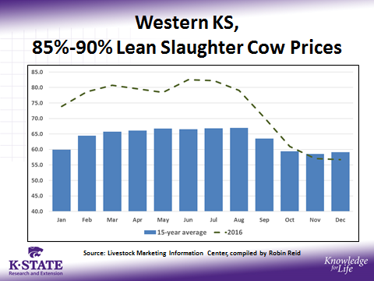
Cull Cow Marketing Strategy
Cull Cow
Sell Immediately
Market Cow Enterprise
Favorable market
Cows in BCS 5-6
Low Input
(Extensive)
High Input
(Intensive)
Forage-based
- Supplement may
be necessary
Cow BCS < 5
Favorable market > 60 days away
Grain-based
Cow BCS < 5
Favorable market < 60 days away

Slide 28
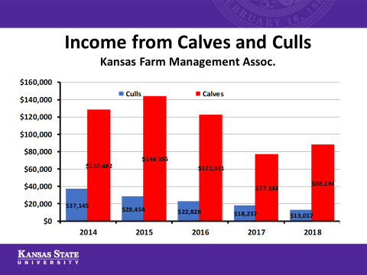
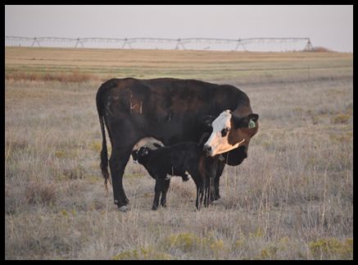
Calf Revenue
Number of calves
  Stocking Rate, Reproduction
  Increase lbs calf/acre
Sale weight of calves
  Calf age, calving distribution, Genetics, Creep feeding, Implants, Weaning,Backgrounding/Preconditioning

Slide 29
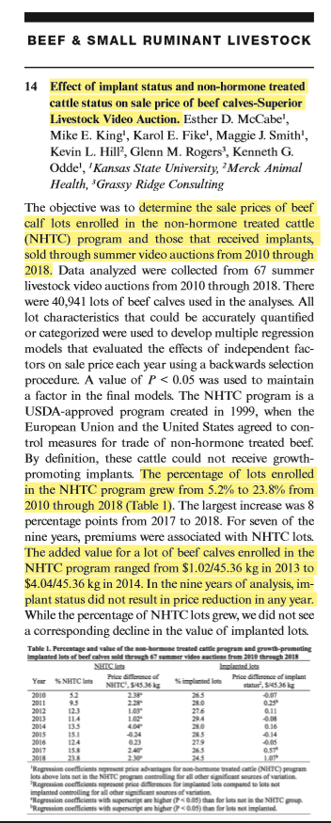
Implants
Criticism
  Effects on replacement heifers
    “Read and follow all label directions”
  Implanted cattle are less desirable as feeders….discounted
Do implanted cattle receive discounts?
July, 2019 Abstract
https://academic.oup.com/jas/article/97/Supplement_2/7/5541199

Slide 30
The value of an implant
Cattle at least 30-45 days of age, less than 400 lbs, 1 implant
Increase ADG 0.1 lb/d on steer calves, 90-120d
  (9-12 lbs total weight gain per head)
“50 steers calves, an implant produces
450-600 lbs of gain…
What was the average sale weight of your calves? “

Slide 31
Weaning
Critical point
Weight loss and health challenges can make the difference between profit and loss
More than maternal separation…preparation for the next phase…setting the calf up for success

Slide 32
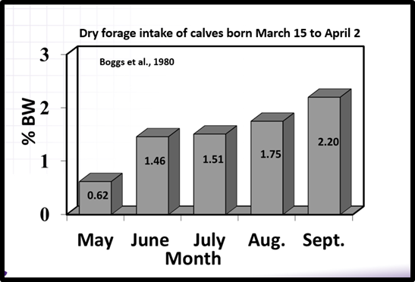
“Weaning should be more stressful on the cow than the calf”
Forage intake of calves
  2.2% bodyweight in Fall
Stockmanship
Management & Nutrition

Slide 33
Feeding Management of
Newly Weaned Calves
Dry matter intake is imperative to success
  Newly-weaned calves often reluctant to eat and subsequent DM intake is low (1-1.5% BW)
 | % of Body Weight
Weight | 1.0 | 1.5 | 1.8 | 2.0 | 2.5
350 | 3.5 | 5.25 | 6.13 | 7.0 | 8.75
400 | 4.0 | 6.0 | 7.0 | 8.0 | 10.0
450 | 4.5 | 6.75 | 7.9 | 9.0 | 11.25
500 | 5.0 | 7.50 | 8.75 | 10.0 | 12.5
Day 1
Day 10-14

Slide 34
K-State Weaning Feed Management Program
Feeding day* | Weaning Diet (75-85% Concentrate) | Premium grass hay | Feedstuff order
1 | 0.5% of BW | 0.5% of BW | diet bottom/hay top
2 | 0.7% of BW | 0.5% of BW | diet bottom/hay top
3 | 0.9% of BW | 0.5% of BW | diet bottom/hay top
4 | 1.1% of BW | 0.5% of BW | hay bottom/diet top
5 | 1.3% of BW | 0.5% of BW | hay bottom/diet top
6 | 1.5% of BW | 0.5% of BW | hay bottom/diet top
7 | 1.8% of BW | ― | diet only
8 → | Increase diet by 0.25 to 0.50 lb per calf
*Remove any uneaten feedstuffs before feeding current day’s diet

Slide 35
Backgrounding/Preconditioning
VAC 45/VAC 45+ generated $7.09/cwt premium relative to VAC 24 (Smith et al., 2018)
  43,242 lots sold through Superior Livestock, from 2010-2018
Additional body weight gain
  2.0 lb/d ADG x 45 days = 90 lbs sale weight
  Ability to convert feed to live weight gain

Slide 36
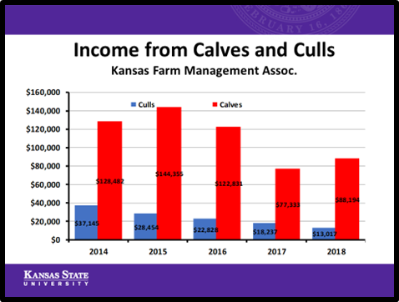
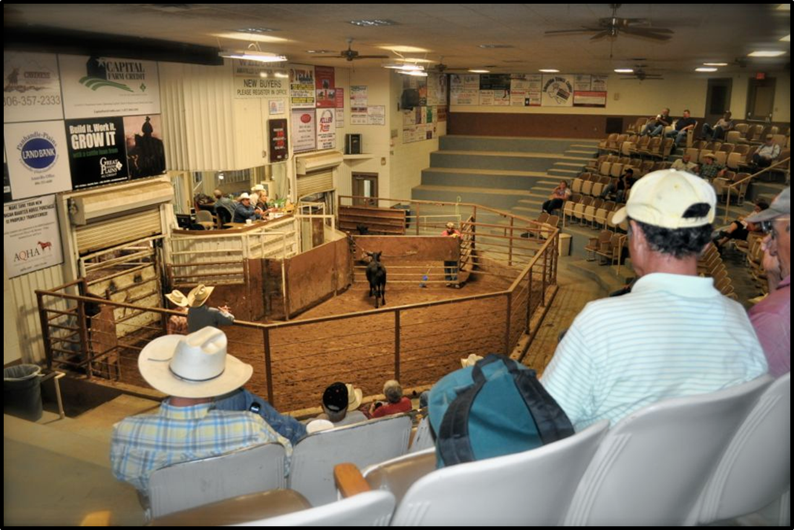
Price received drives calf revenue
Do you control the price received
for your cattle?

Slide 37
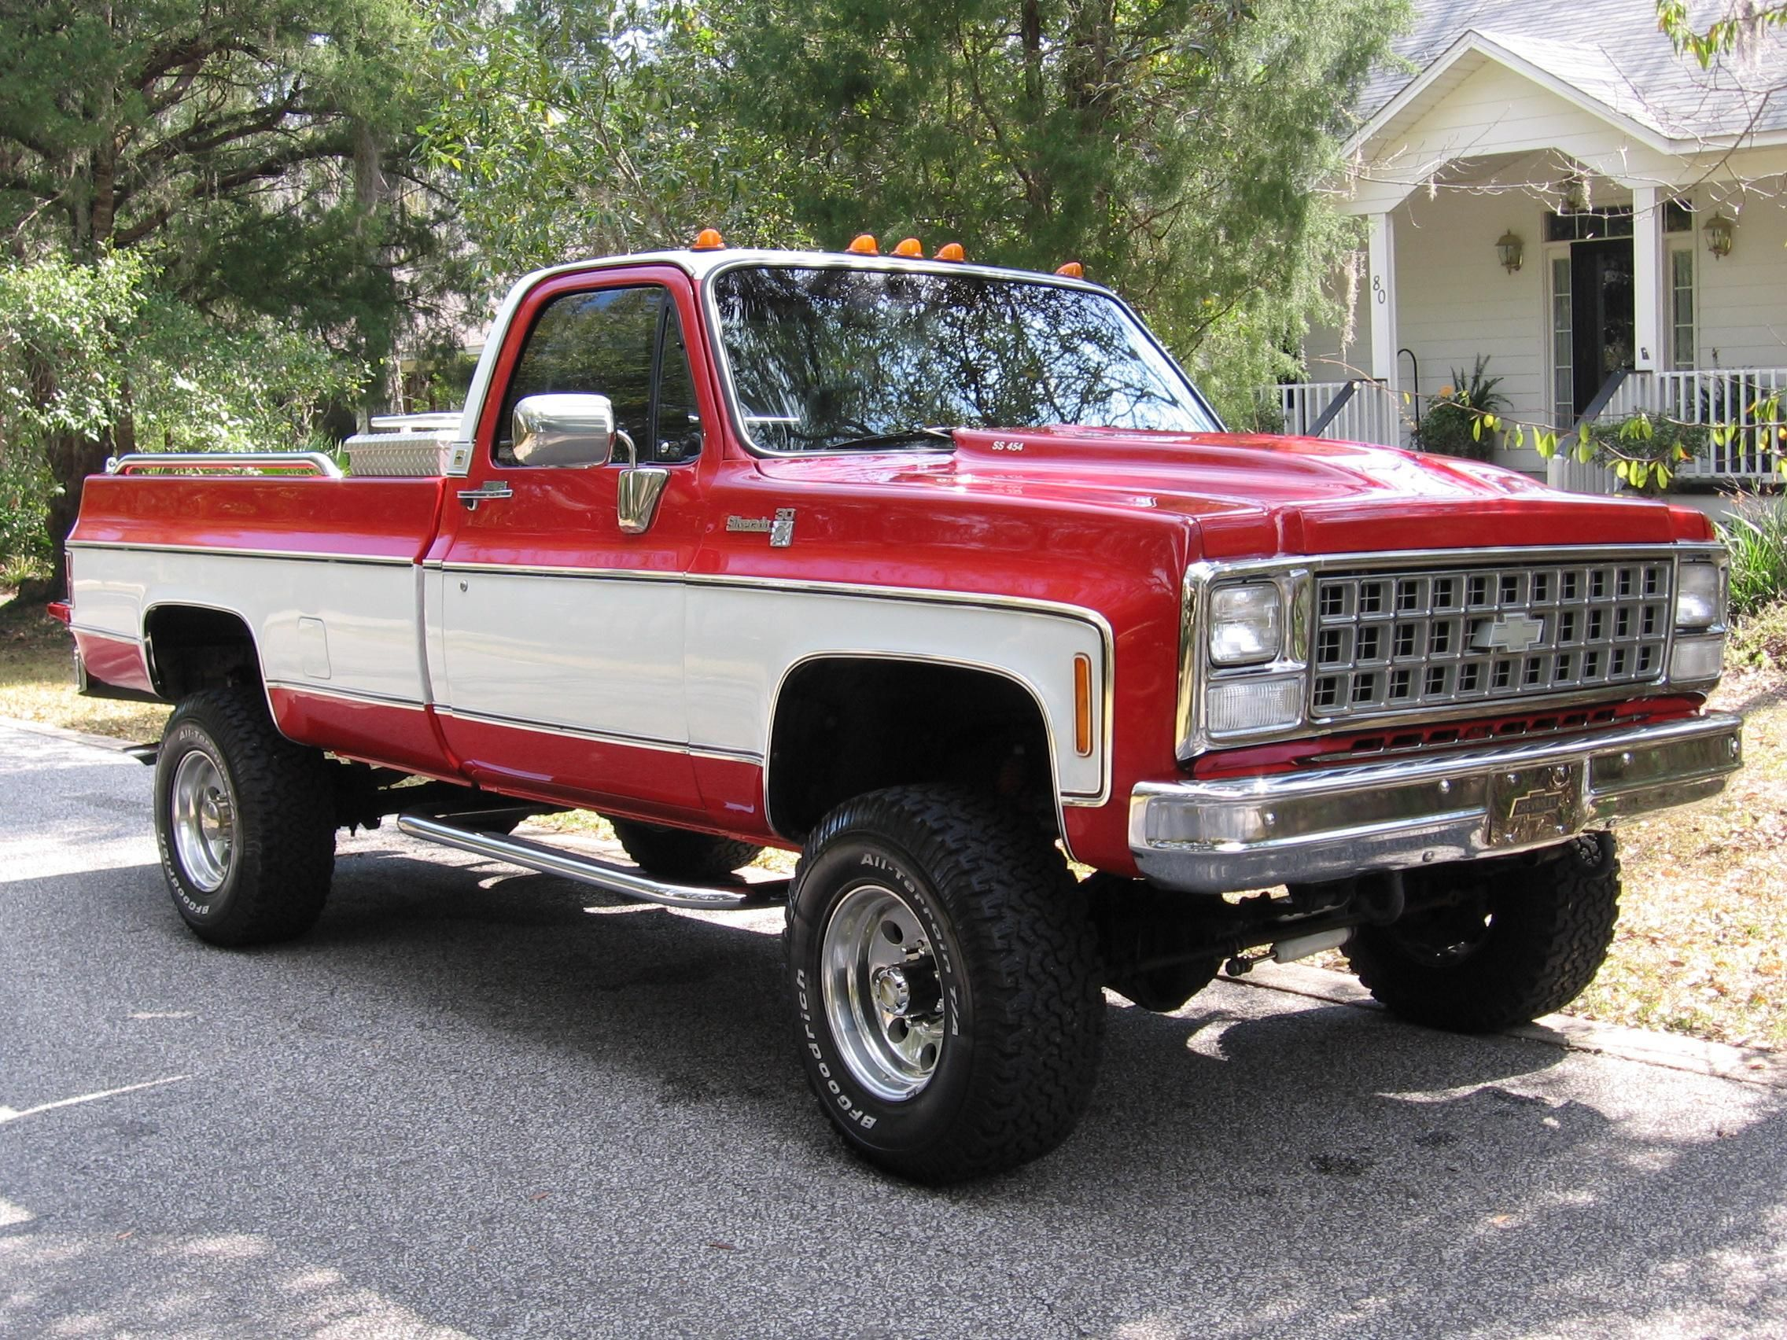
Selling calves…

Slide 38
Marketing Calves
What are you going to sell?
  Calves, feeders
When?
Can you upgrade or target different markets?

Slide 39
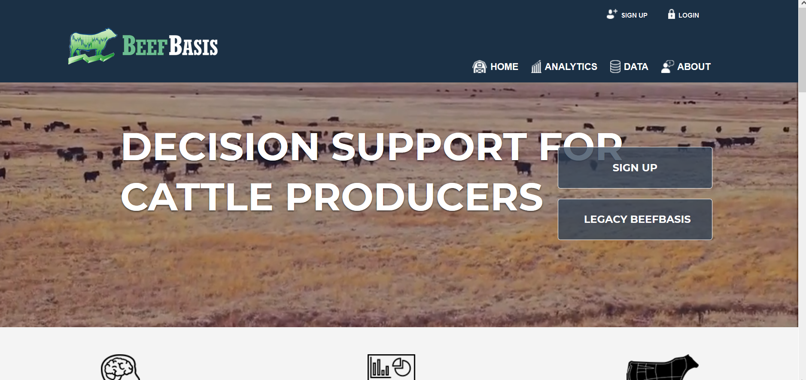
Data

Slide 40
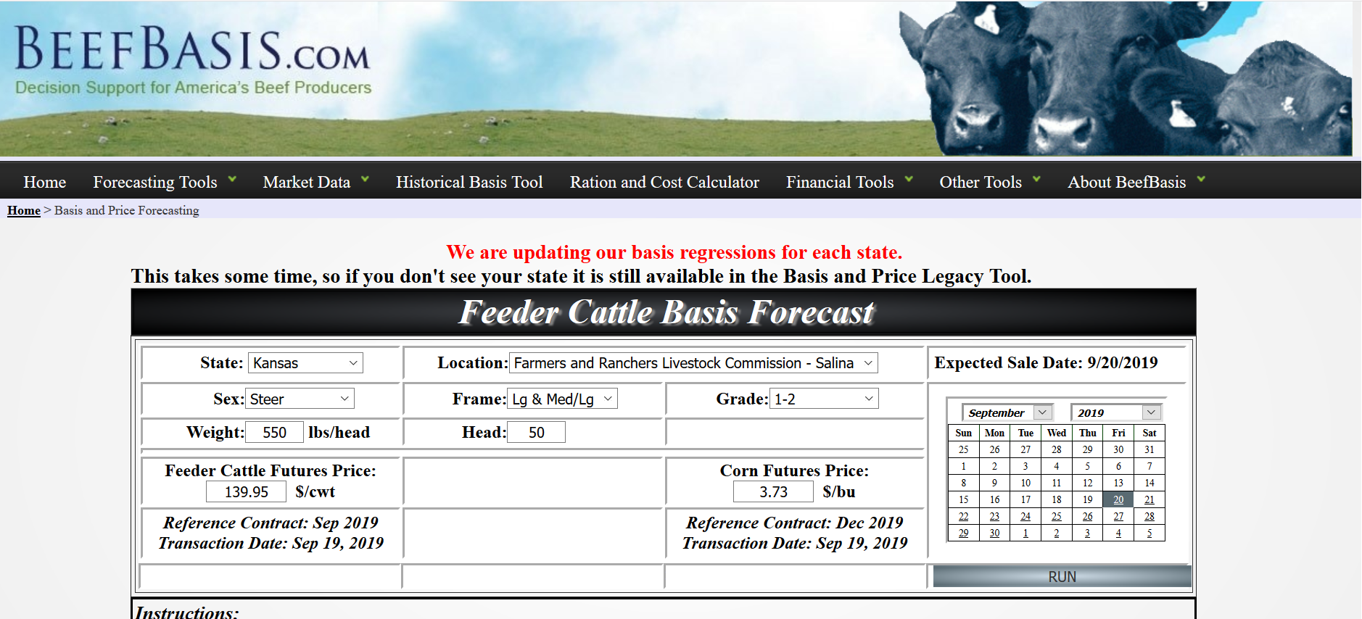

Slide 41
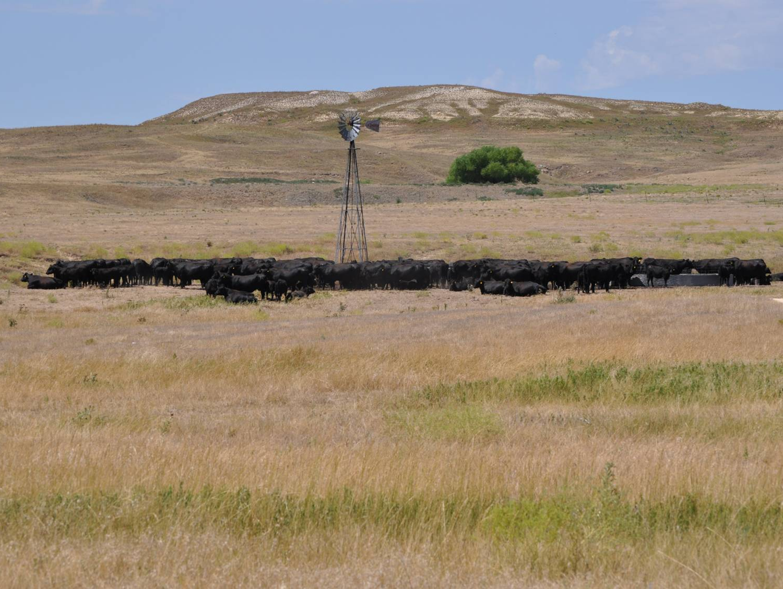

KSUBeef.org
Justin W. Waggoner, Ph.D.
jwaggon@ksu.edu
Beef Systems Specialist
Garden City, KS
620-275-9164

