Slide 1
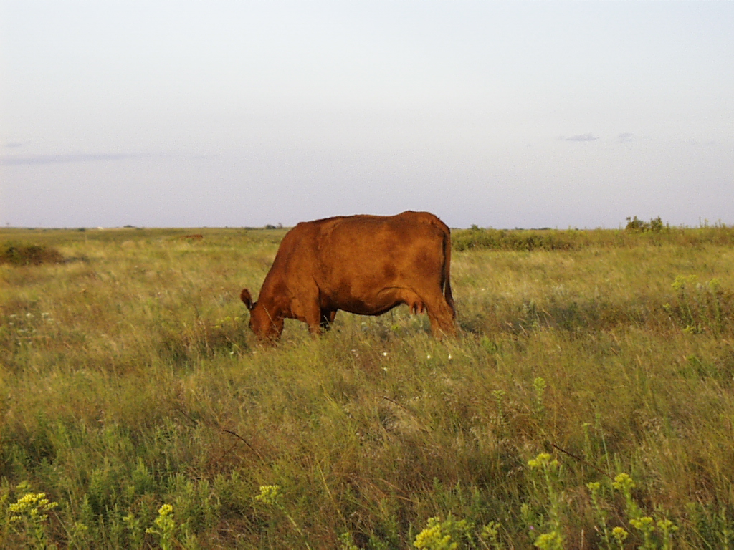



Grass Management and Planning: Rules of Thumb
Keith Harmoney, KSU Ag Research Center - Hays

Slide 2
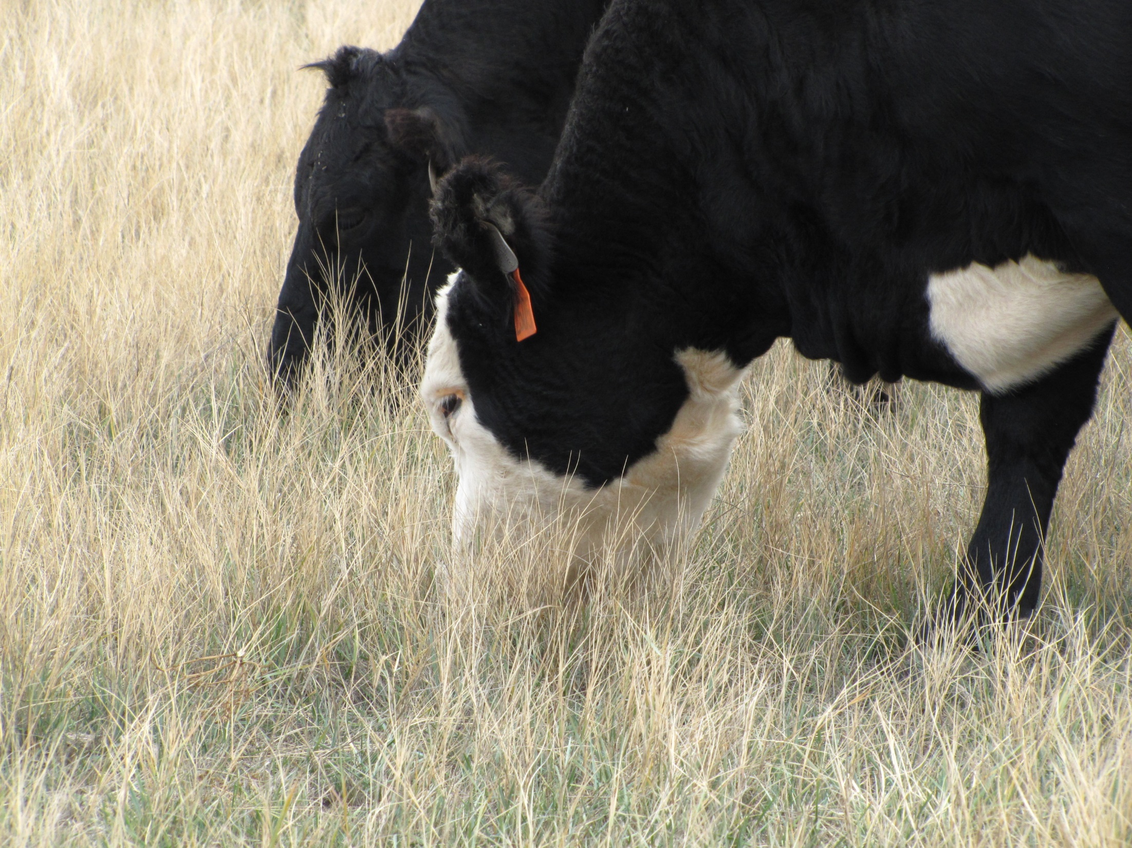

Grazing Rules of Thumb:
Short statements of advice or strategies to help simplify management

Slide 3
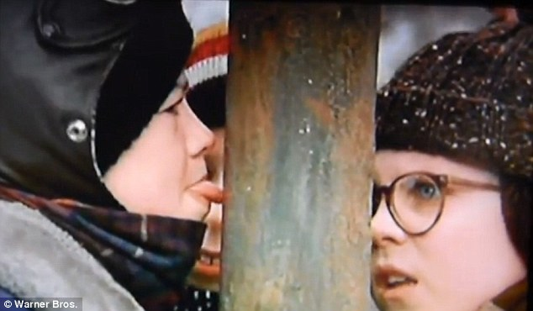
For example: Don’t lick cold metal

Slide 4
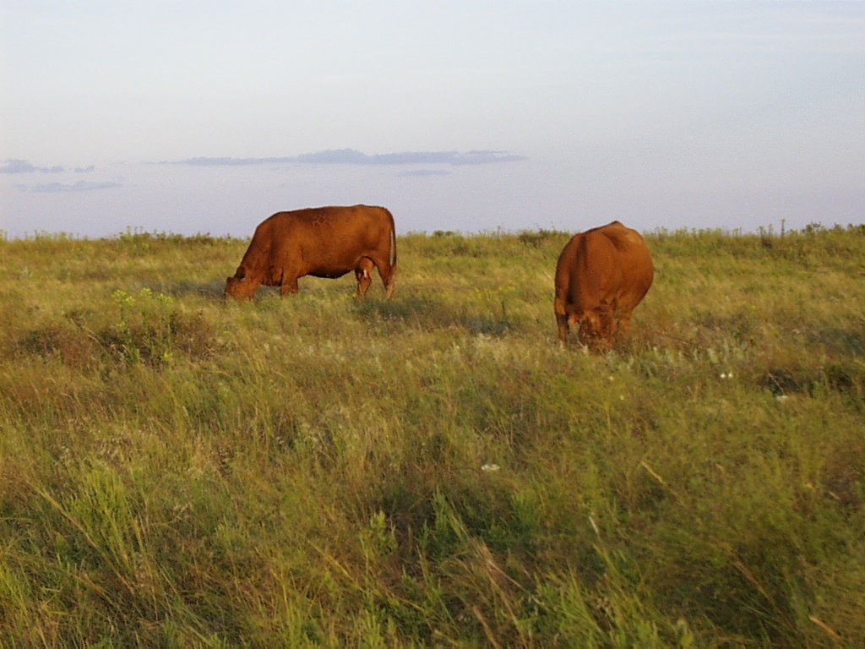
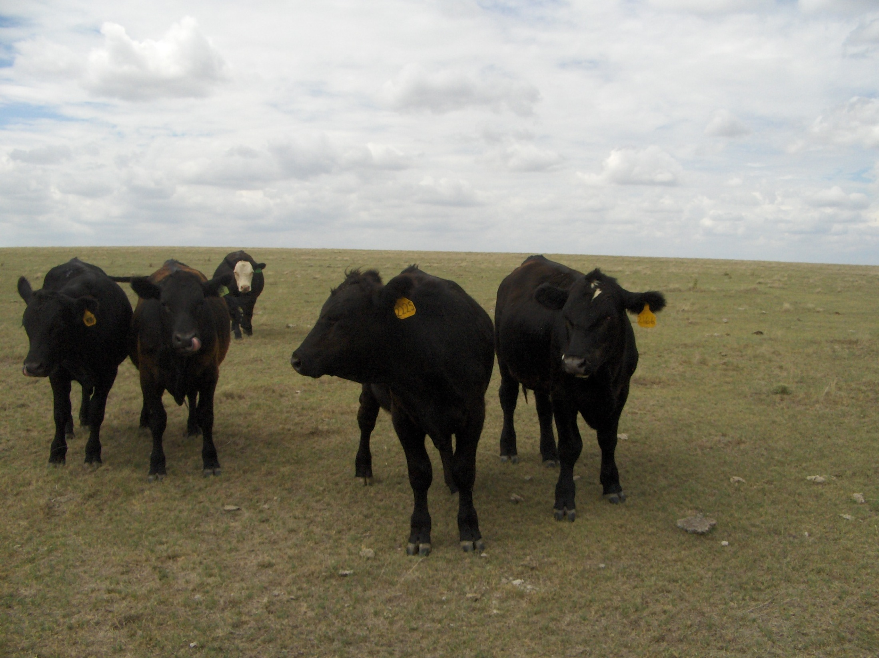
1. The most common rule of thumb:
during the growing season take half,
leave half
25% animal intake; 25% wildlife, waste, & trampling;
50% residual left standing for photosynthesis and cover

Slide 5
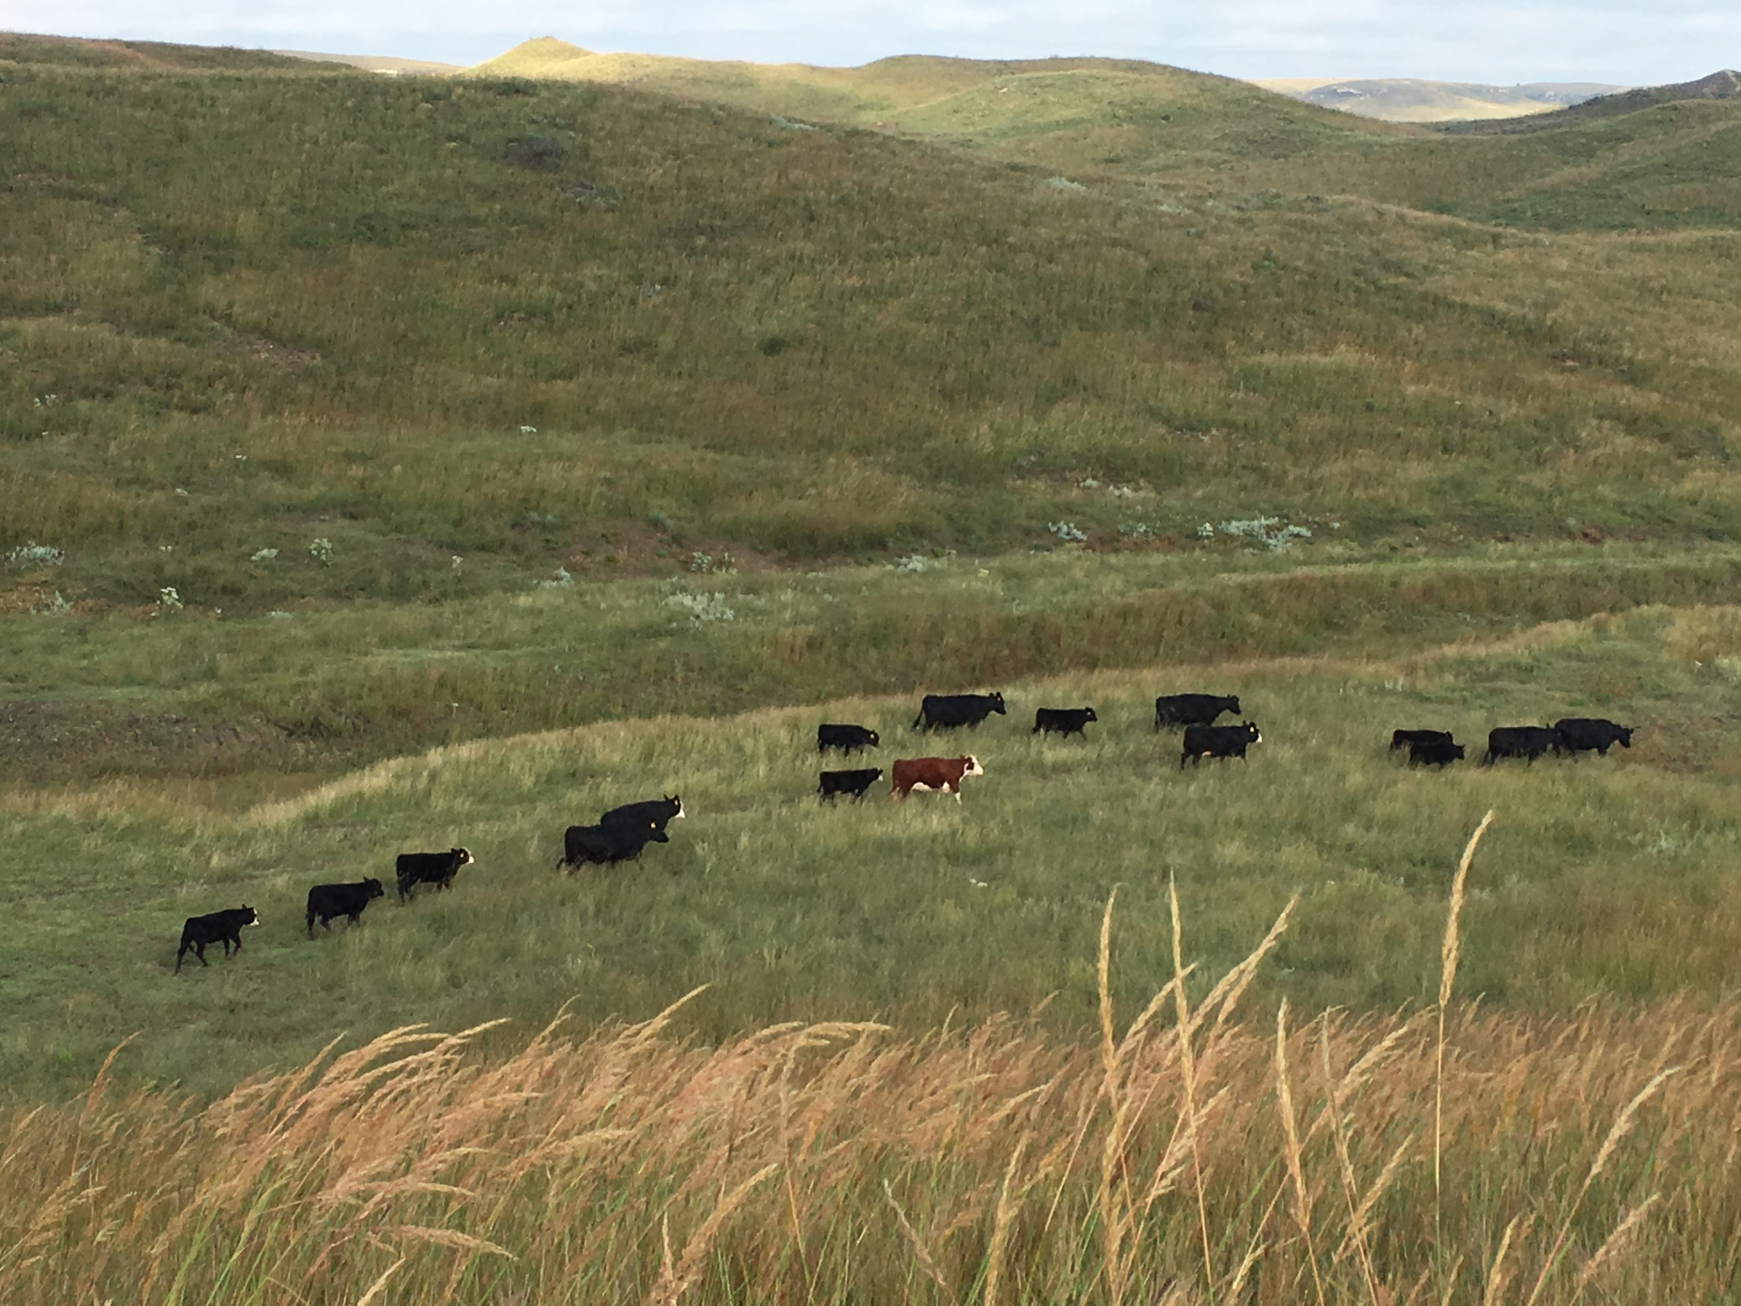
The right stocking rate balances forage availability with animal requirements on a sustainable basis.

Slide 6
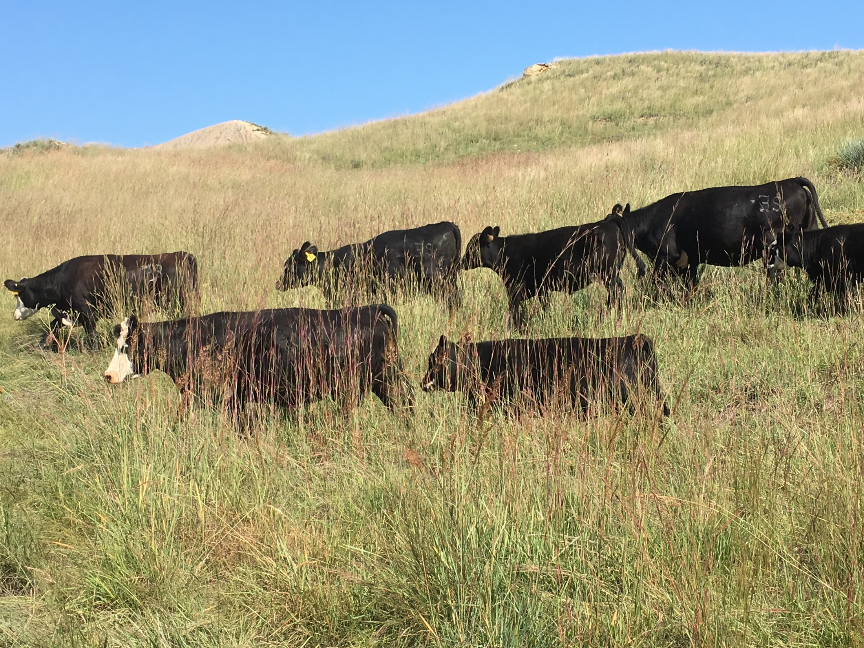
At a moderate stocking rate, some years will have excess forage…

Slide 7
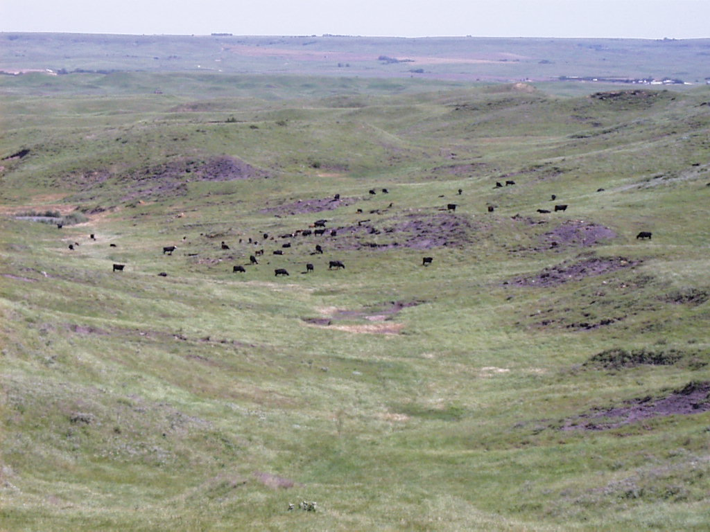
… and some years will have less forage

Slide 8
Native Rangeland Grass Response to Stocking Rate and Precipitation
6000
D
= Drought year
W
W
= Wet year
5000
W
4000
W
Avg.
Avg.
New Growth lbs/acre
3000
Avg.
2000
D
D
1000
D
0
Hvy 66%
Mod 47%
Lgt 38%
Percent Forage Utilization

Slide 9
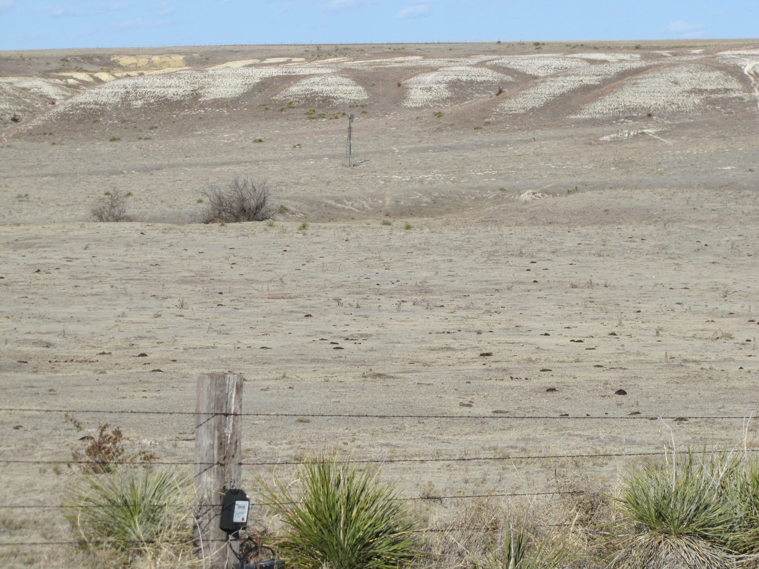
2. You can’t overgraze and make money

Slide 10
Relationship of Stocking Rate,
Animal Production, and Economic Return
High
High
Gain (lb/day)
Gain (lb/acre)
Area of maximum economic return/acre
Low
Low
Low
High
Stocking Rate

Slide 11

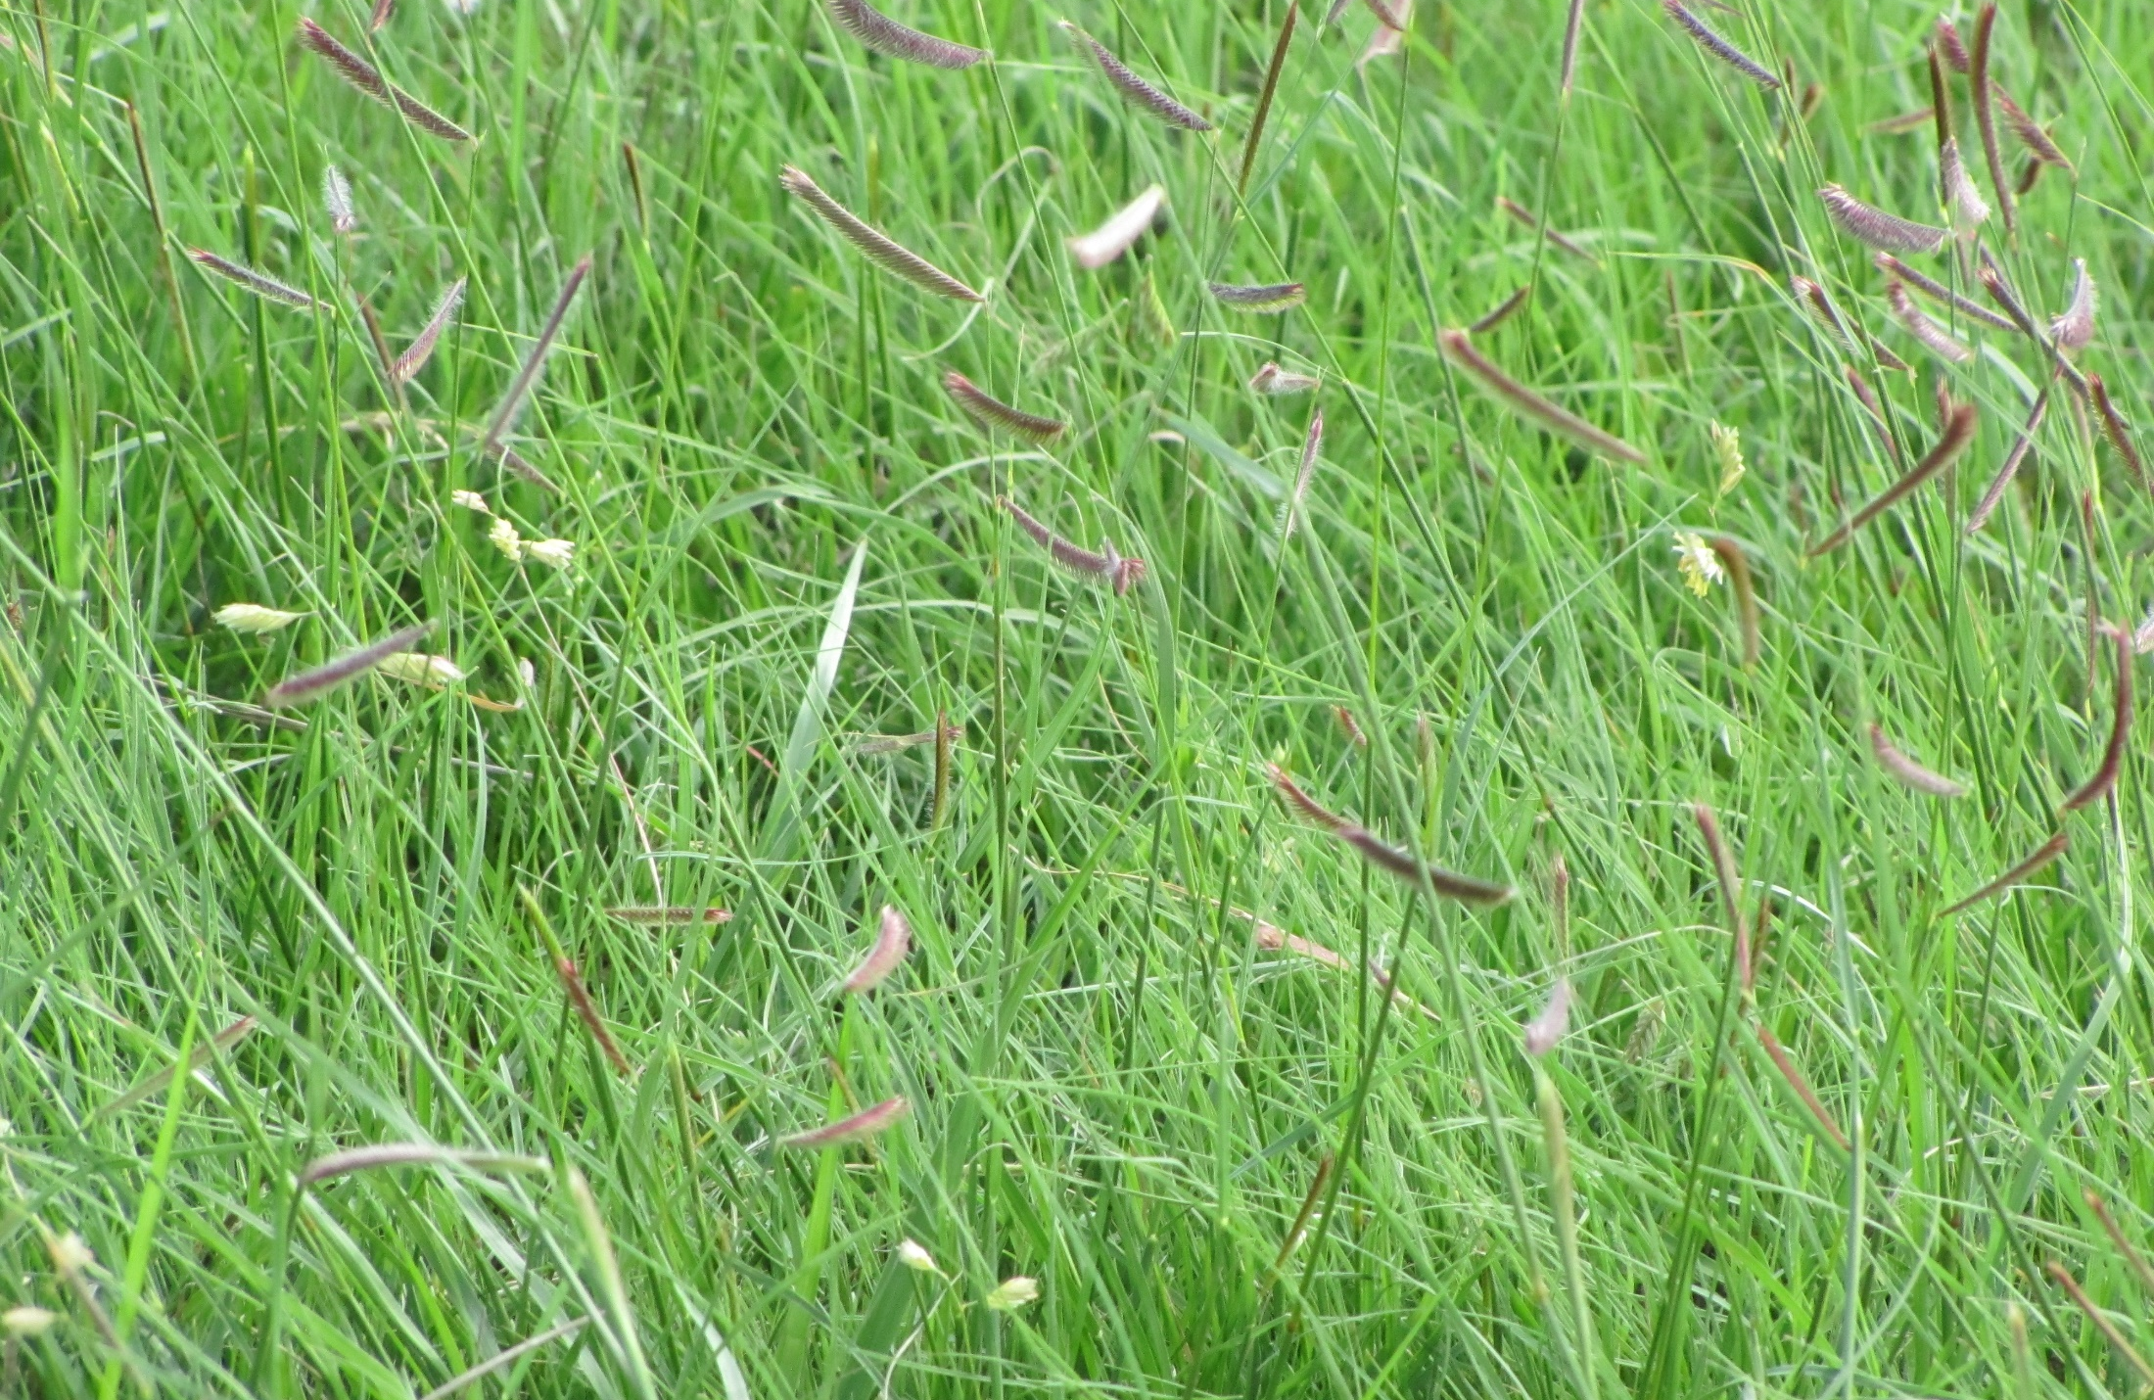
3. If it’s not grass, it’s a weed

Slide 12
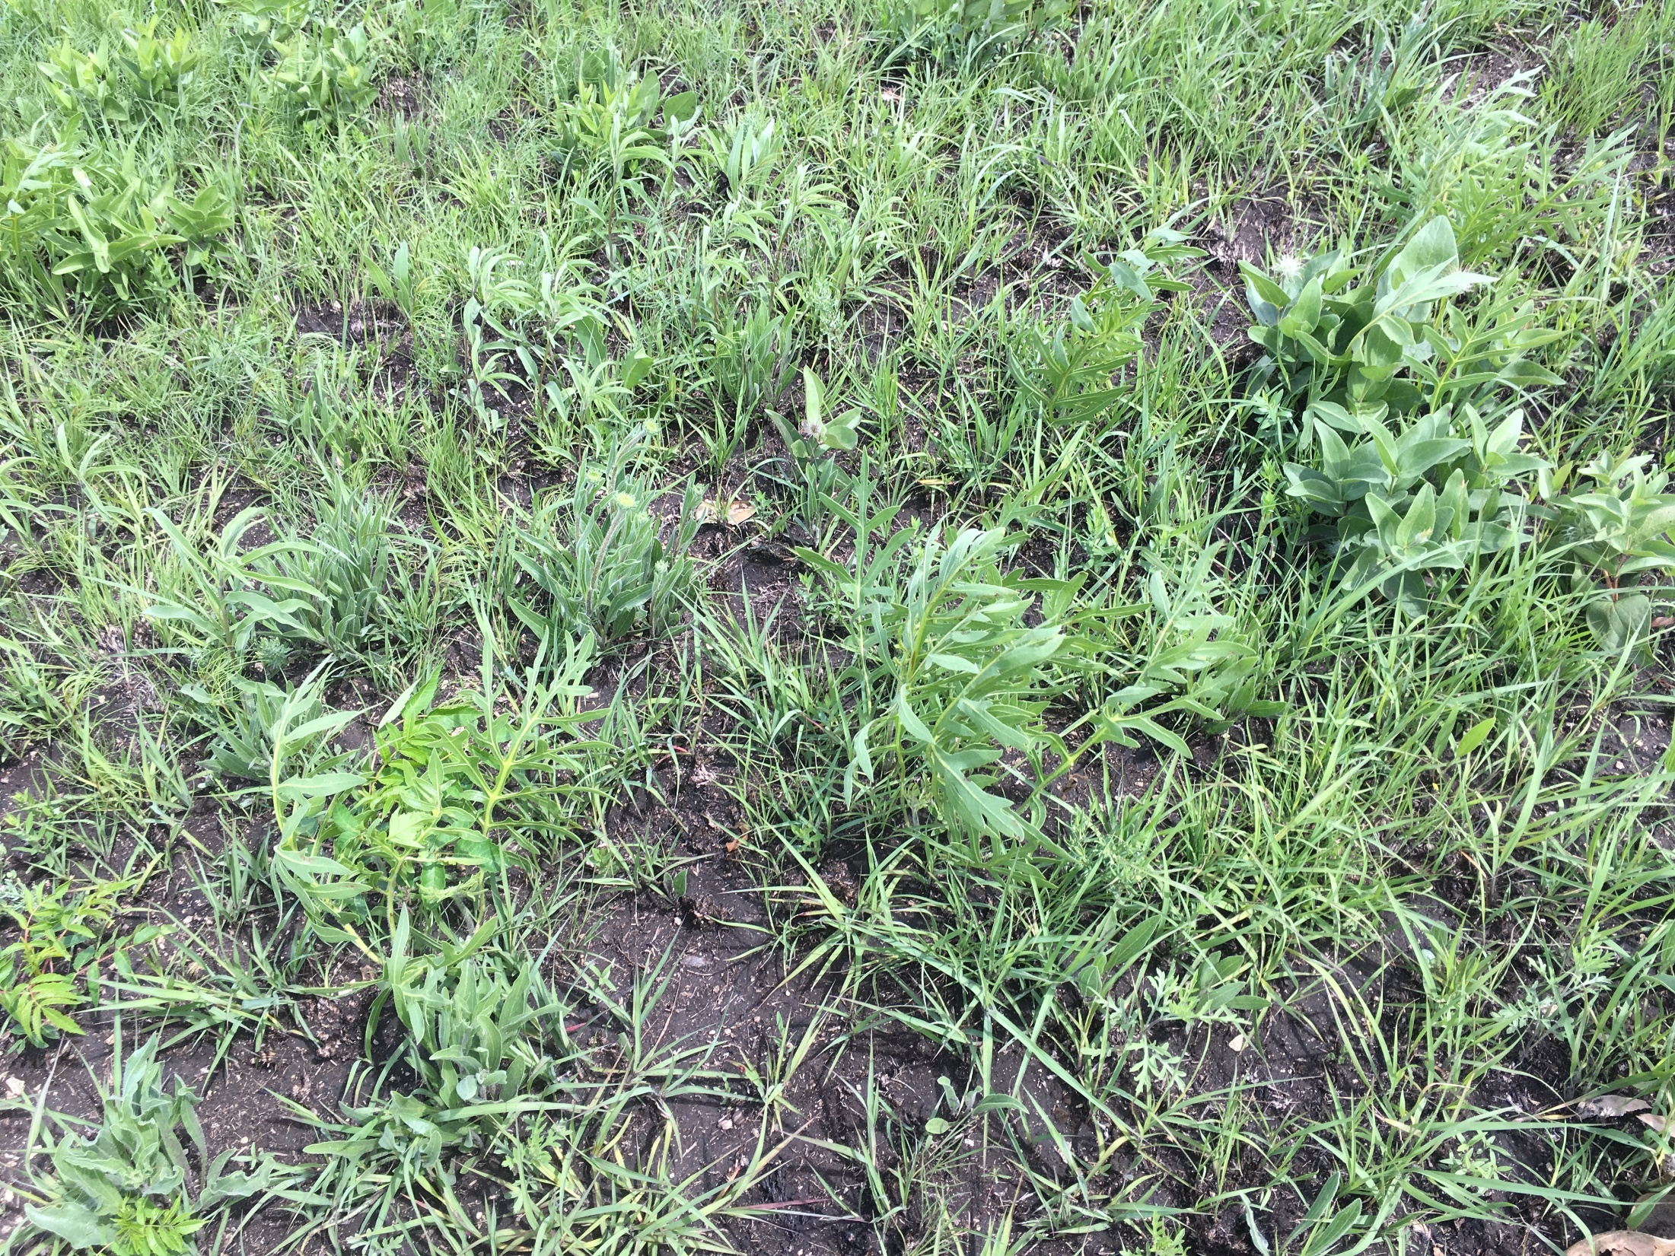
Forbs make up 10-25% of cow diets

Slide 13
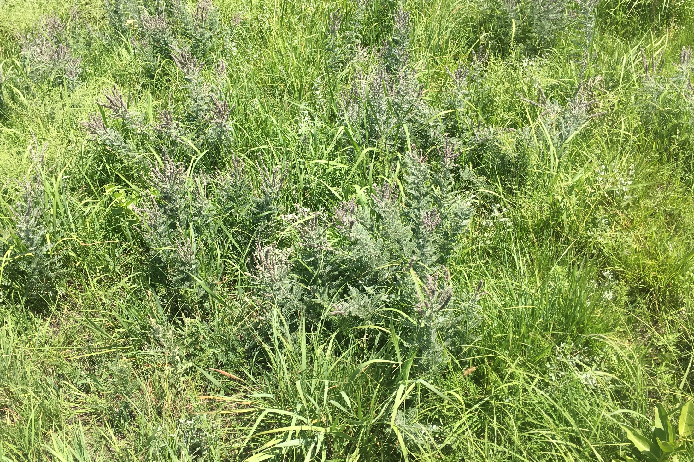
Native legumes benefit animal nutrition and soil fertility

Slide 14
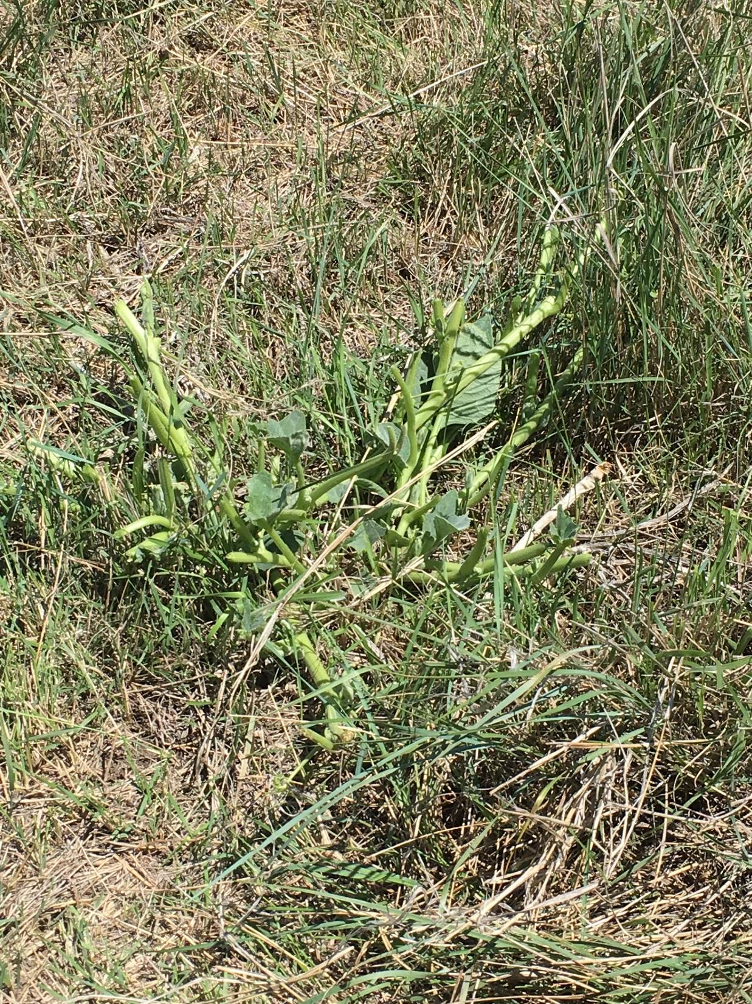
Even ‘weedy’ species may be highly palatable.

Slide 15
Western Ragweed
One of the most common perennial forbs in mixed and shortgrass rangelands
Average dry matter composition at Hays has ranged from 1-34% during 1956-1965, and from 0-21% during 2002-2014
In 1956-65, yield averaged 710 lb/acre, and 49% consumed; Yield averaged 223 lb/acre in 2002-2014

Slide 16
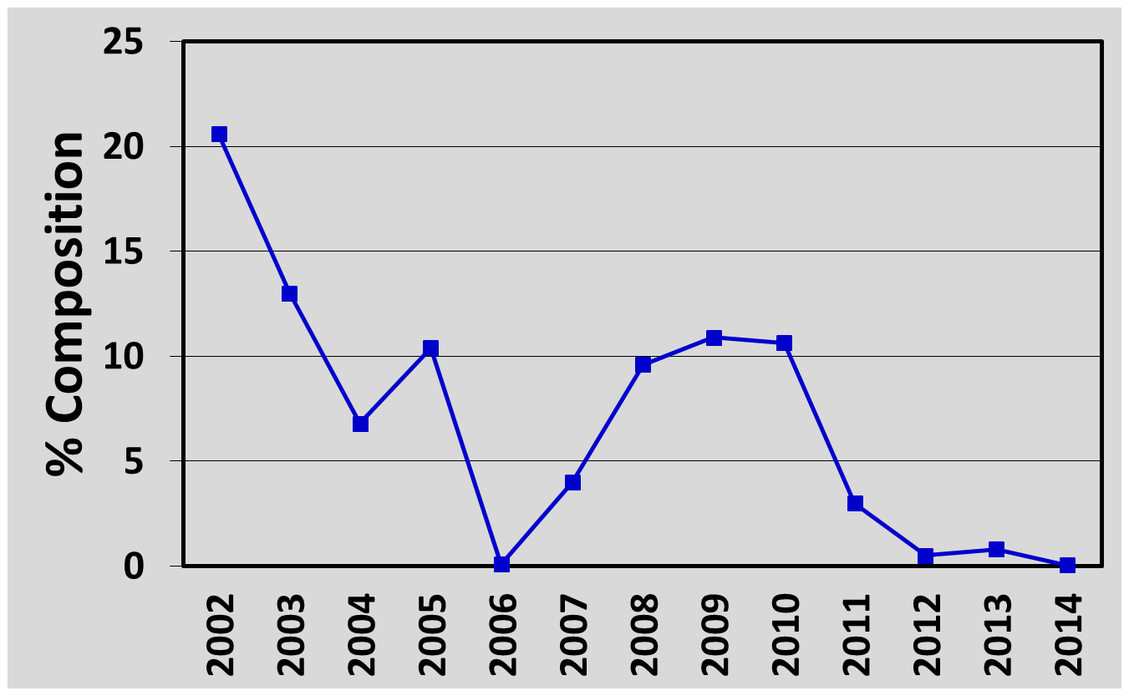
Ragweed Composition in Mixed Grass
2002-2014 Under Moderate Stocking
Avg. 22.7 inches
16.7 inches
Sep ‘10 – Aug ‘11
13.4 inches
Sep ‘05 – Aug ‘06
16.4 inches
Sep ‘11 – Aug ‘12
Composition is highly precipitation dependent

Slide 17
Ragweed Composition in Mixed Grass
1958 and 2008
Threshold Level ~ 40% Composition
(1958)
Native Grass (lb/ac)
(2008)
Western Ragweed (lb/ac)

Slide 18
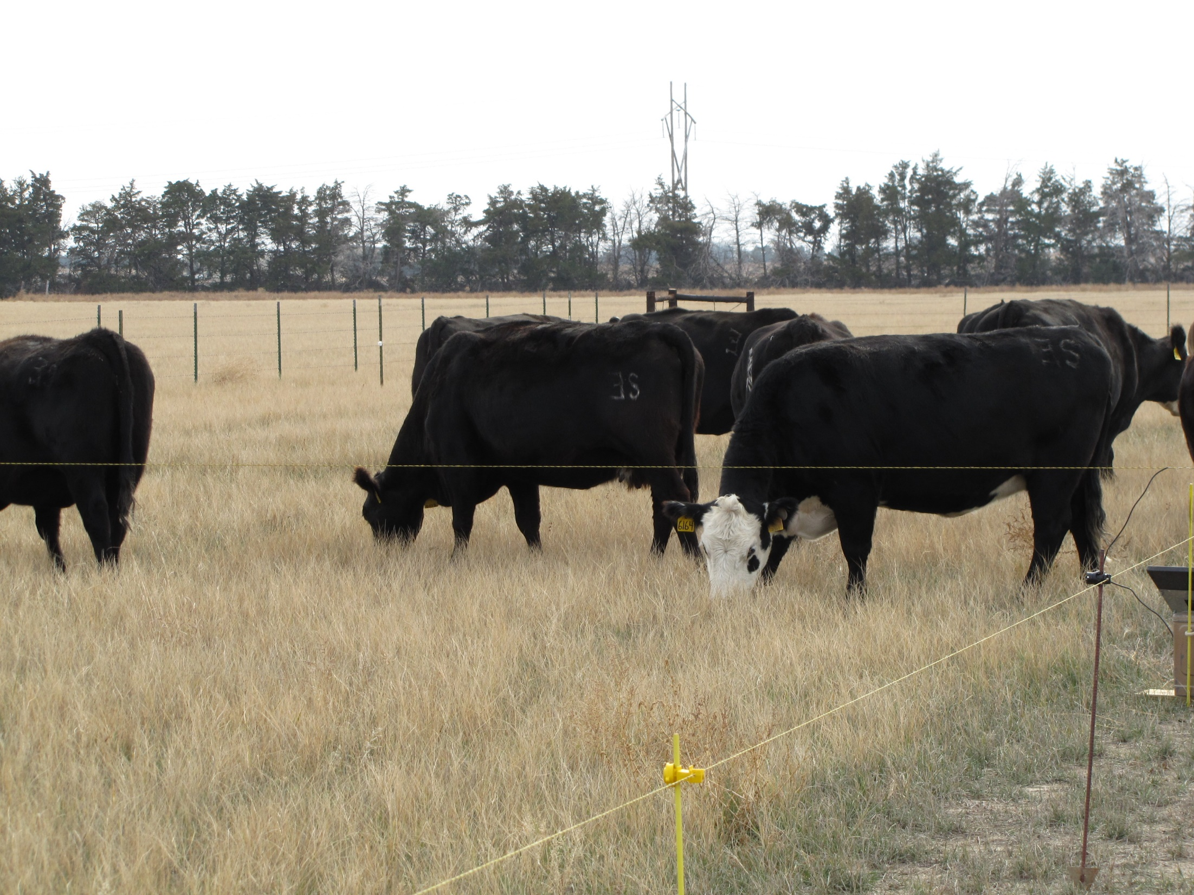

4. Rotational grazing is better
than continuous grazing

Slide 19
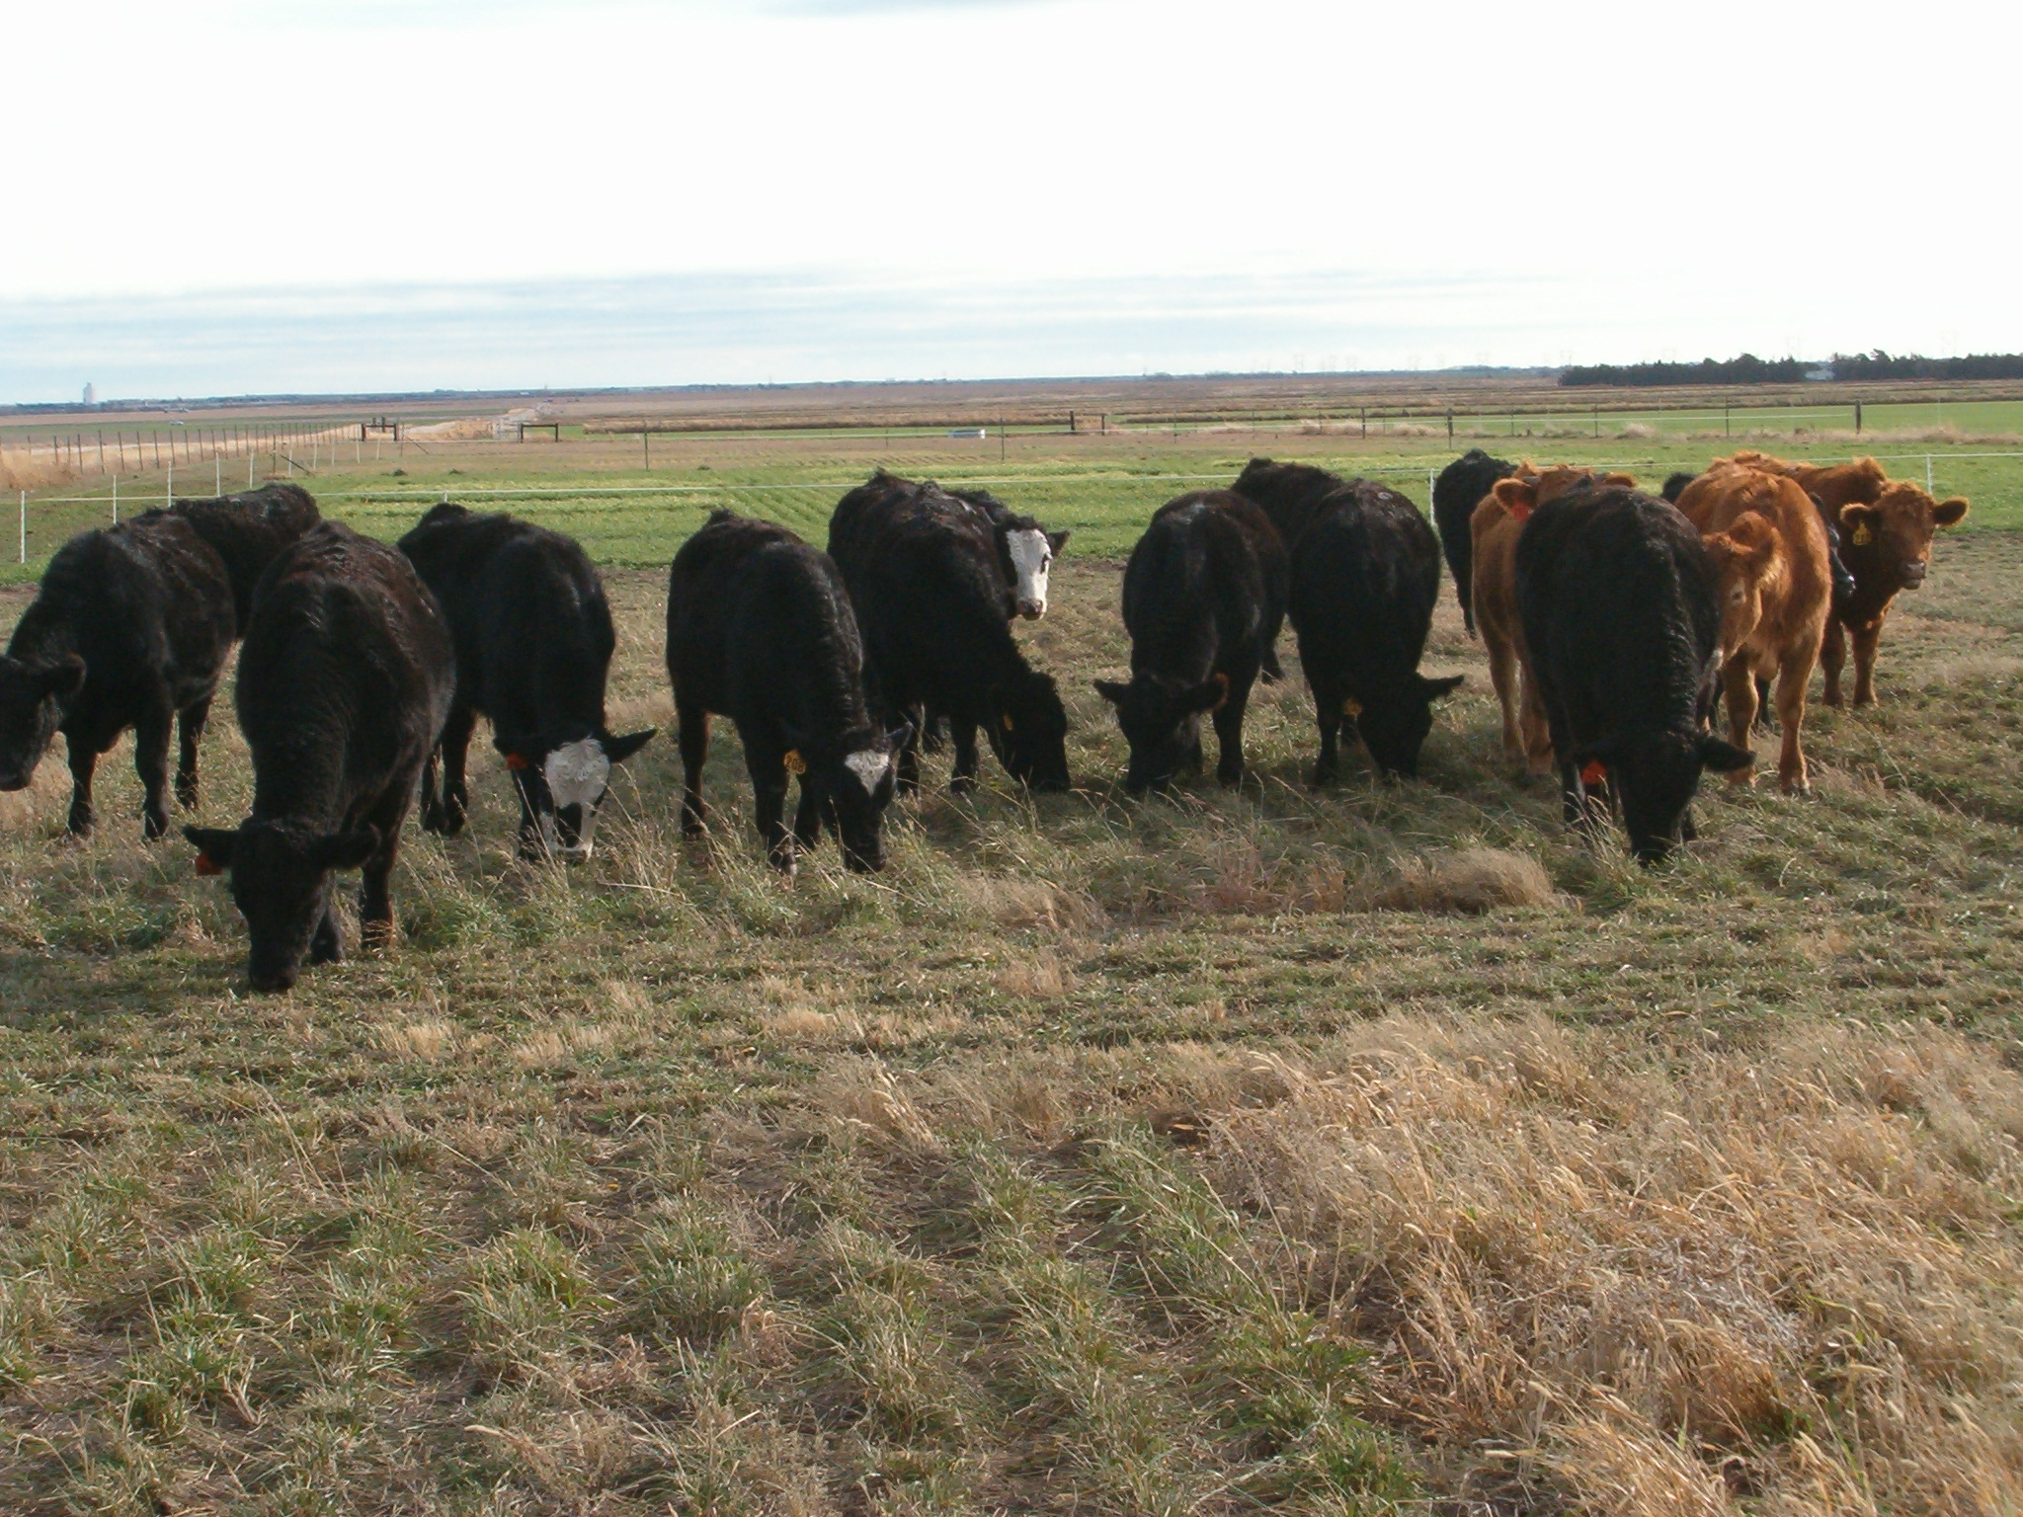
Most research shows that plant and animal production in continuous or rotational grazing systems are similar at the same stocking rates

Slide 20
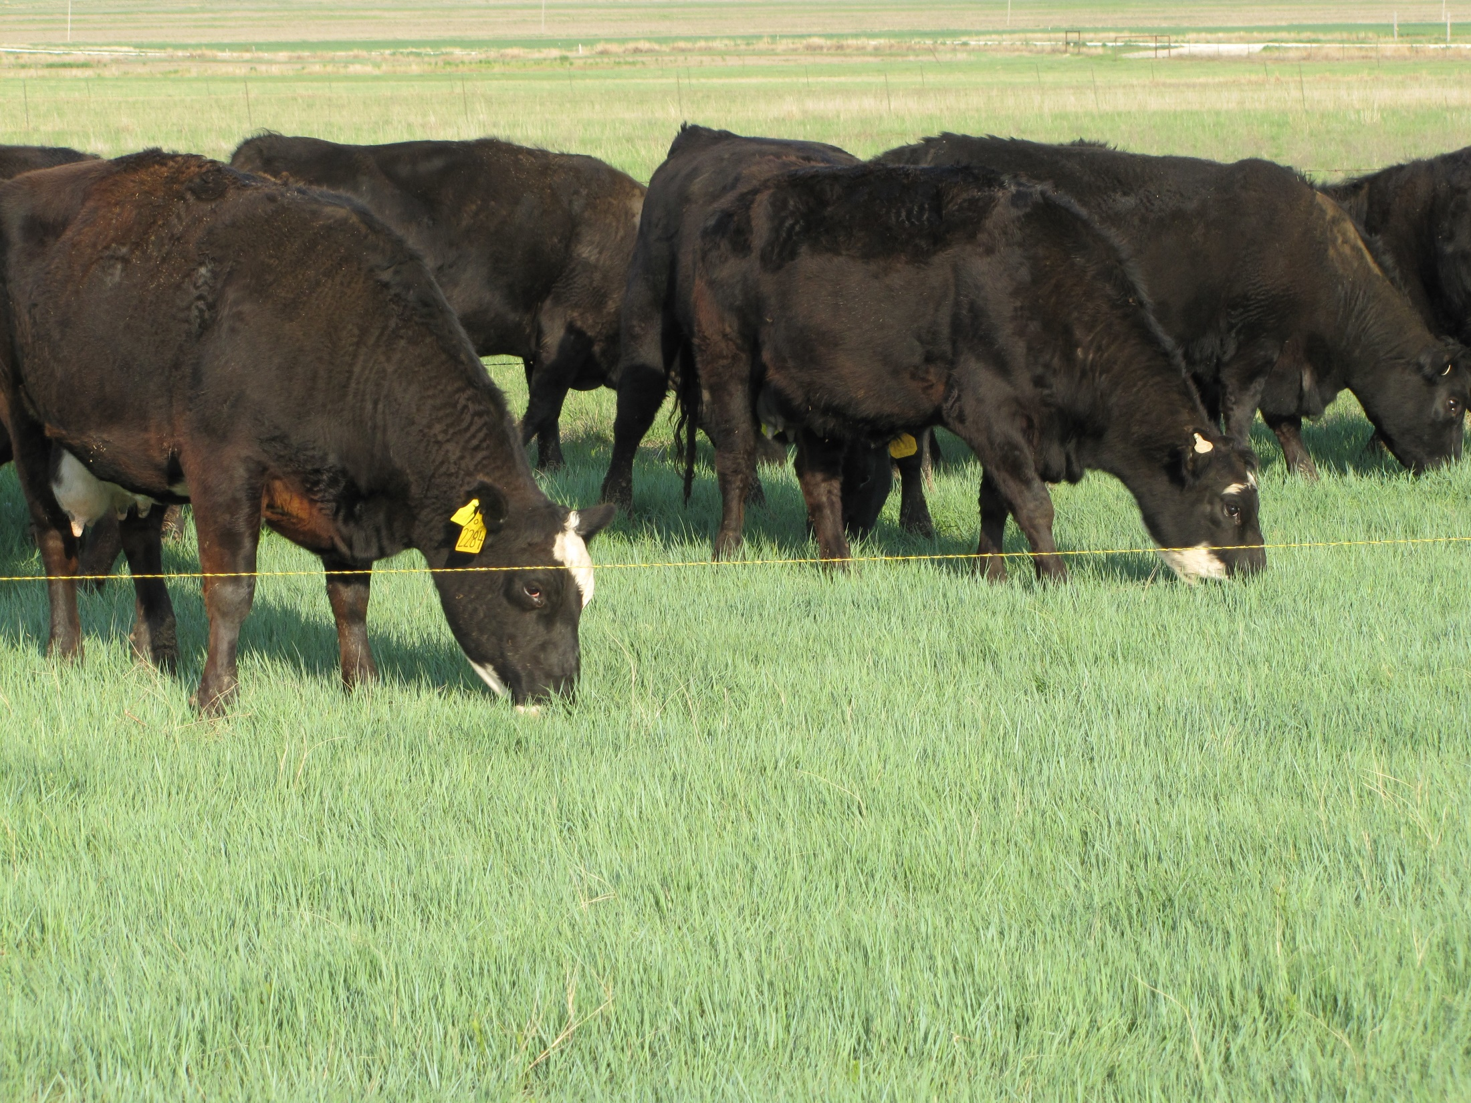
Rotational systems have two main positive attributes:
*Better distribution *Growing season rest for all plants

Slide 21
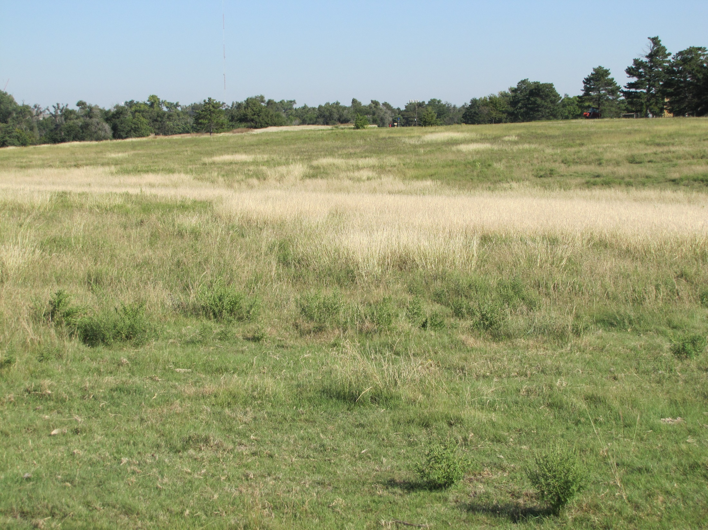
5. Don’t be overgrazed
and understocked

Slide 22
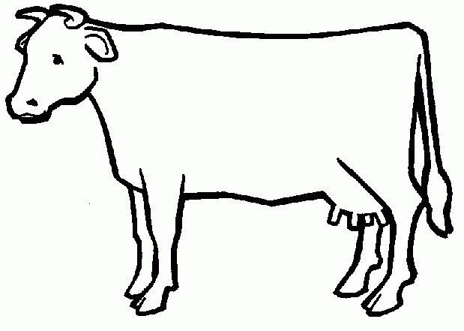
Ideal Distribution
water

Slide 23
What Really Happens
Water
Shade
Topography
Wind direction
Forage quality
water

Slide 24
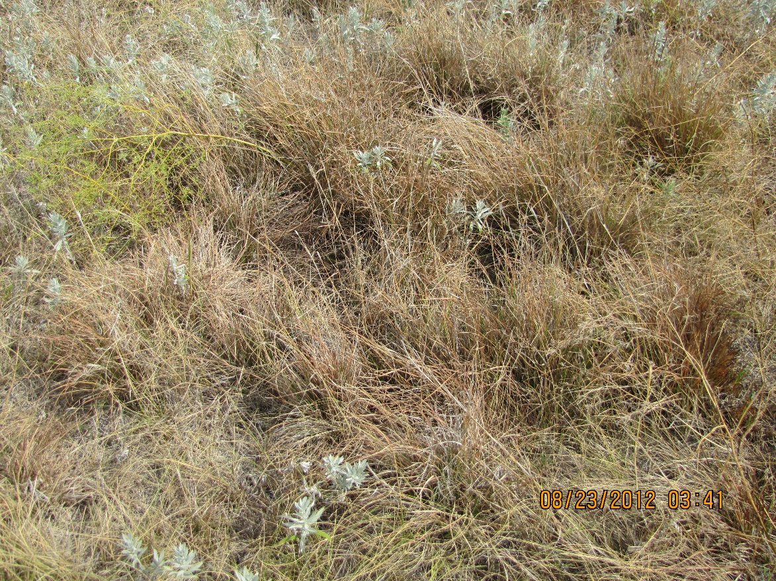
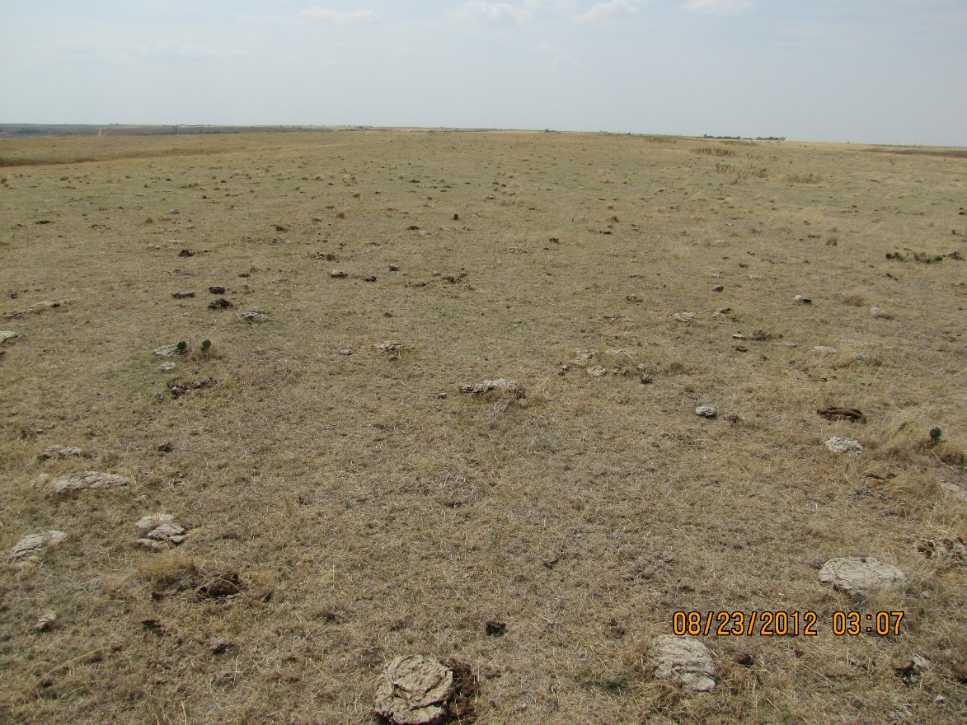

Slide 25
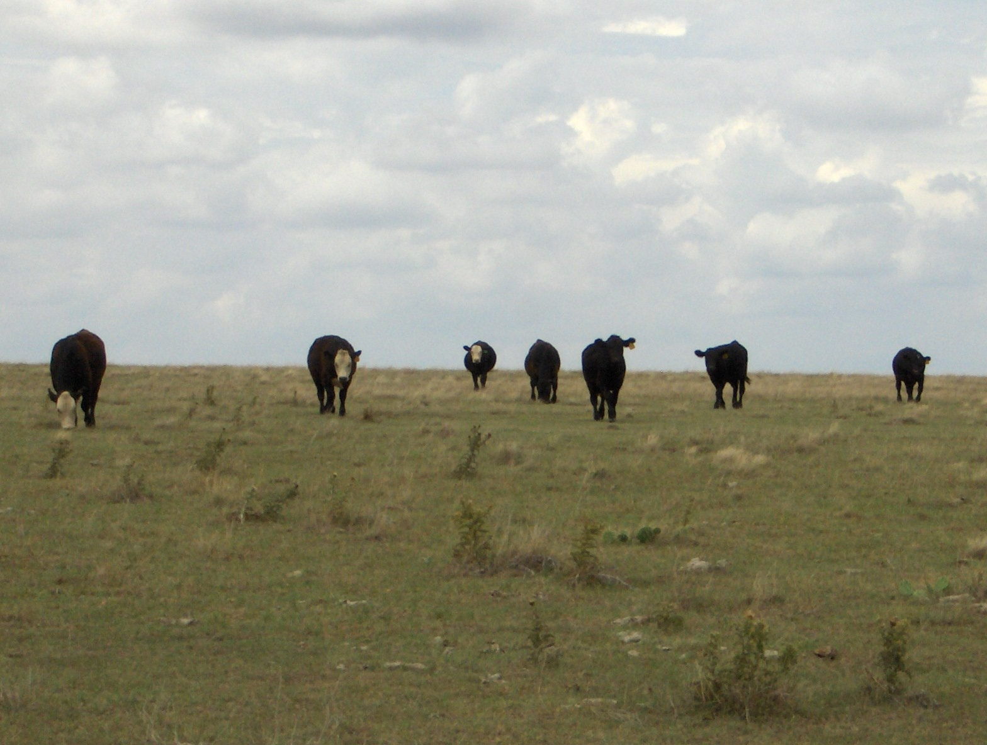
Things that change distribution:
Fence
Water location
Prescribed burning
Mowing
Salt, mineral, and/or protein locations
Foliar sprays

Slide 26
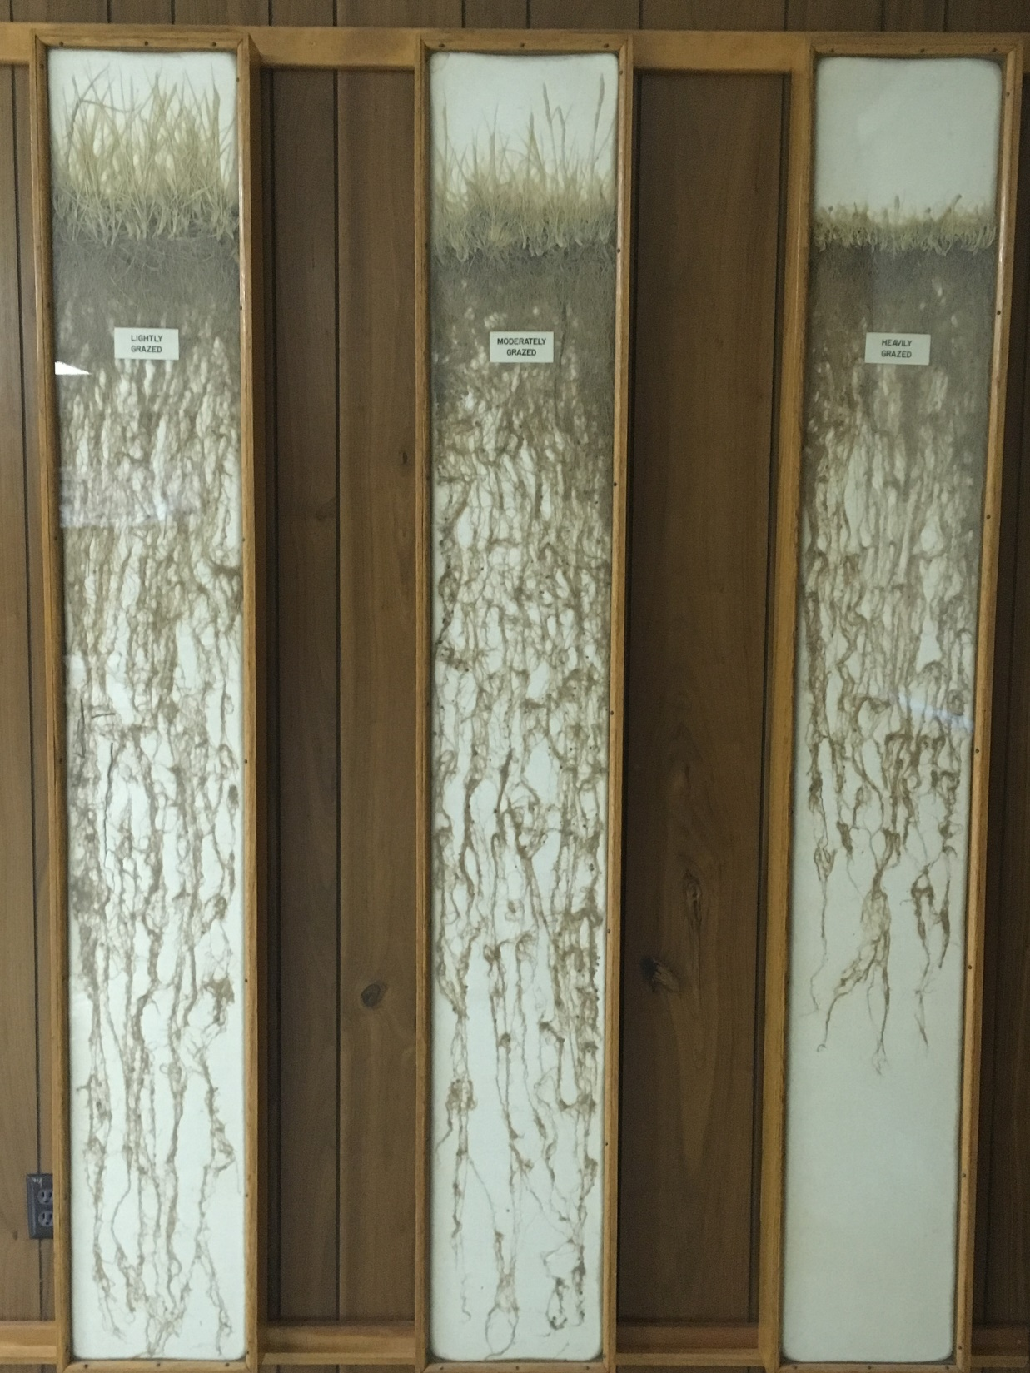
6. What you see aboveground is what you get below ground

Slide 27
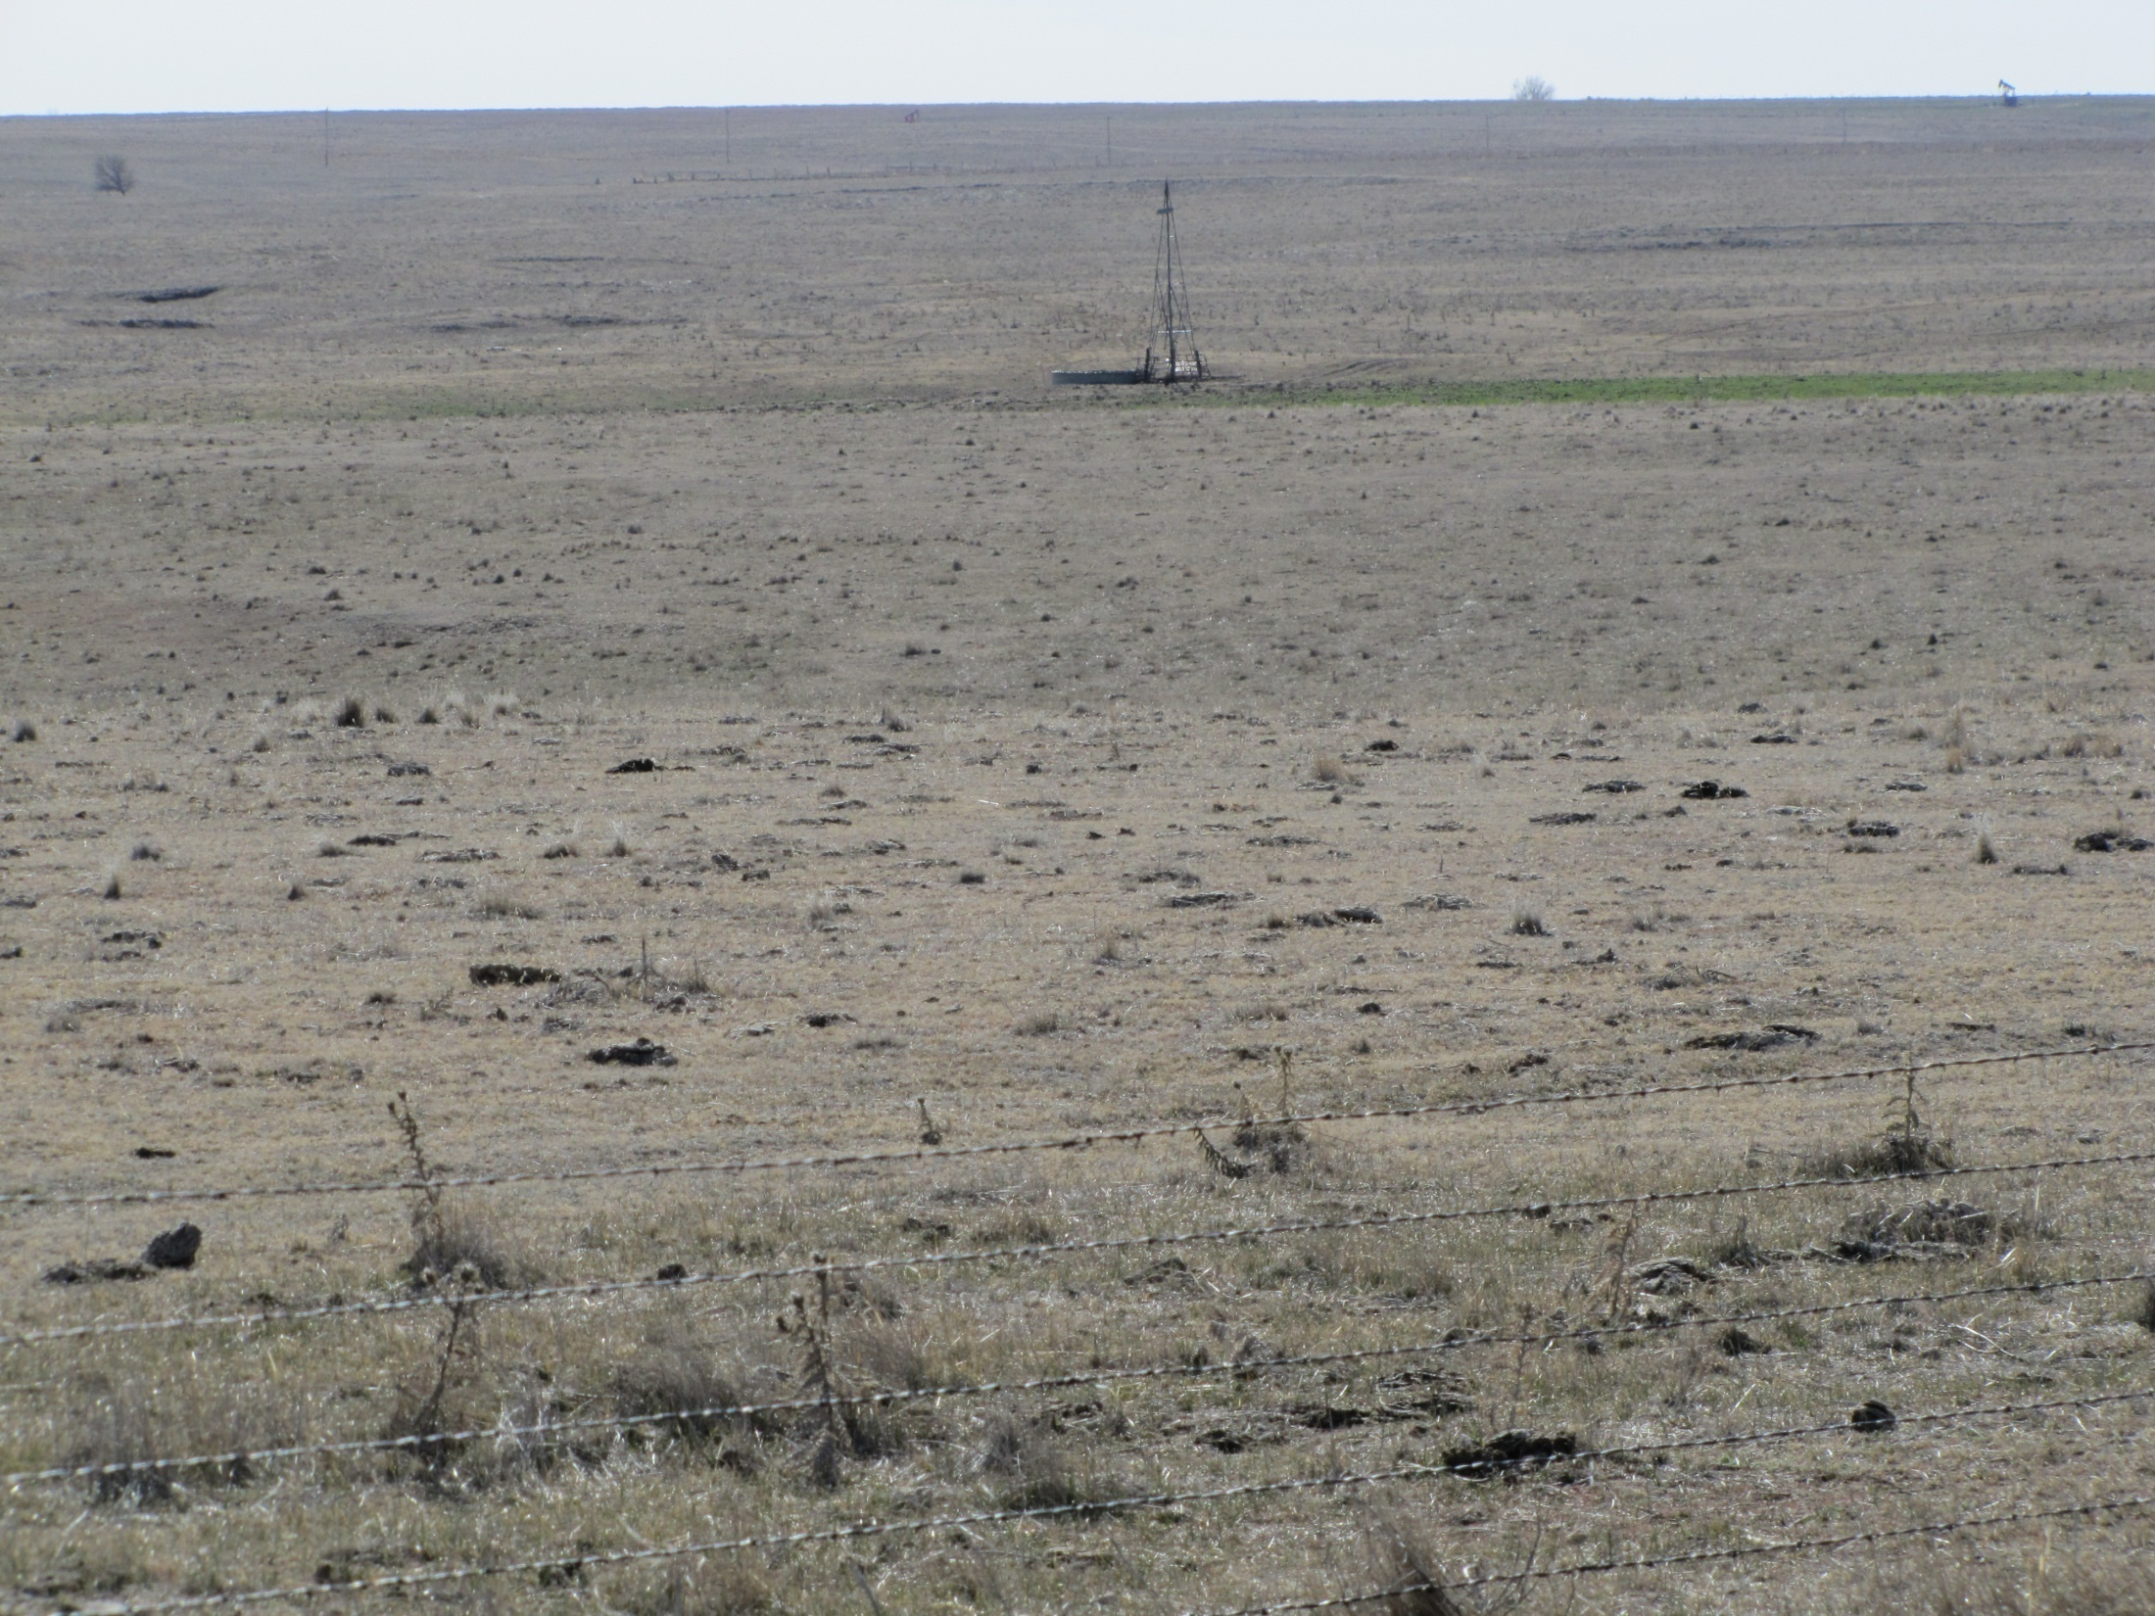
Less vegetative cover reduces water infiltration, root growth, and leaf growth;
increases bare soil, soil erosion, water runoff, and evaporation

Slide 28
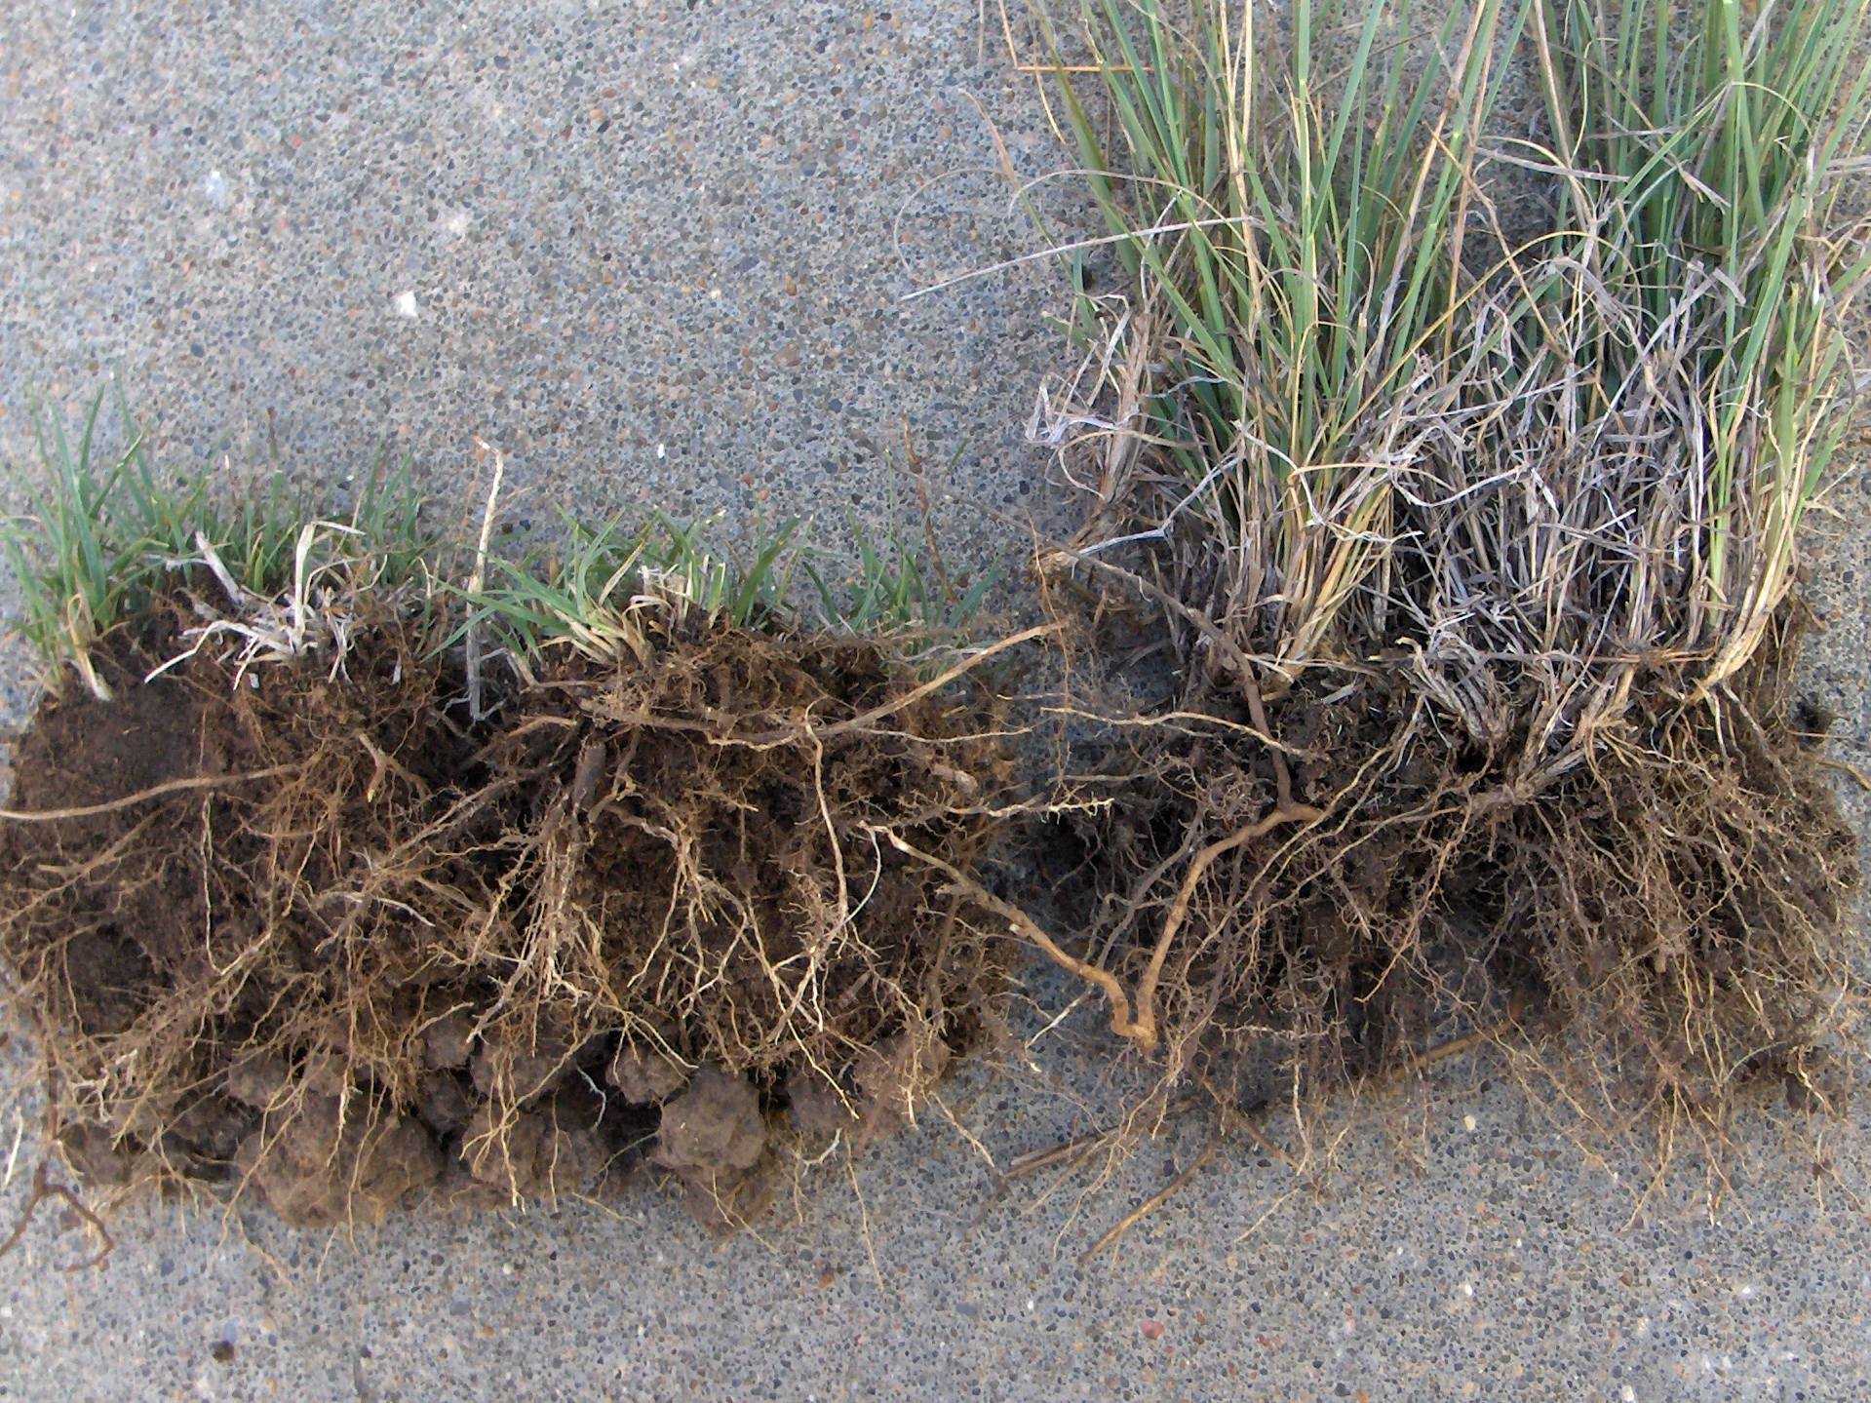
Over grazing creates a ‘self-induced’ drought

Slide 29


Water infiltration
Utilization | Infiltration Rate in/hr
66% (heavy) | 0.73
47% (moderate) | 1.19
38% (light) | 1.58

Slide 30
7. 60% of growth occurs by July 1
Limy Slopes Ecological Sites-
% of Total Growth Occurring
 | Mar | Apr | May | Jun | Jul | Aug | Sep
Mixedgrass | 5 | 10 | 15 | 30 | 25 | 10 | 5
Accumulated | 5 | 15 | 30 | 60 | 85 | 95 | 100
Shortgrass | 0 | 5 | 25 | 30 | 25 | 10 | 5
Accumulated | 0 | 5 | 30 | 60 | 85 | 95 | 100

Slide 31
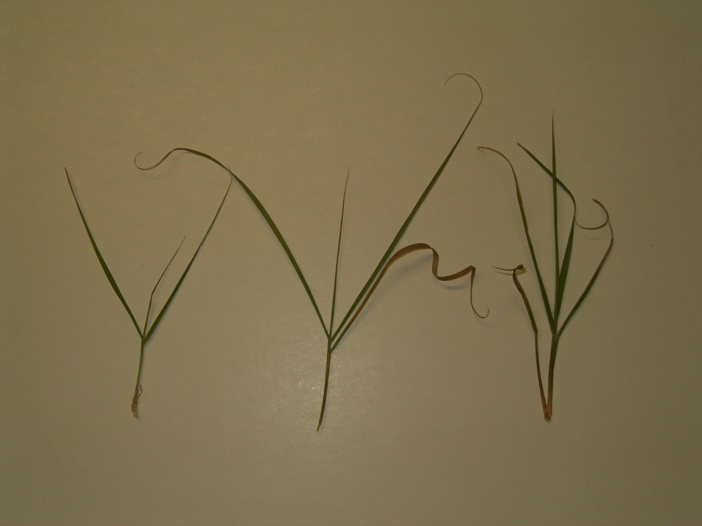

Slide 32
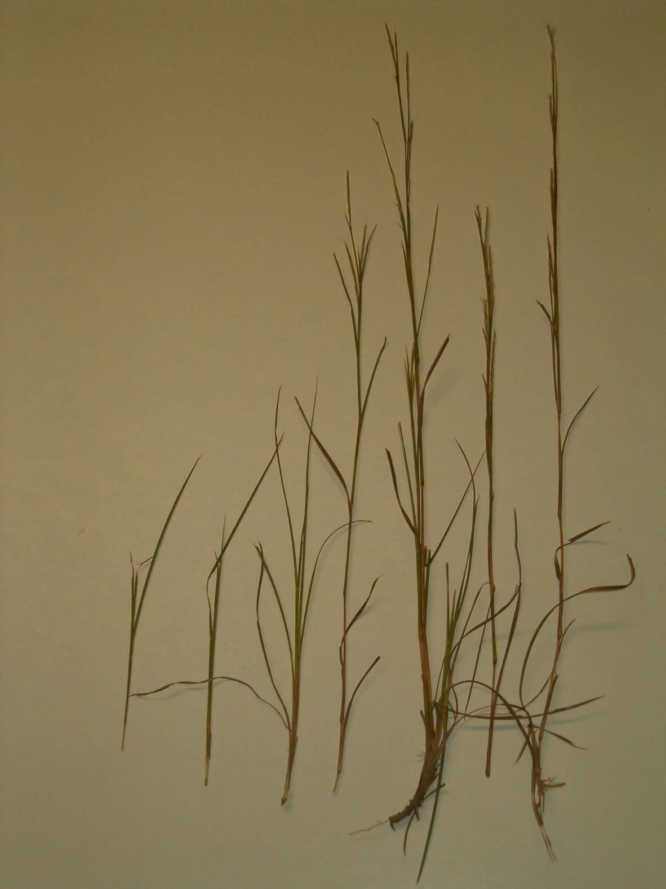

Slide 33
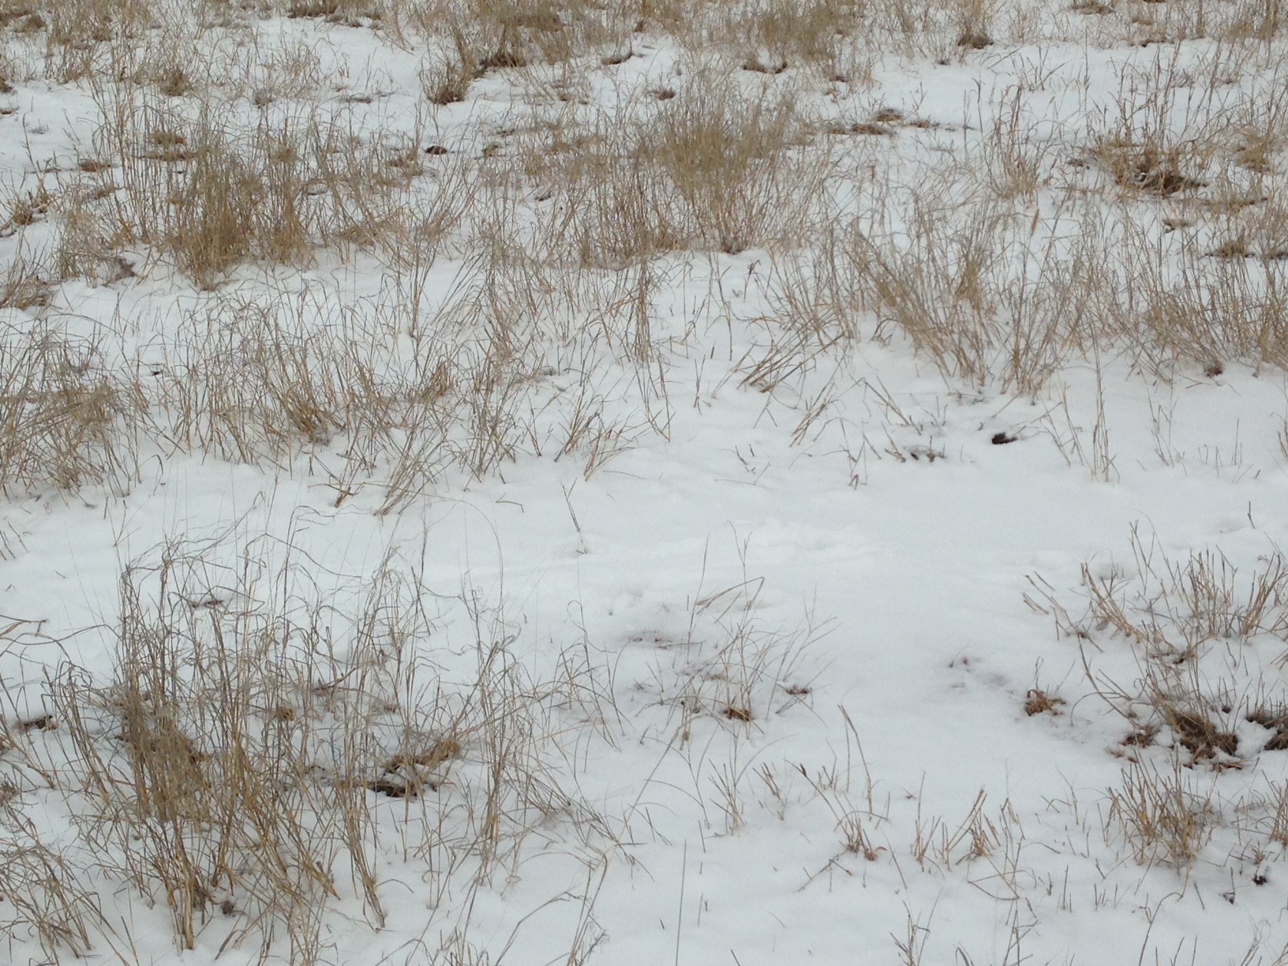

8. Wet winters produce more grass

Slide 34
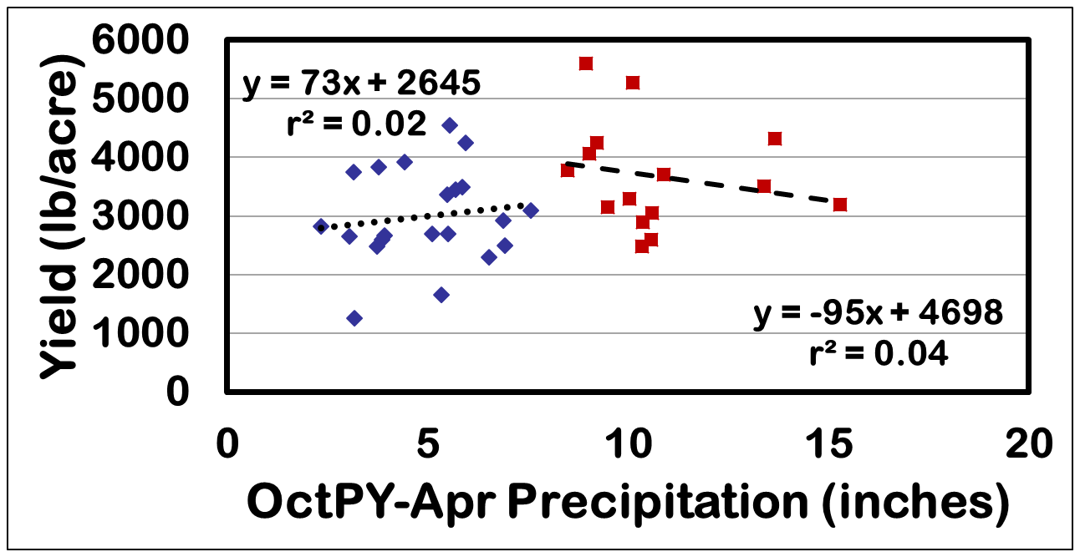
Relationship of Pasture Yield and Winter Precipitation - 36 Years
Winter precipitation doesn’t help predict yield!
Avg.

Slide 35
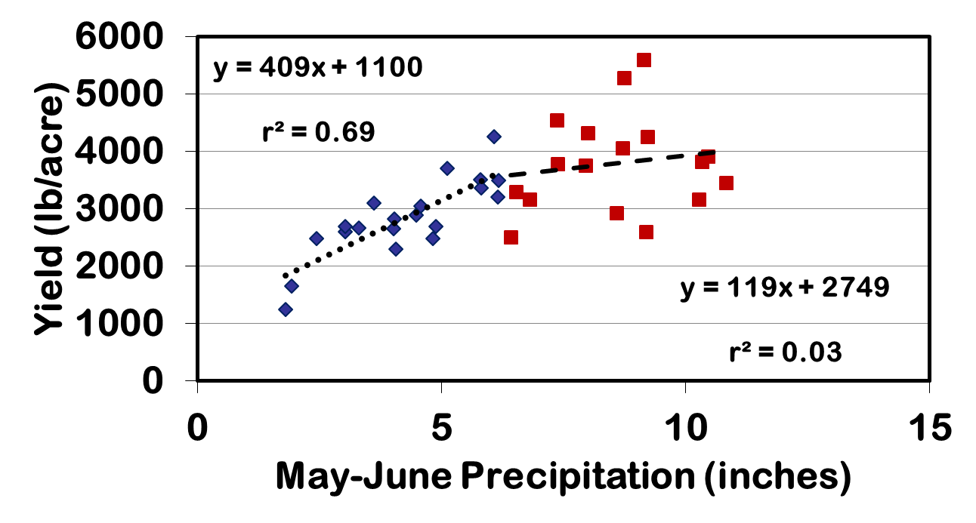
Relationship of Pasture Yield and Spring Precipitation - 36 Years
Avg.

Slide 36
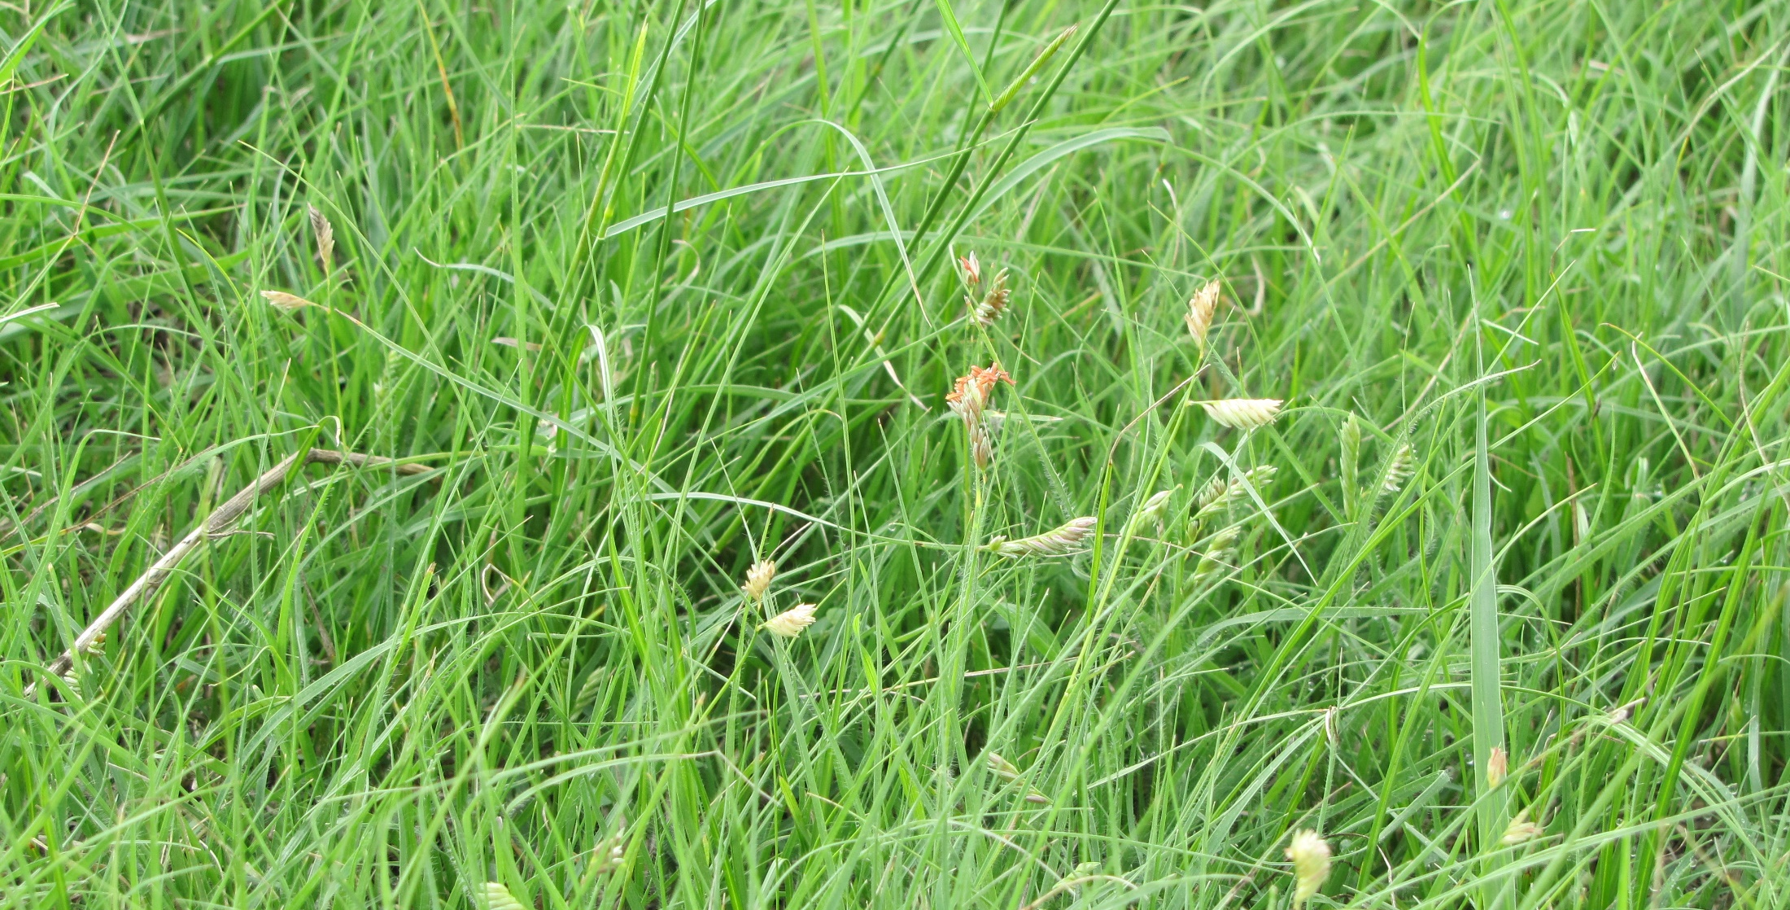
Generally, prior year precipitation sets the stage for next year’s growth,
but current year growing season rainfall is the main factor that will determine actual pasture yield.

Slide 37
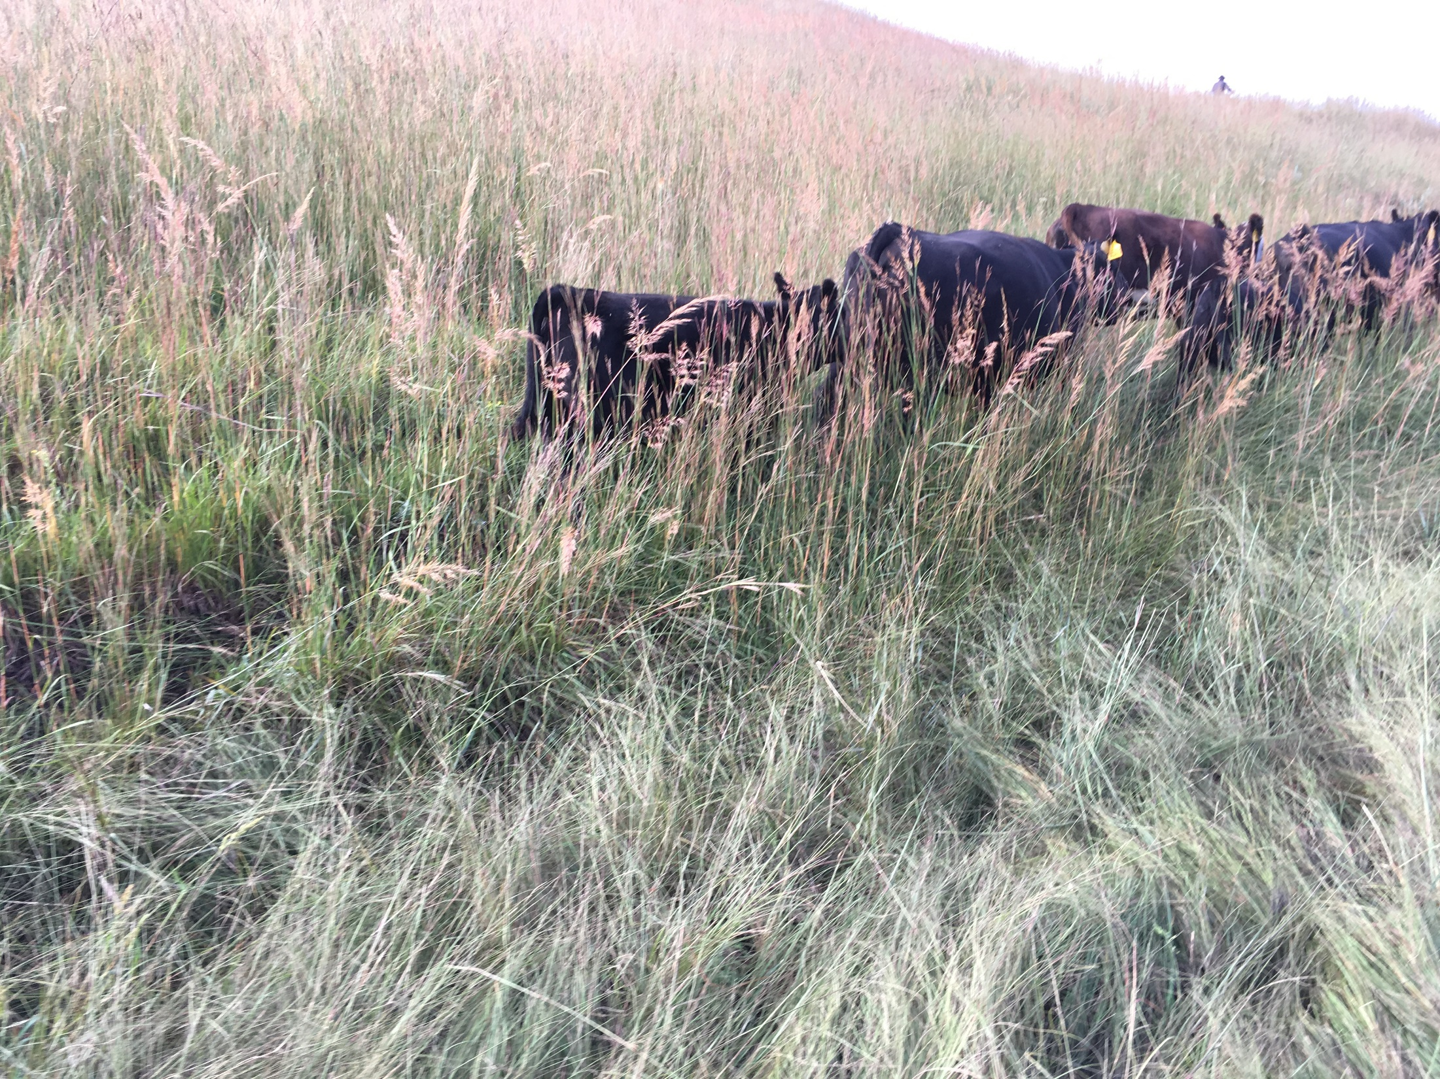
9. Every inch of growth is 150 lb/acre

Slide 38
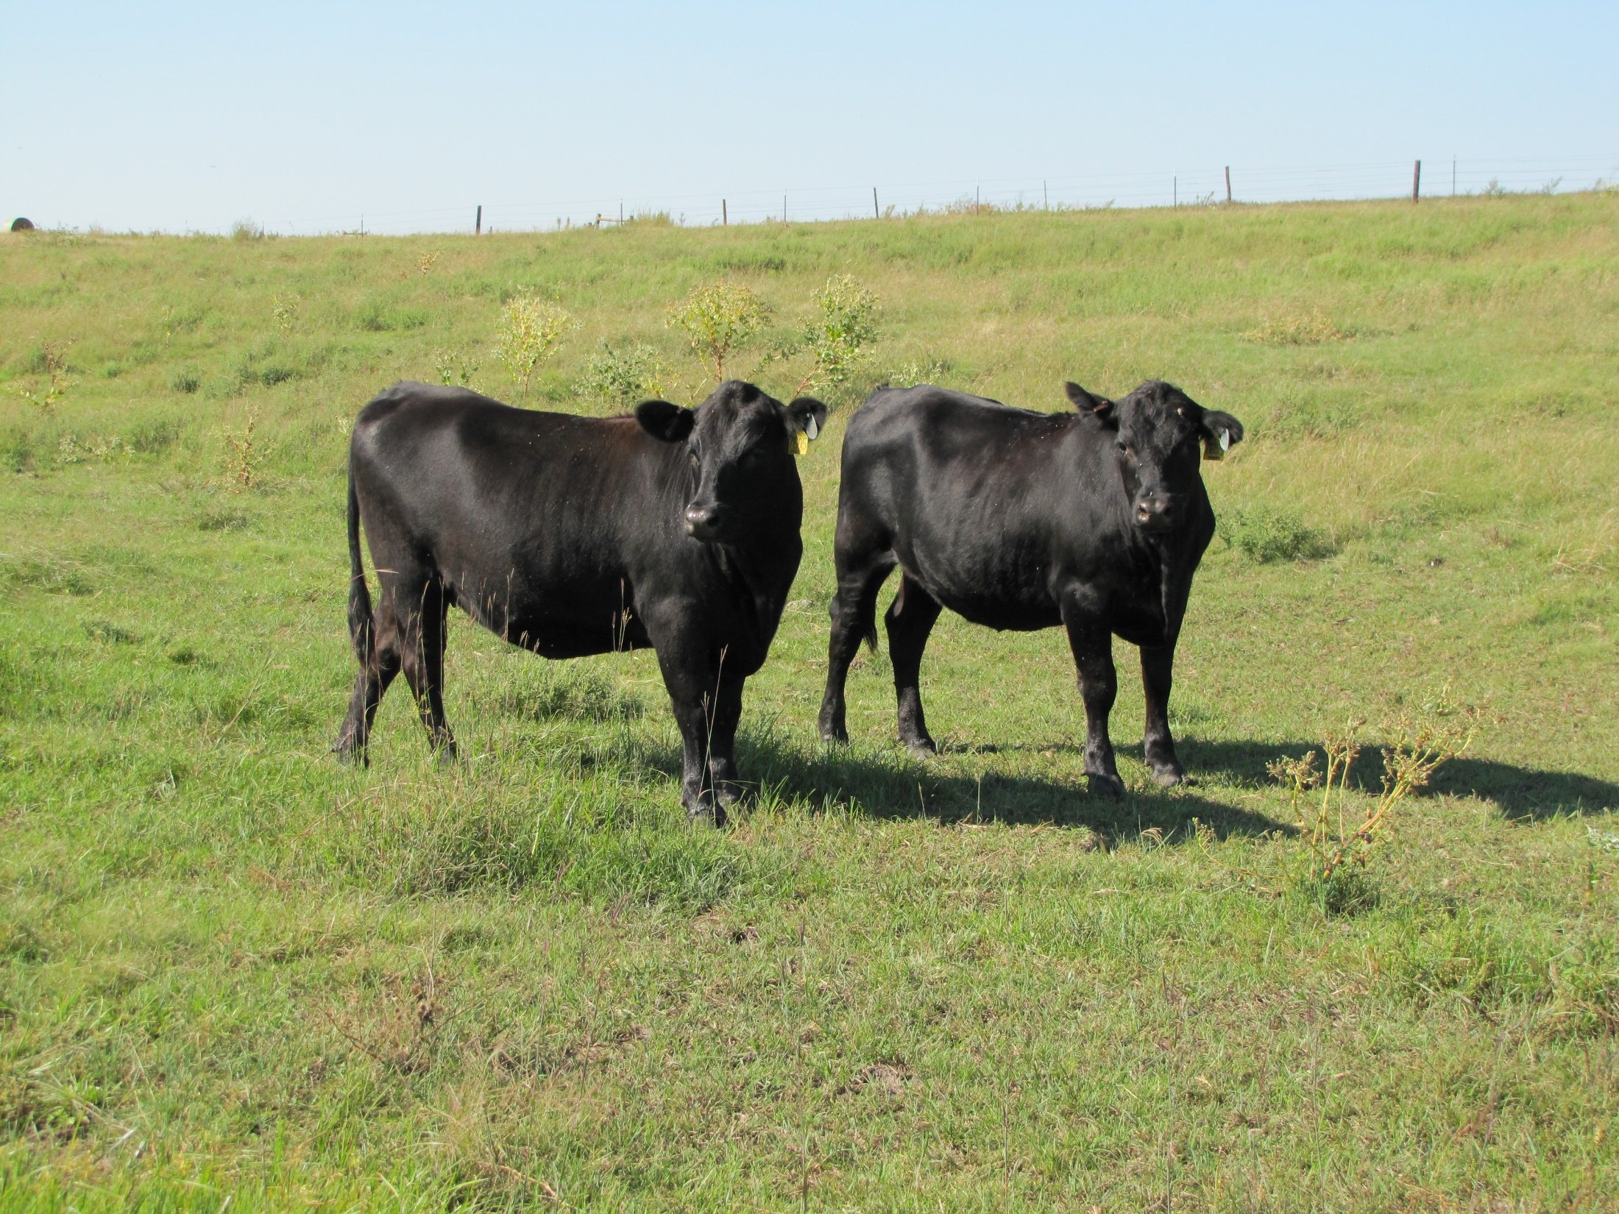
Rangeland Type | Low Density lb/ac/inch | Medium Density lb/ac/inch | High Density lb/ac/inch
Tallgrass | 120-160 | 160-230 | 230-300
Mixedgrass | 70-120 | 120-160 | 160-230
Shortgrass | 30-40 | 40-50 | 80-120

Slide 39
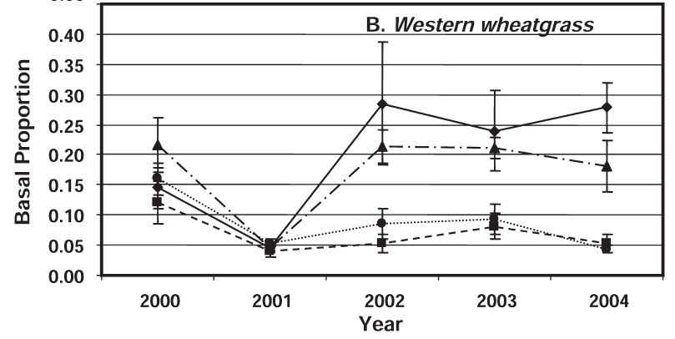
10. Don’t graze the same place at the
same time every year
Ungrazed in April
Intense April grazing

Slide 40
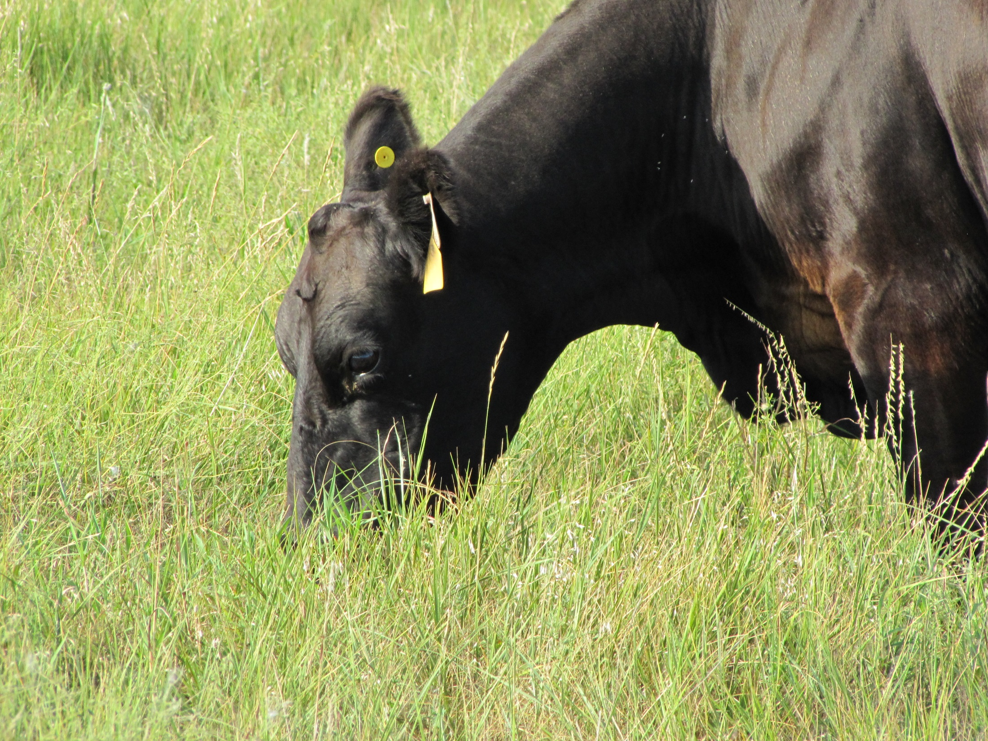
Grazing only in mid-summer will shift pasture to cool-season species

Slide 41
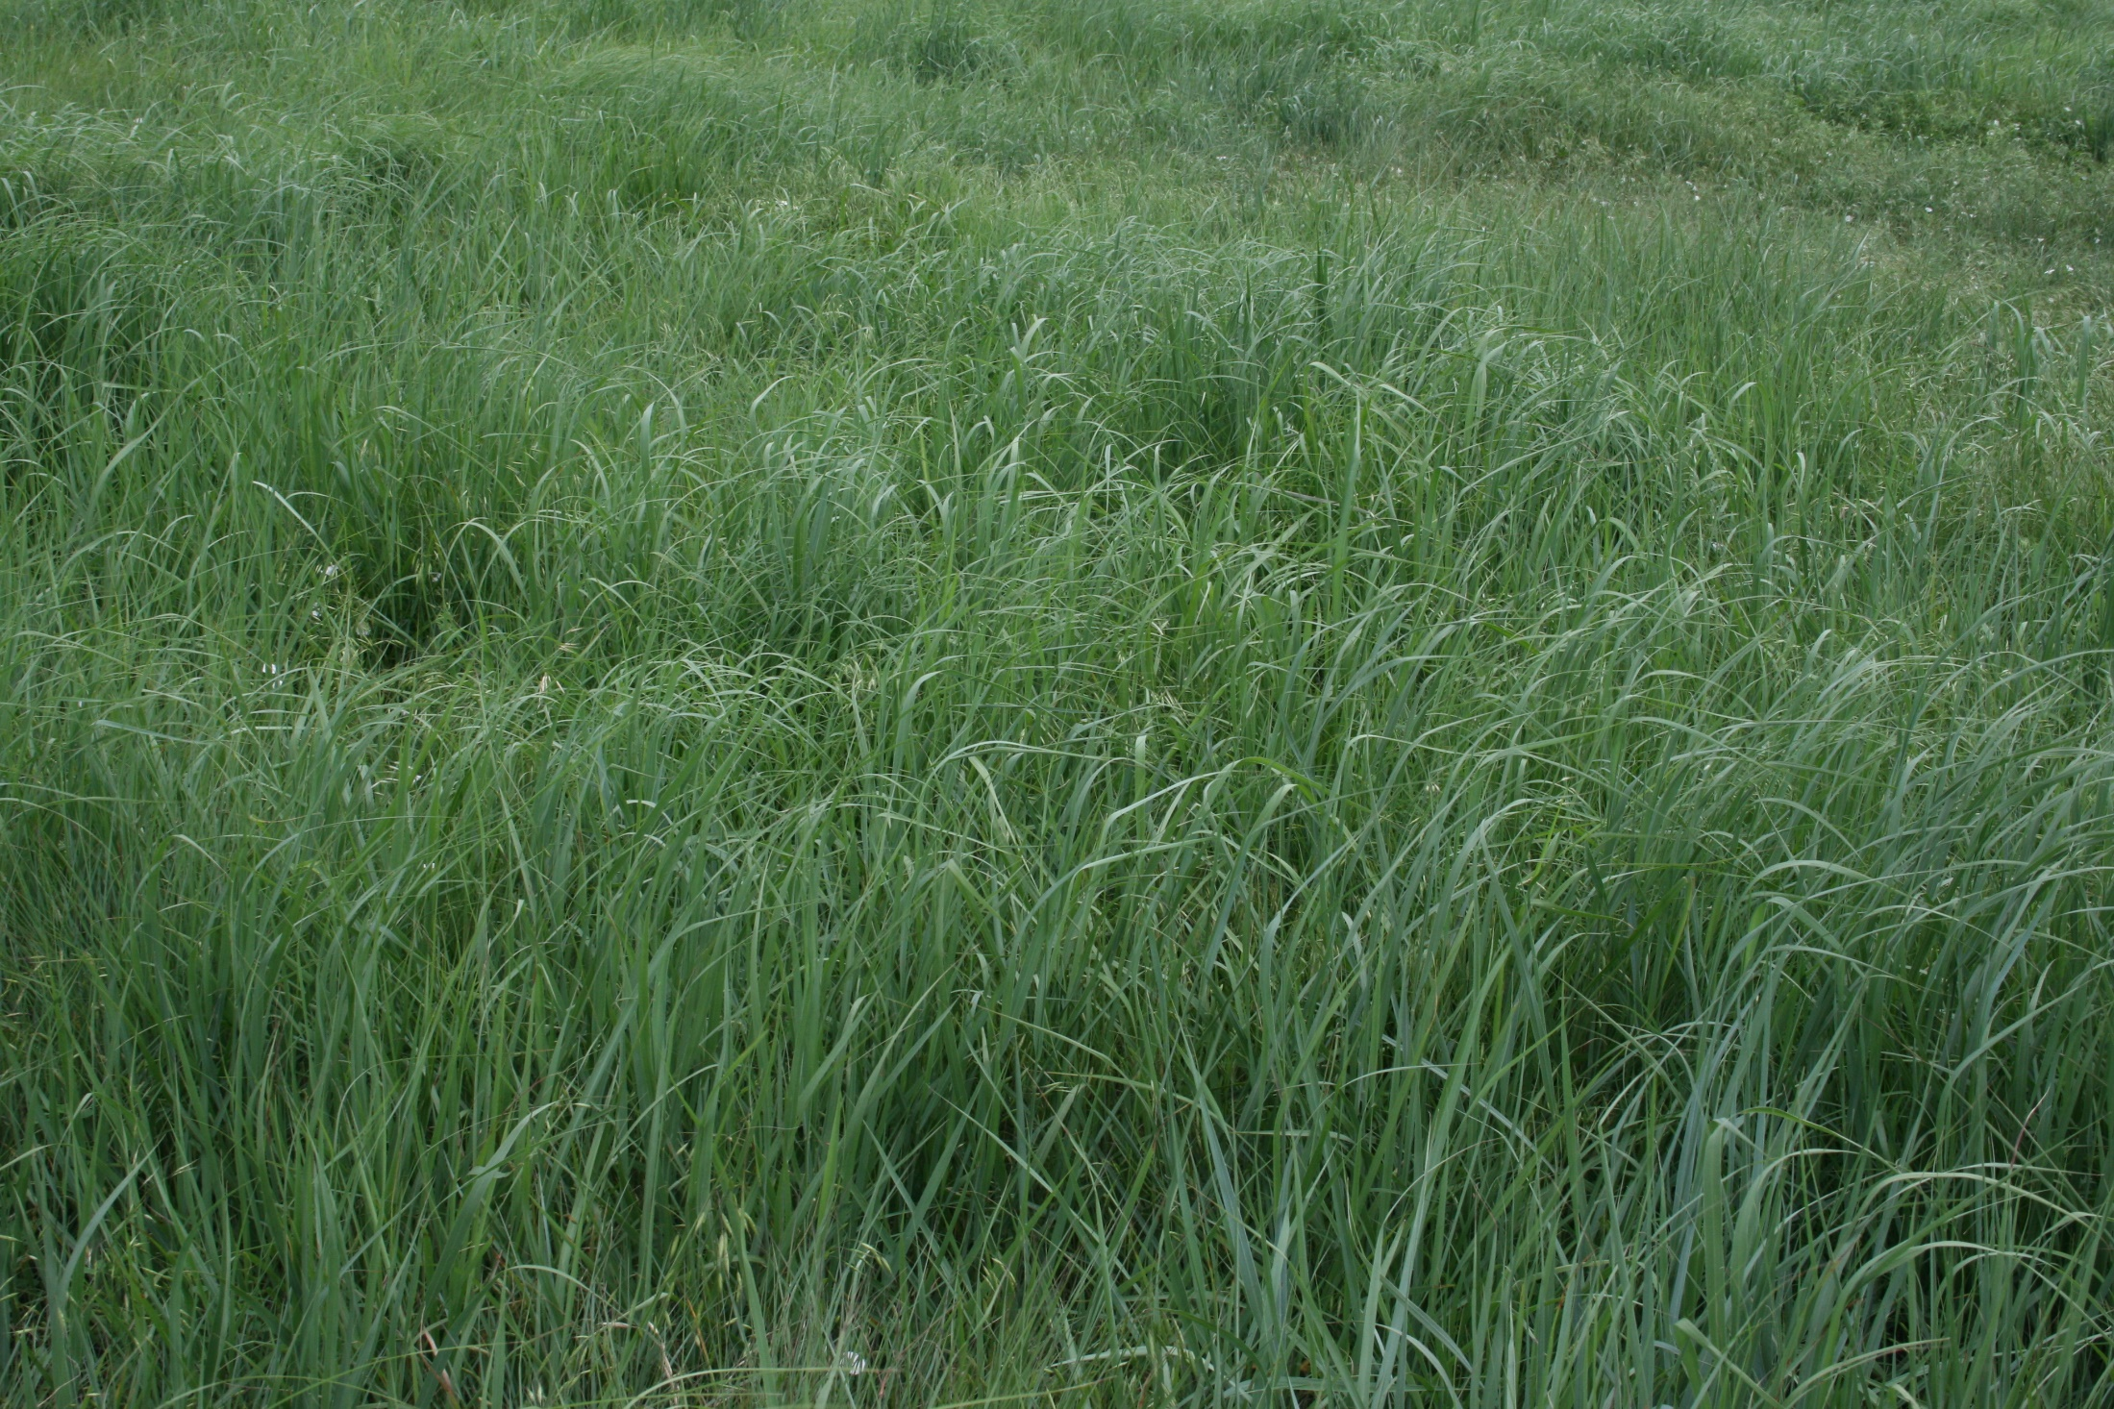
Grazing repeatedly in early spring will shift pasture to warm-season species

Slide 42
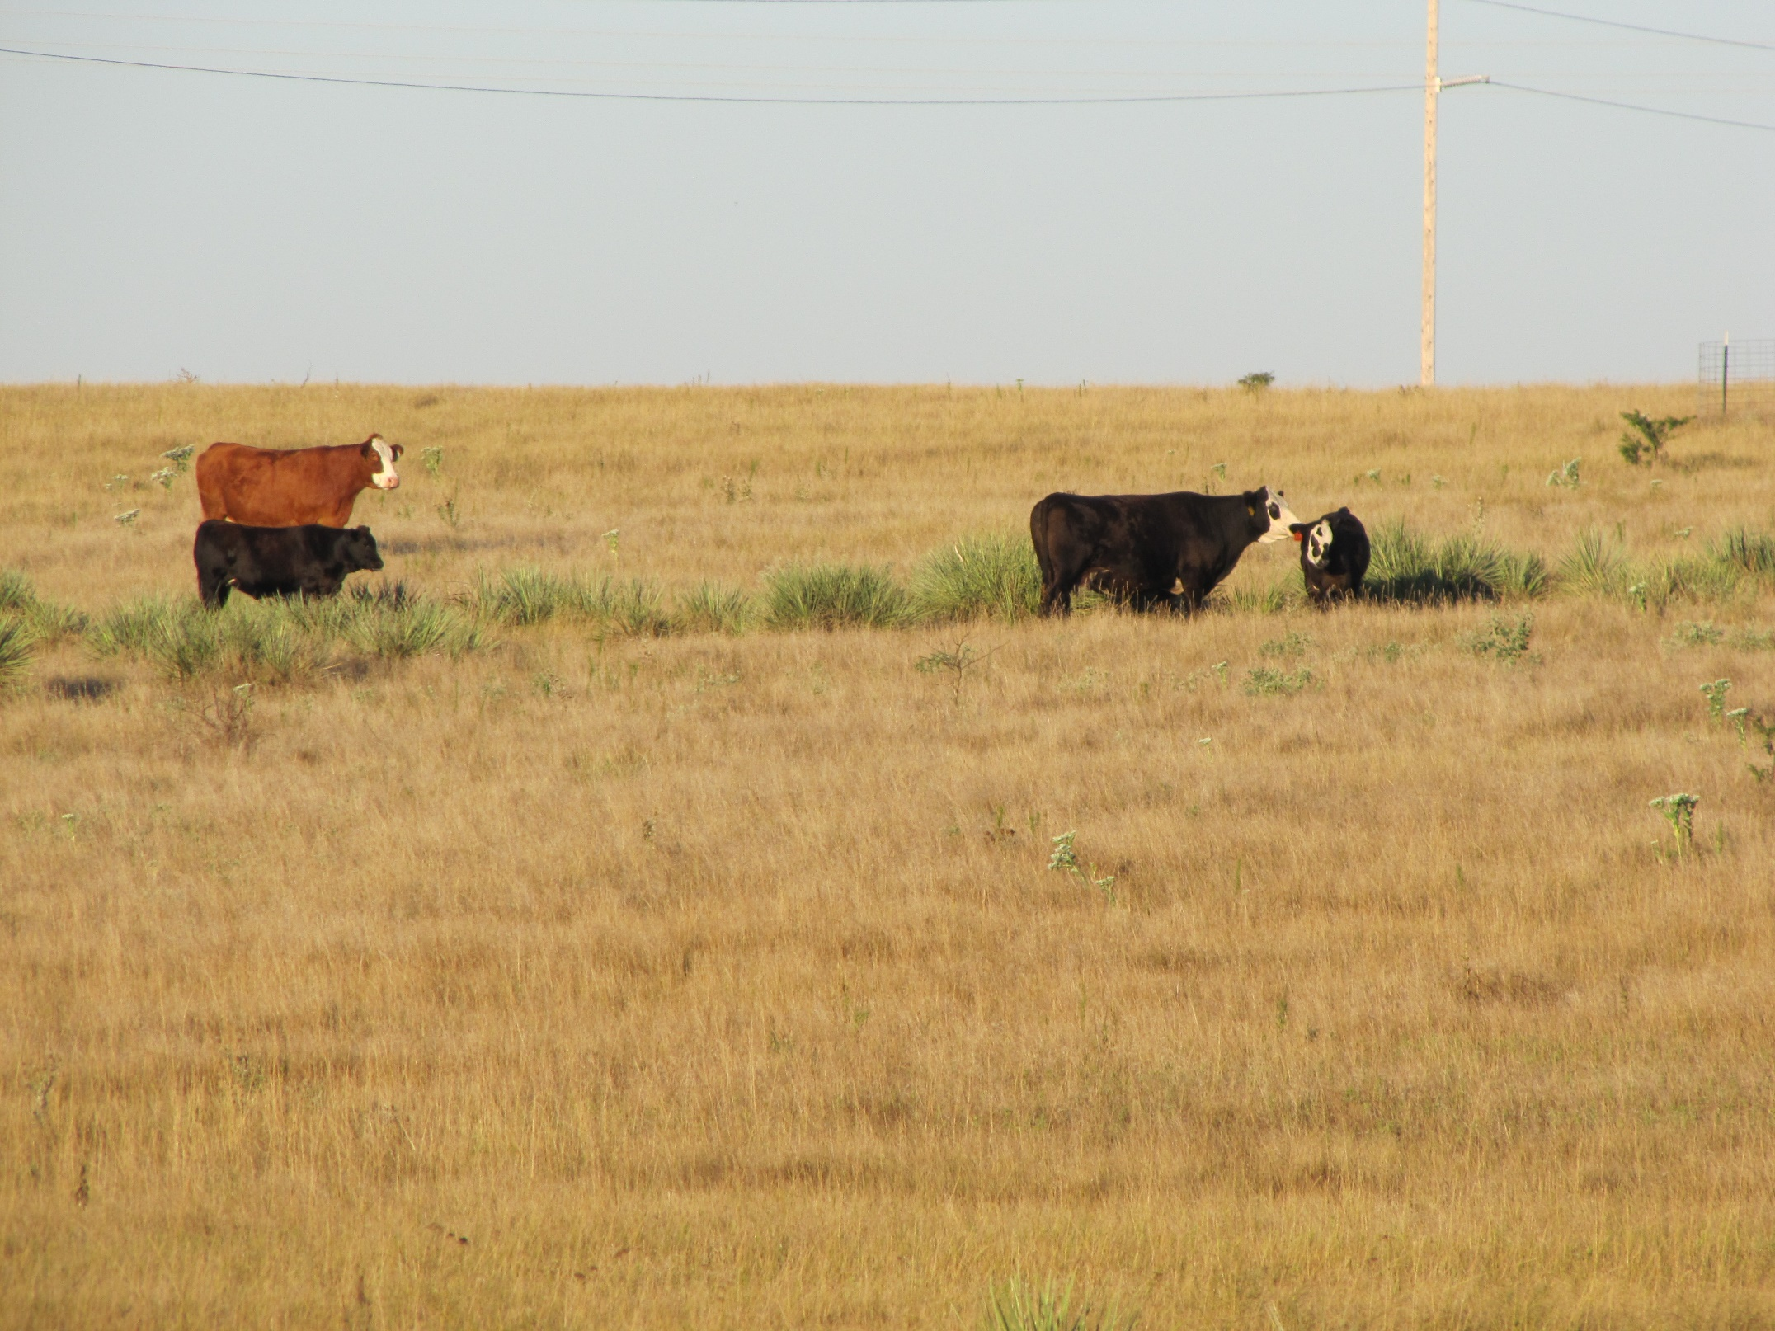
11. It’s hard to kill a dead man
Top growth of dormant grass is already dead, and can be utilized to a greater extent during the winter

Slide 43
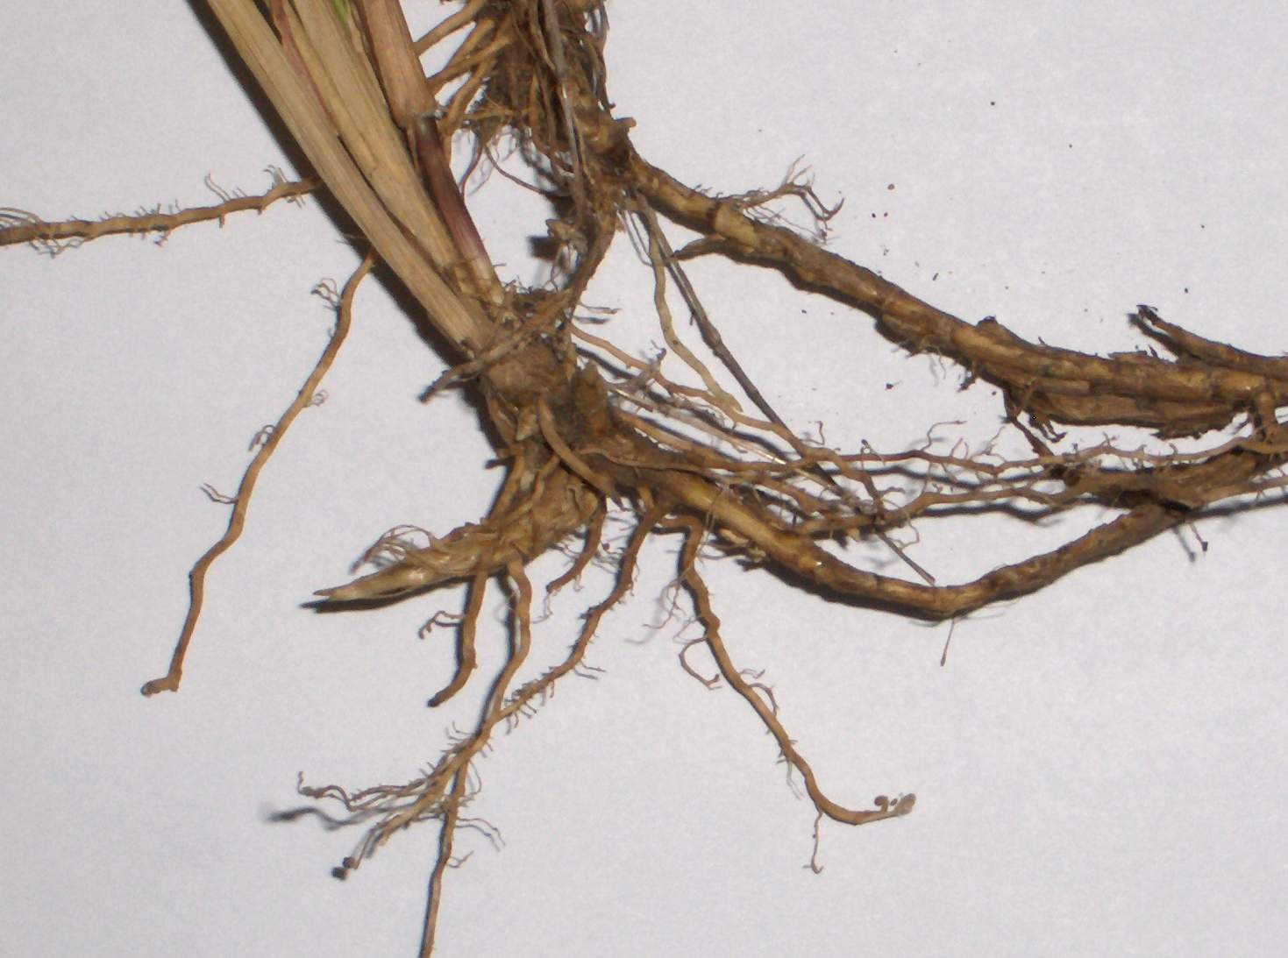
Future production comes from crown buds, rhizomes, and stolons
stembases
buds
roots
rhizomes
- Require carbohydrate and water to form and survive
- Store carbohydrate and minerals during the dormant season

Slide 44
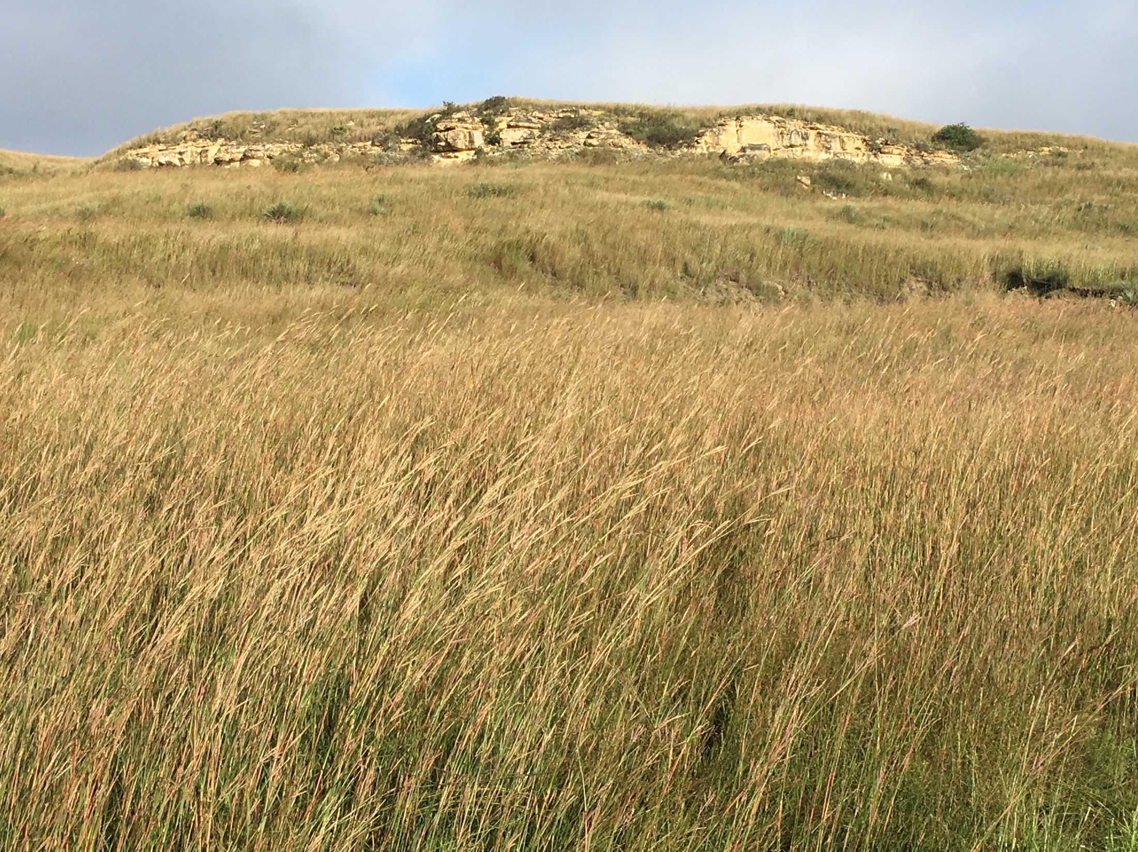
Approximately 60% of standing dormant forage from the prior year is still available May 1.

Slide 45
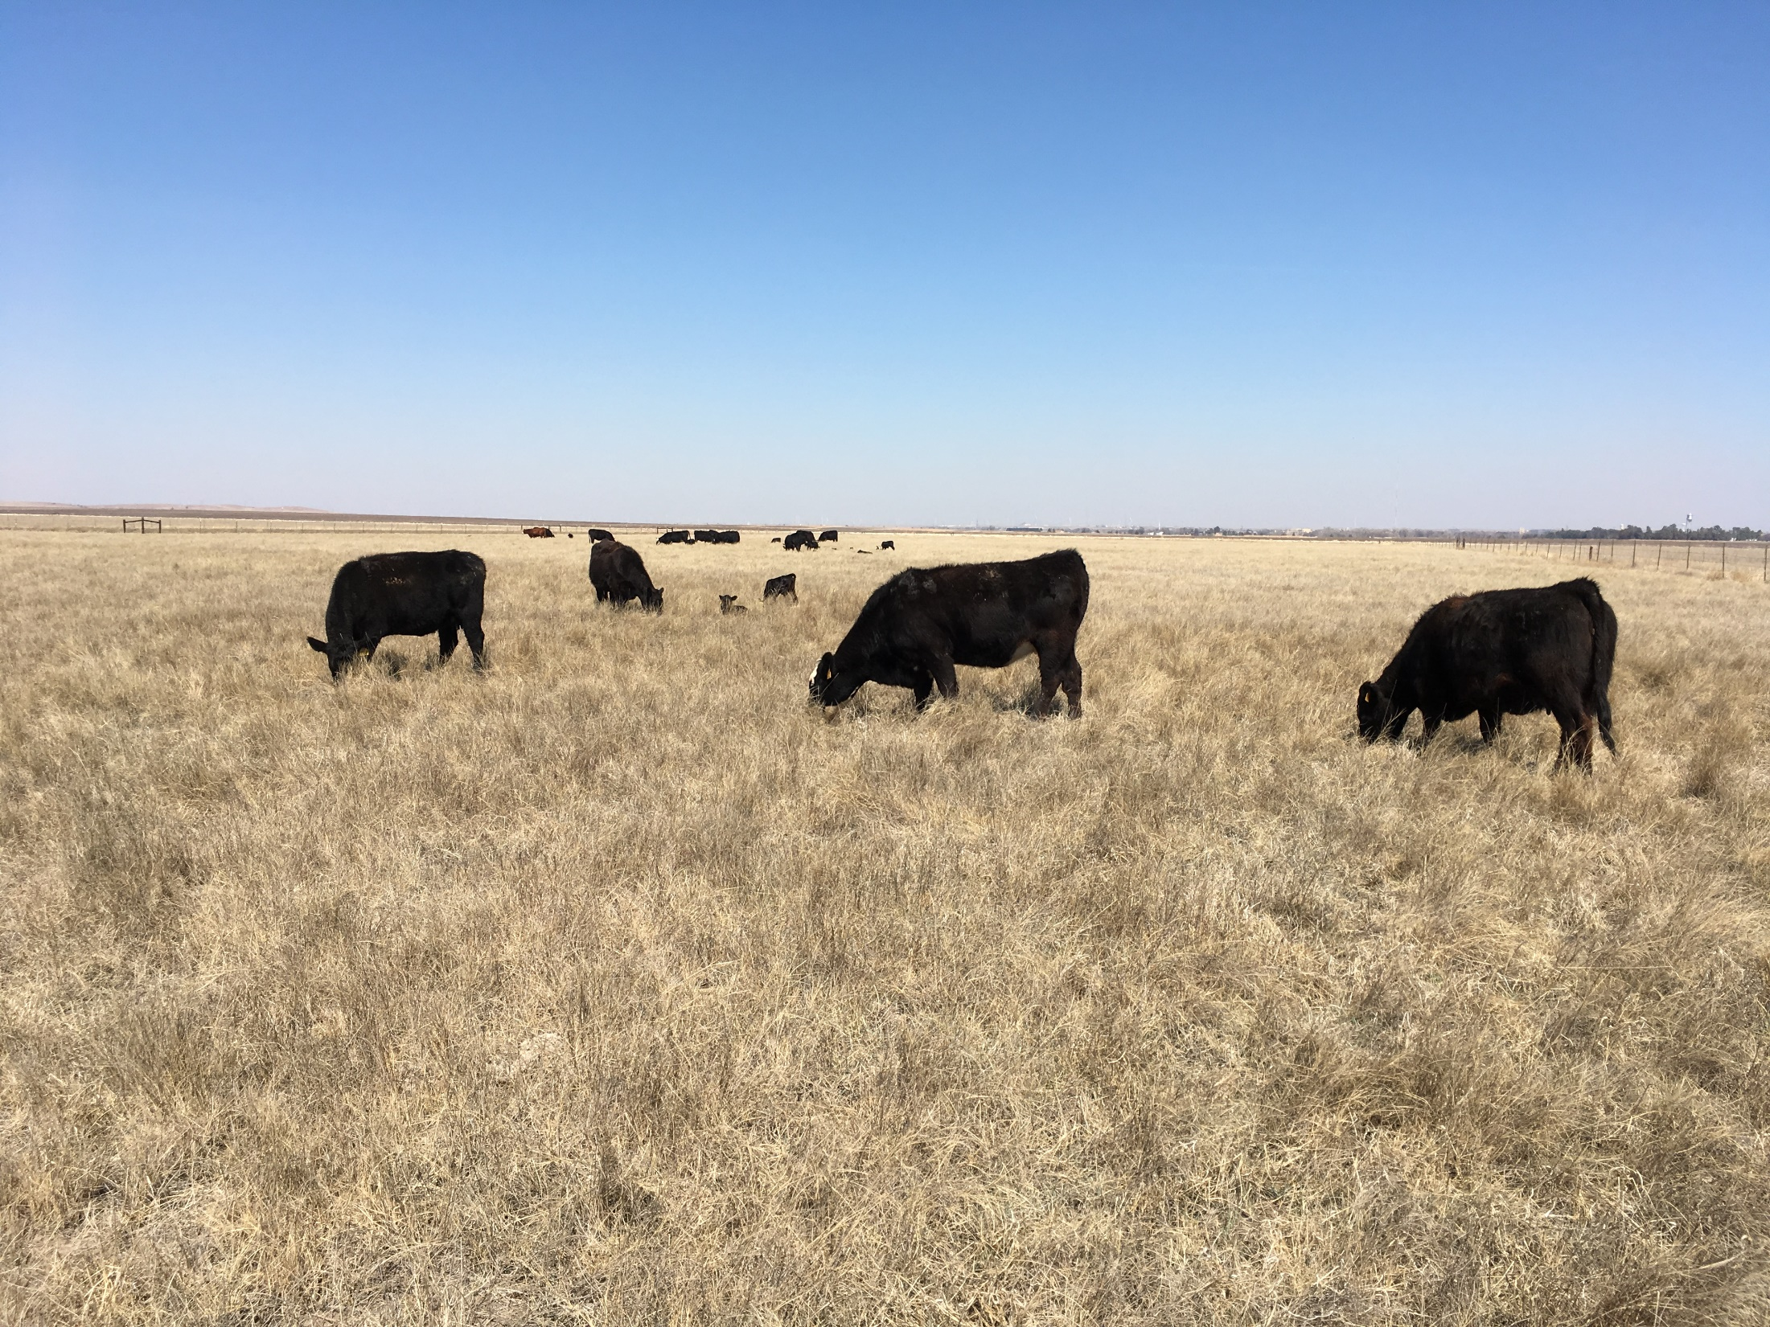
Lower quality (4.0 - 4.5% CP), but stockpiled range can have 30-35% utilization in the dormant season to extend grazing and reduce feed costs

Slide 46
12. It’s important enough to state again:
during the growing season,
take half, leave half

Slide 47
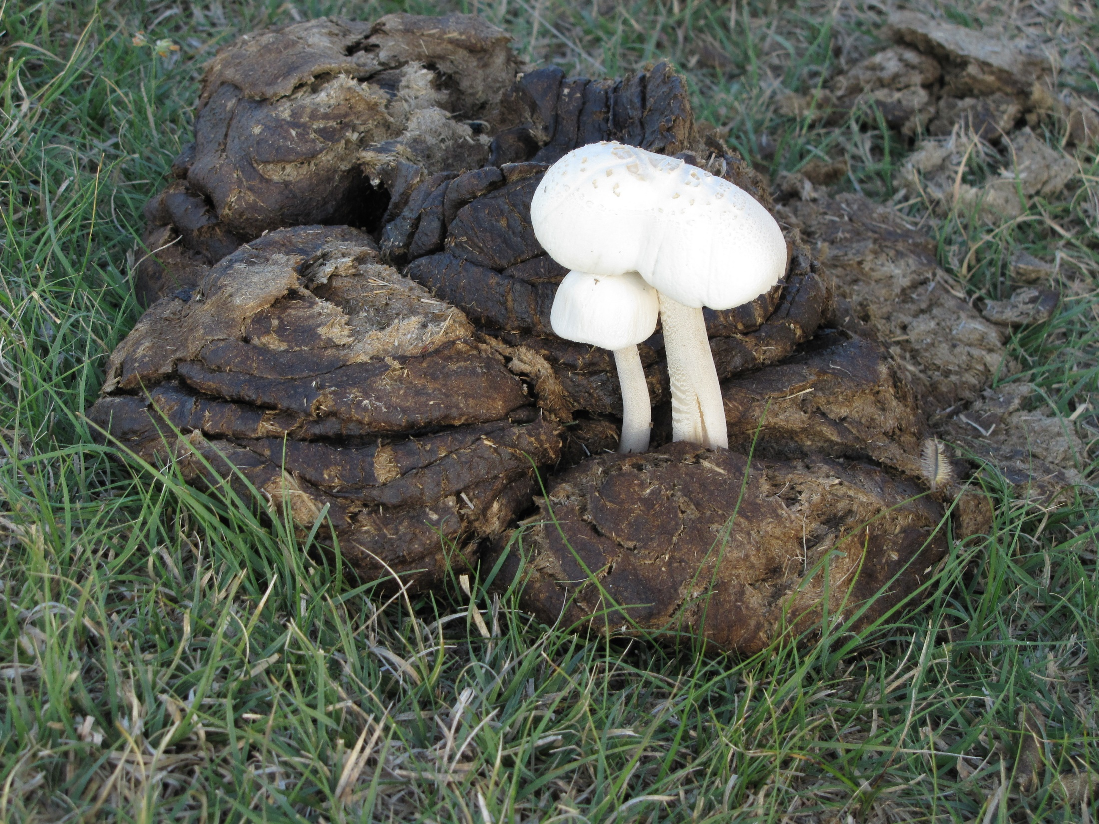
Questions: kharmone@ksu.edu
785-625-3425 ext. 221

Slide 48
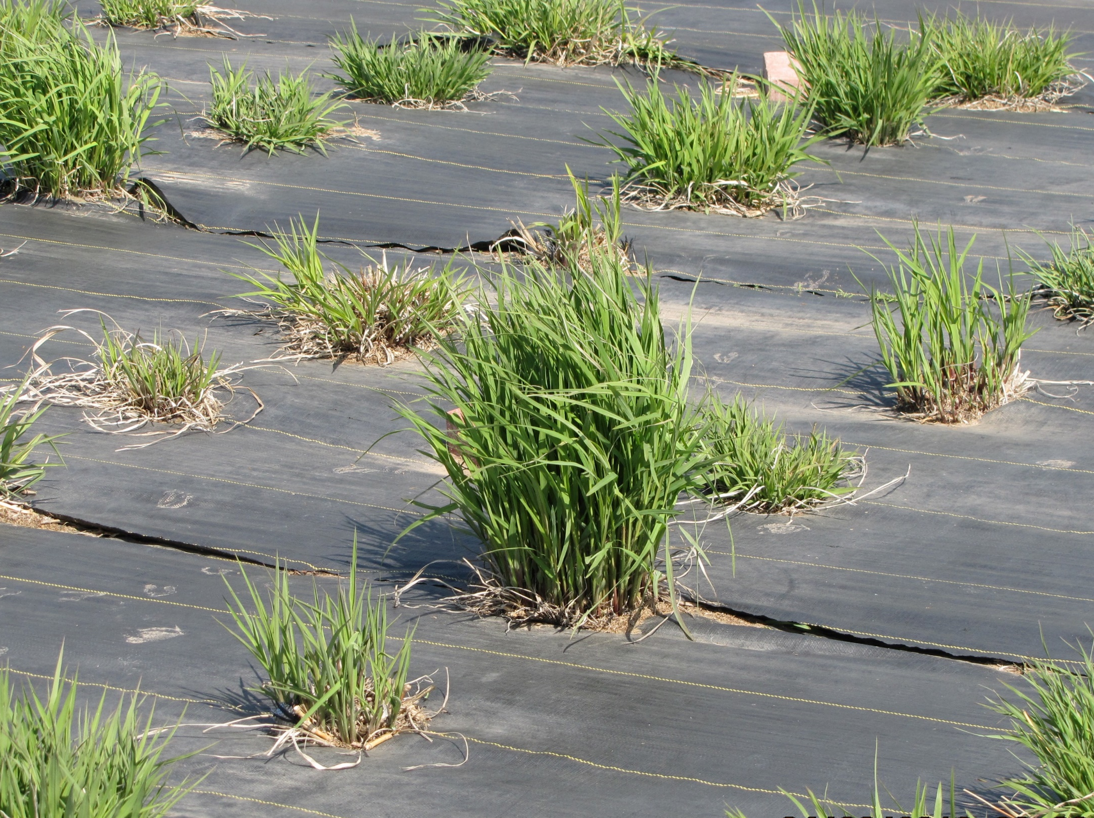
Where is half?

Slide 49
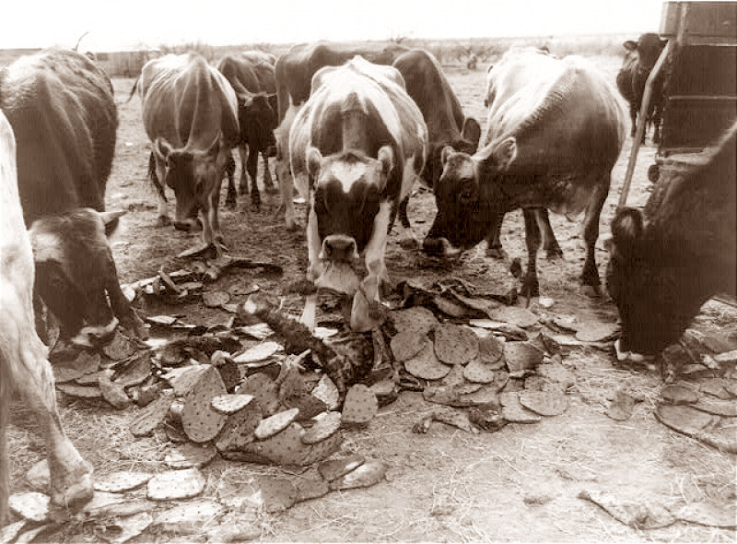
Some ‘weeds’ are useful in emergencies

Slide 50
Take half, leave half – true
You can’t overgraze and make money – true
If its not grass, it’s a weed – false
Rotational grazing is better than continuous grazing – generally false
60% of growth by July 1 – true
What you see aboveground is what you get below ground – true
Pasture can be overgrazed but understocked – true
Wet winters produce more grass – false
Every inch of growth is 150 lb/acre – generally true
Don’t graze at the same place at the same time – true
It’s hard to kill a dead man – true
Take half, leave half – true

Slide 53
To calculate number of animals:
Hodgeman County Example
2200 lb/ac forage
1280 acres
25 % animal utilization
=
704000 lb available forage
X
X
1525 lb/animal
2.5 % daily intake
180 days grazing
=
6863 lb/animal total forage required
X
X
704000 lb available forage
÷
6863 lb/animal total forage required
=
103 total number of animals

Slide 54
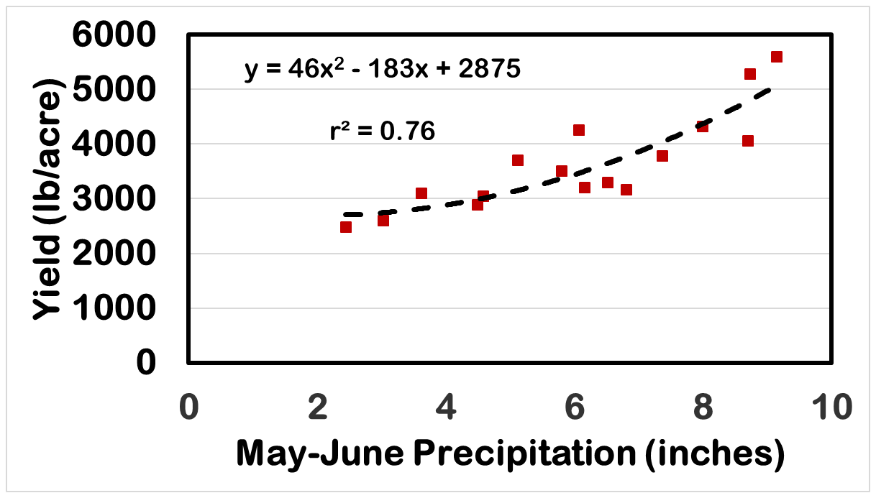
Predictability of End of Year Yield from May & June Precipitation Following a Wet Winter

Slide 55
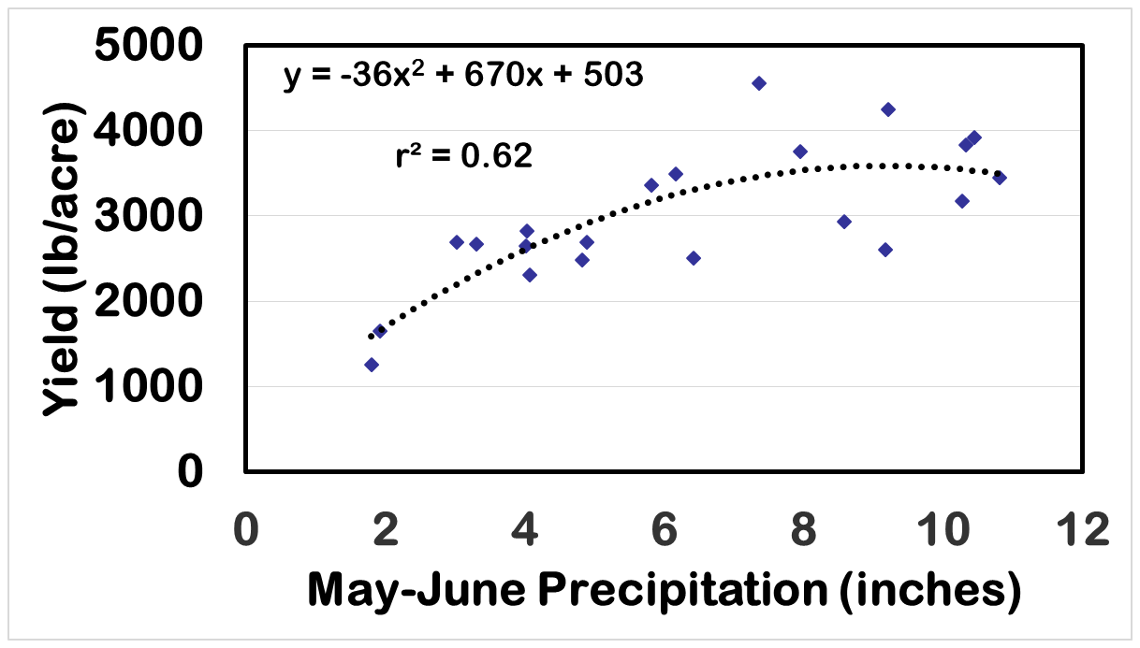
Predictability of End of Year Yield from May & June Precipitation Following a Dry Winter

Slide 56
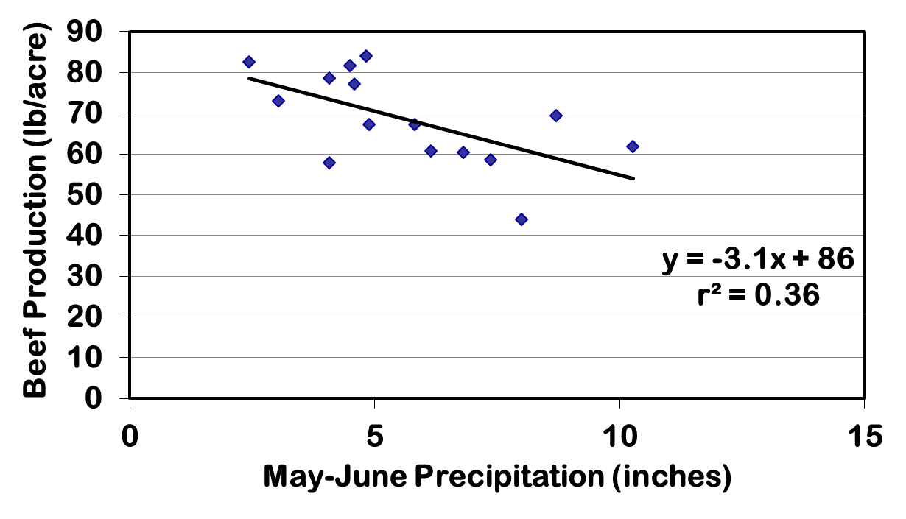
Relationship of Animal Production and May-June Precipitation 1999-2014

Slide 57
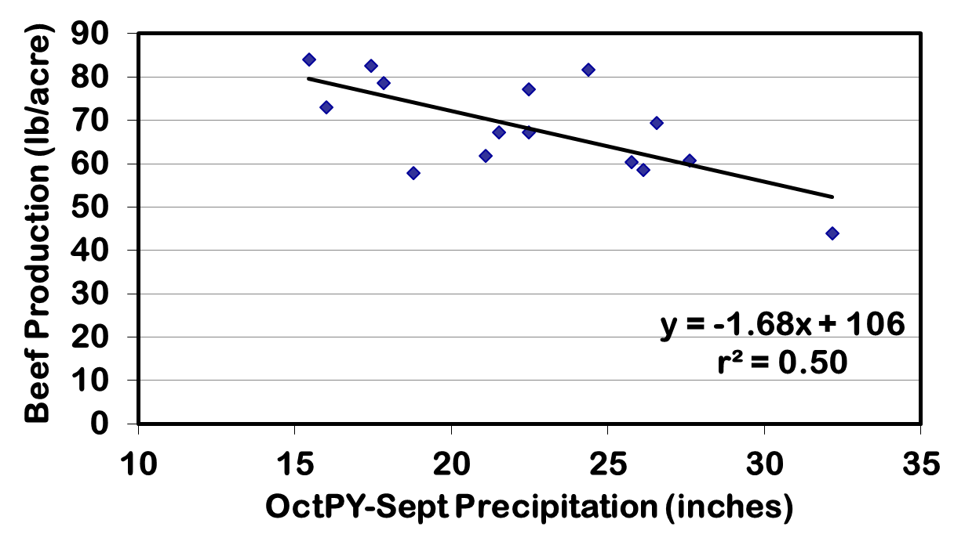
Relationship of Animal Production and OctPY-Sept Precipitation 1999-2014

Slide 58
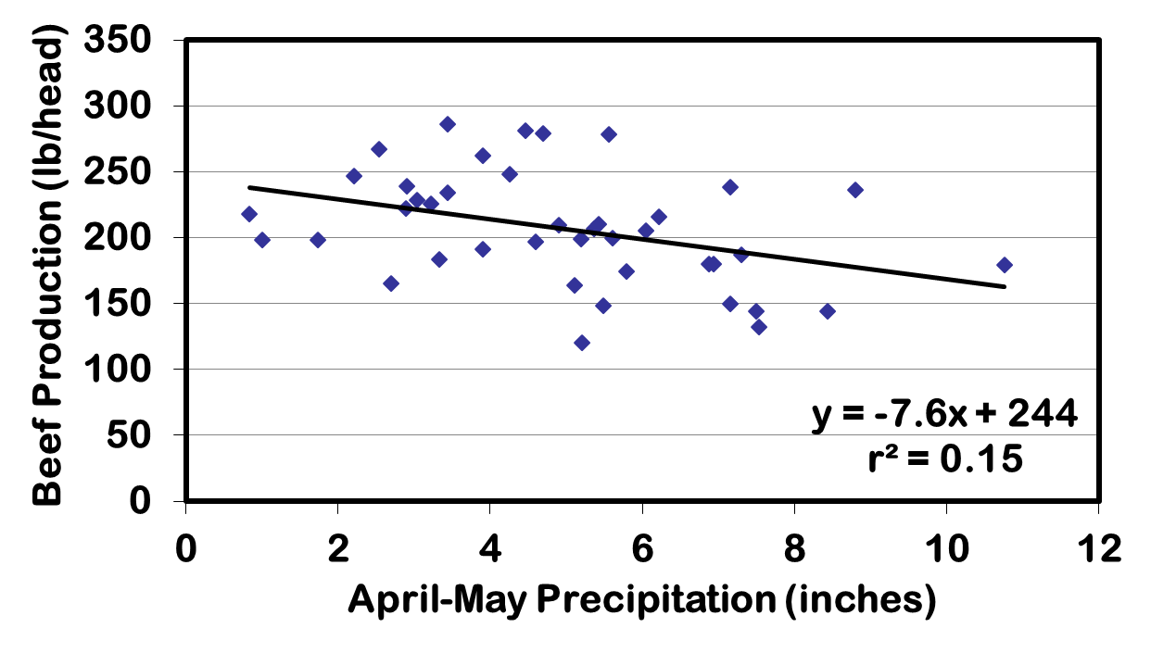
Relationship of Animal Production and Spring Precipitation – 41 Years

Slide 59
Native Rangeland Response to 1 Year of Extreme Drought – Kansas 1956
6000
D
= 1956 Drought year
R
= 1957 Recovery year
5000
R
4000
Avg.
R
Avg.
New Growth lbs/acre
R
3000
Avg.
2000
D
D
1000
D
0
Hvy 66%
Mod 47%
Lgt 38%
Percent Forage Utilization
(Launchbaugh, 1967)

Slide 60
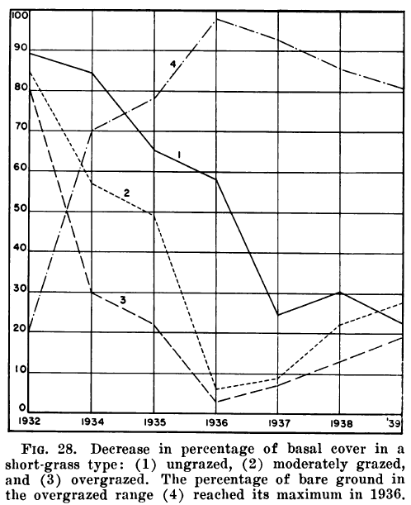

Slide 61
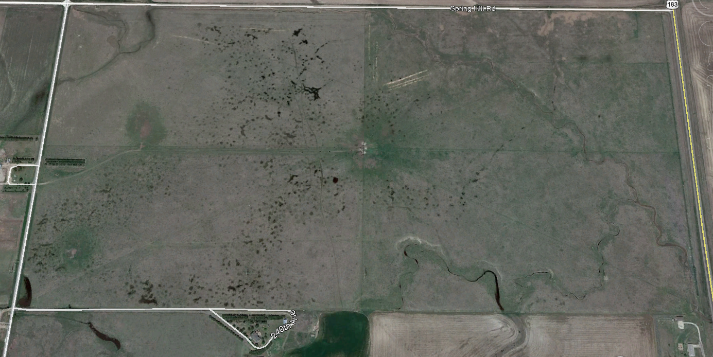
5.

Slide 62

6. Tall residual heights results in faster regrowth
For greater individual gain, rotate quickly
For greater pounds of forage, occupy only once
or twice per season

Slide 63
Native Rangeland Response to Extreme Drought or Extreme Moisture
6000
D
= Drought year, 1956
W
W
= Wet year, 1958
W
5000
W
4000
Avg.
Avg.
New Growth lbs/acre
3000
Avg.
2000
D
D
1000
D
0
Hvy 66%
Mod 47%
Lgt 38%
Percent Forage Utilization

Slide 64
Comparison of Cow/Calf Pair Traits in Continuous Stocked and Modified Intensive Early Stocked Pastures 2015-2018
Animal Trait | CSLS | MIES
Cow May Wt. | 1144* | 1187
Cow May BCS | 5.06* | 5.31
Calf May Wt. | 186 | 188
Cow July Wt. | 1268 | 1282
Cow July BCS | 5.34 | 5.39
Calf July Wt. | 381 | 382
Cow Oct. Wt. | 1287* | 1381
Cow Oct. BCS | 5.20* | 5.74
Calf Oct. Wt. | 567 | 577
Cow FSCR% | 48.1 | 54.2
Cow Final Conception % | 86.6* | 90.4

Slide 65
Comparison of Cow May Body Weight and
May Body Condition Score in
Continuous SLS and Modified IES
 | 2015 | 2016 | 2017 | 2018 | Avg.
 |  |  | BCS
CSLS | 5.17 | 5.26* | 4.84* | 4.96* | 5.06*
MIES | 5.27 | 5.56 | 5.13 | 5.26 | 5.31
 |  | Start Weight
CSLS | 1124 | 1121* | 1149* | 1181* | 1144*
MIES | 1091 | 1199 | 1227 | 1239 | 1187

